Slide 1
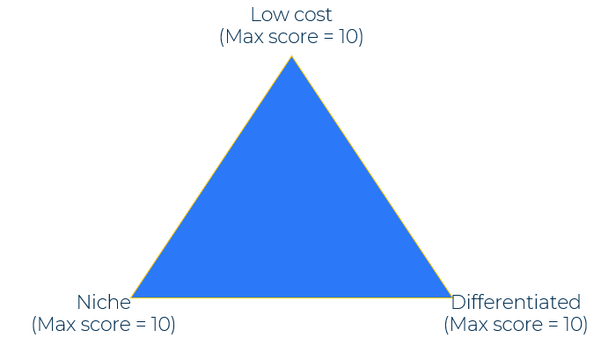
Porter’s Generic Strategies

Slide 2
A business model for determining a strategic position.
Use this model to find out your strongest competitive position
Competitive advantage
Michael Porter argues that a company can compete on a cost advantage or on its differentiated position. It can also aim at a broad market or a narrow market. This results in three strategic positions:
Low-cost – where a company has a considerable cost advantage over competing companies. (This can be to a broad or narrow market).
Niche – were a company sells specialised products to a narrow segment of the market.
Differentiated – where a company sells a strongly branded product to a mass market.
Complete the questions in the next templates to determine which is the best strategic position for your company. Bear in mind that the worst place to be is stuck in the middle.
Cost advantage
Brand strength
Broad target
Cost leadership
Differentiation
Competitive scope
Narrow target
Cost focus
Differentiation
Niche

Slide 3
Ability to build a low-cost position.
Ask yourself the following questions in order to determine whether you have an ability to take a low-cost position. Give yourself a score on each question (10 means you have a significant strength)
Low cost position | Strength (10 = high)
Do you have large volume sales to a mass-market?
Do you have manufacturing processes that result in very low cost of production
Do you have access to raw materials that gives a cost advantage?
Do you have access to low-cost labour that will stay low cost in the long term?
Do you have an efficient route to market (no expensive middleman)?
What is your overall low-cost position (average of the above)

Slide 4
Ability to build a niche position.
Ask yourself the following questions in order to determine whether you have an ability to take a niche position. Give yourself a score on each question (10 means you have a significant strength)
Niche position | Strength (10 = high)
Is your product regarded as a specialist product by a tight segment of the market?
Does your products have significant strengths over other products serving the specialist market?
Does your product receive strong/positive reviews in specialist magazines and blogs?
If your product was no longer available, would it be sadly missed by users?
Is your product one that customers love to chat about one with another?
What is your overall niche position (average of the above)

Slide 5
Ability to build a differentiated position.
Ask yourself the following questions in order to determine whether you have an ability to take a differentiated position. Give yourself a score on each question (10 means you have a significant strength)
Differentiated position | Strength (10 = high)
Is an important part of your customer value proposition your brand?
Does your brand have strong values – stand for something special?
Do you address a mass-market?
Does your brand command a premium price even if similar to others?
If your product was no longer available, would it be sadly missed by users?
Is your product one that customers love to chat about one with another?
What is your overall differentiated position (average of the above)

Slide 6
Returning to the model.
Use the scores to work out your position. If you find yourself towards the middle rather than near a corner of the triangle, consider how you can move closer to the desired position.
Low cost
(Max score = 10)
Niche
(Max score = 10)
Differentiated
(Max score = 10)

Slide 7
Things to think about.
Clarity is really important when developing a strategy. It is why Michael Porter argues in favour of building a strategy based on differentiation, cost leadership or focus. Don’t get confused about the strength of your brand. You can have a strong brand in cost leadership and also in a niche. But what is it in overall terms that gives you a competitive strategic advantage?
Once you have established your strategic advantage, make sure that your customer value proposition and your messaging emphasises it. This will give resonance to your communications.

Slide 8
Thank you.

