Slide 1
STEP 1: CONSIDER THE BARGAINING POWER OF SUPPLIERS
In some markets suppliers of materials are able to dictate what happens. Consider the following factors and their bargaining power (10 means their bargaining power is very high).
Bargaining power of suppliers | Level of force (10 = high)
Monopolistic position of suppliers
Suppliers limited by patents or special technology
Suppliers vertically integrated with competitors
Overall bargaining power of suppliers (average)

Slide 2
STEP 2: CONSIDER THE THREAT OF NEW ENTRANTS
Consider the threat of new companies entering the market. What are the factors that may encourage entry into the market and what is the level of threat on a scale from 1 to 10 (10 means the threat is very high).
Threat of new entrants | Level of force (10 = high)
Start-up costs for entering the market
Threat of a disruptor presenting a low-cost alternative to existing products
High profit margins that could encourage new entrants
Ease/difficulties of penetrating existing channels to market
Loyalty of customers to existing suppliers
Marketing costs to reach customers
Overall threat of new entrants (average)

Slide 3
STEP 3: CONSIDER THE THREAT OF SUBSTITUTES
In some markets it is easy for buyers to choose alternative products or services. Consider the importance of this force by indicating the level of threat from substitute products or services (10 means a high level of threat).
Threat of substitutes | Level of force (10 = high)
Ease of switching to an alternative product or service
Easy access to alternative products or services
Low cost of alternative products or services
Overall threat of substitutes (average)

Slide 4
STEP 4: CONSIDER THE POWER OF BUYERS
In certain markets buyers are big enough to have a stranglehold on the market. Consider the force that buyers have on your market (10 means they have a very strong bargaining position).
Power of buyers | Level of force (10 = high)
Size of buyers versus size of suppliers
Limited number of buyers
Difficulties of getting "listed" at buyers
Sensitivity of buyers to price changes
Ease of switching to new suppliers
Overall power of buyers (average)

Slide 5
STEP 5: CONSIDER THE INTERNAL RIVALRY
The forces that arise from the bargaining power of suppliers, the threat of new entrants, the bargaining power of buyers and the threat of substitute products/services influences the rivalry of companies within the market. Consider the following forces and indicate their importance in creating rivalry (10 means a high level of rivalry).
Internal rivalry | Level of force (10 = high)
There is an oversupply of capacity within the market
There is a lack of loyalty amongst customers
There are only a small number of suppliers, each fighting for a significant market share
Customers have low profit margins and seek out low-cost suppliers
Overall internal rivalry (average)

Slide 6
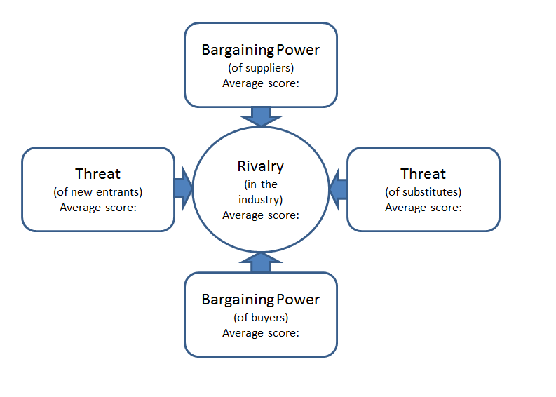
STEP 6: RETURNING TO THE MODEL
You will now have an average score for each of the five forces and an understanding of the root cause of each of these forces.
Try and answer the following questions:
What can you do to mitigate any of the forces? How easy or difficult would this be? If you are successful in mitigating the force, what will be the overall effect on your business?
Bearing in mind the forces you have analysed, where do you expect the market to be in 3 to 5 years time? How will this influence your business? What steps can you take to ensure that you are prepared for the future scenario?

