Slide 1
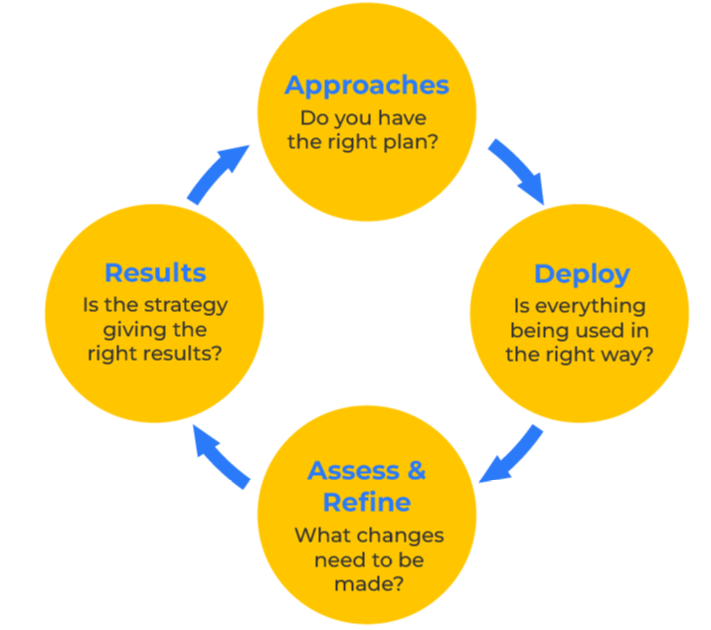
EFQM

Slide 2
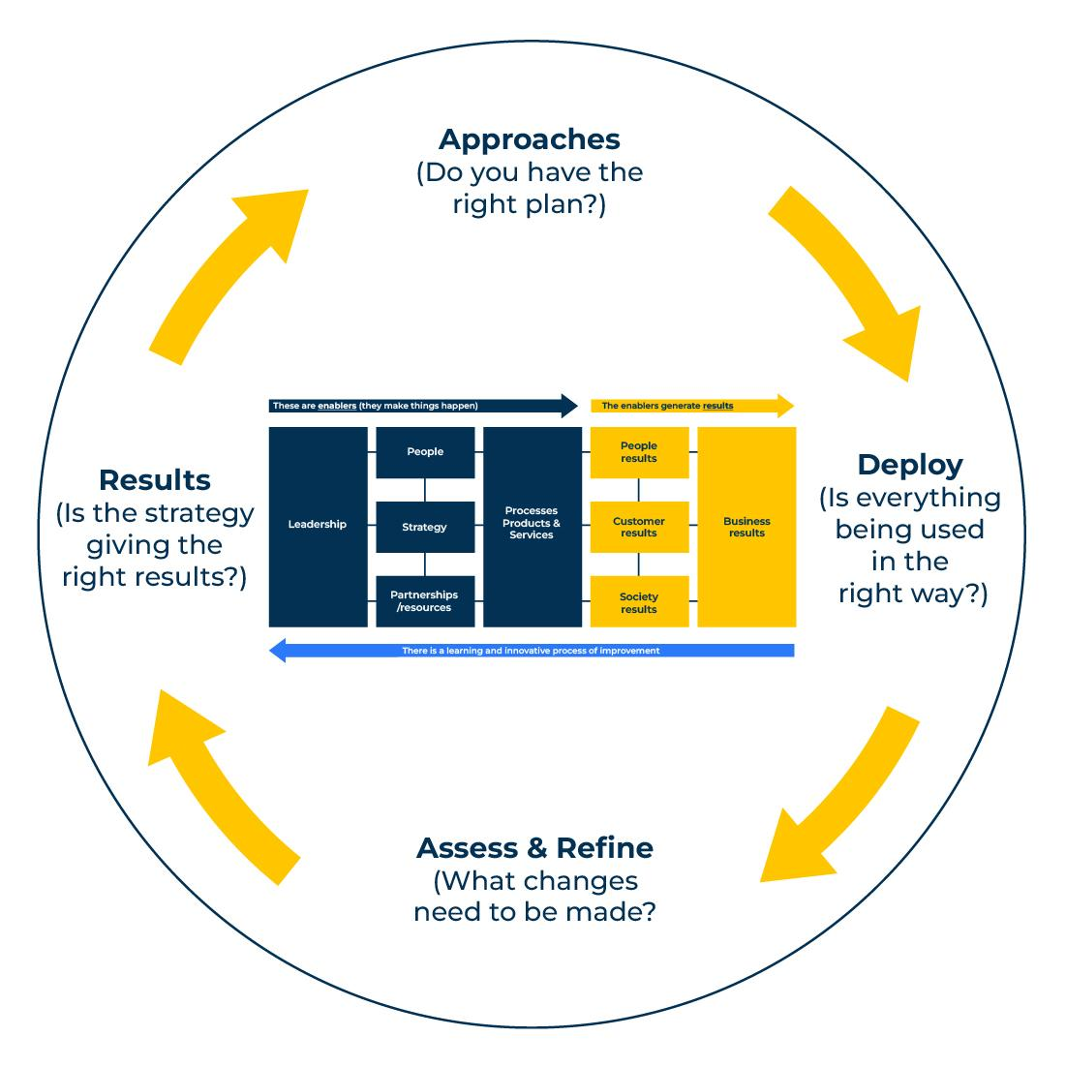
Improve an organisation’s quality and performance.
Use this model to build a more efficient company.
The European Foundation For Quality Management (EFQM) model looks at the cause and effect between what an organisation does and what it achieves. The premise is that if an organisation wants to achieve a different result, it has to change something within the organisation.
There are three integrated components of the model:
The fundamental concepts – these are the pillars of a company that are required if excellence is to be achieved
The criteria – the ingredients of the excellence recipe and the results they deliver
RADAR – the control and monitoring process for ensuring excellence.

Slide 3
Your ratings on fundamental concepts.
The EFQM model proposes seven fundamental concepts of excellence. These are considered hygiene factors. Rate your organisation on these seven factors.
 | Score out of 10 | Suggested course correction
Adding value to customers
Being environmentally friendly and sustainable
Responding to change
Being innovative and constantly improving
Having the right ethics
Being agile and quick in what you do
Having a culture of empowerment and nurturing talented people

Slide 4
Your ratings on the enablers group.
Now rate your organisation on the five criteria that make up “the enablers group”. Each of these enablers has a weight of importance as determined by EFQM. Wherever you have a weakness in your score out of 10, suggest a course of correction.
 | Weight of importance | Score out of 10 | Suggested course correction
Leadership – it all begins here. These are the people who shape the organisation, set its values, and inspire people to perform | 100
Strategy – this is the way that an organisation achieves its goals | 80
People – excellence in any company must have people who can deliver it. They must have the capabilities and inspiration to perform | 90
Partnership and resources – excellence requires an organisation to have the right factories, offices or physical assets and the right suppliers and partners who can support the operation | 90
Process, products and services – a smooth manufacturing or production process is essential in any excellent organisation | 140

Slide 5
Your ratings on the results group.
Now rate your organisation on the four criteria that make up “the results group”. Each of these results has a weight of importance as determined by EFQM. Wherever you have a weakness in your score out of 10, suggest a course of correction.
 | Weight of importance | Score out of 10 | Suggested course correction
Customer results – these are based on the satisfaction and loyalty scores that arise from customer surveys | 200
People results – these are based on the scores from employee perception surveys. | 90
Society results – these are the scores that accompany achieves from its sustainability programs | 60
Key performance results – these are the financial results on sales and profitability achieved by the organisation | 150

Slide 6
Your ratings on radar.
RADAR is an acronym for various measures that determine the progress of the quality model. Rate your organisation on these monitoring devices.
 | Score out of 10 | Suggested course correction
Results – is the strategy delivering the right results?
Approaches – do you have the right plan to deliver improved performance?
Deploy – is everything being used in the right way?
Assess and refine – what changes need to be made?

Slide 7
Bringing it all together.
The EFQM model is built on an integration of the enablers and the results and uses the RADAR to monitor performance. The model is data driven requiring a business plan, feedback surveys from customers, employee perception surveys, sustainability policies etc. It is worthwhile contacting EFQM for training on the use of the model and for benchmarking against other high performing companies. Visit http://www.efqm.org/

Slide 8
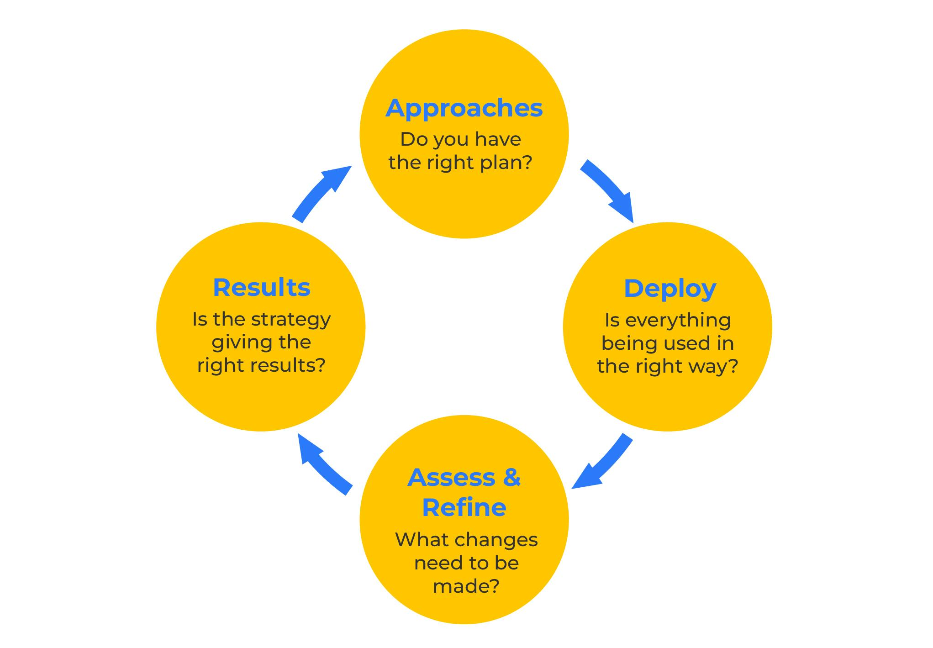
Things to think about.
Consider joining EFQM. It offers training in the tool and shares experiences amongst members.
Do you have the right approach? Do you have the right plan?
Are you deploying things correctly? Is everything being used in the right way?
Are you assessing and refining your approach? What changes need to be made?
Are you responding to the results? Is the strategy giving you the right results?
Central to the EFQM model are people. People play a key role as enablers. People are also an important part of the results (eg customer satisfaction, employees). This has similarities to the service profit model which posits that profits start with an engaged workforce.

Slide 9
Thank you.

