Slide 1
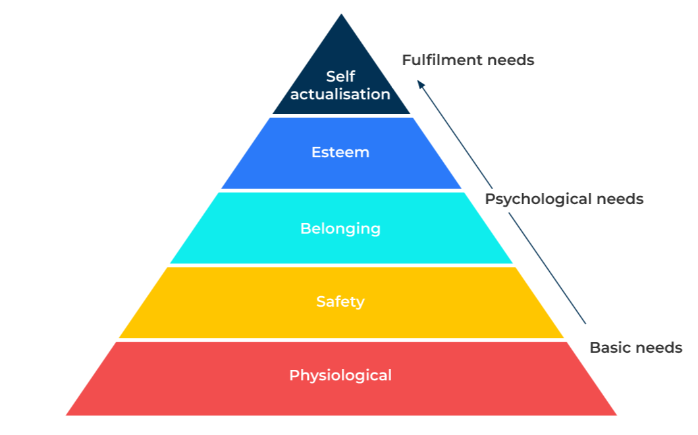
Maslow’s
Hierarchy

Slide 2
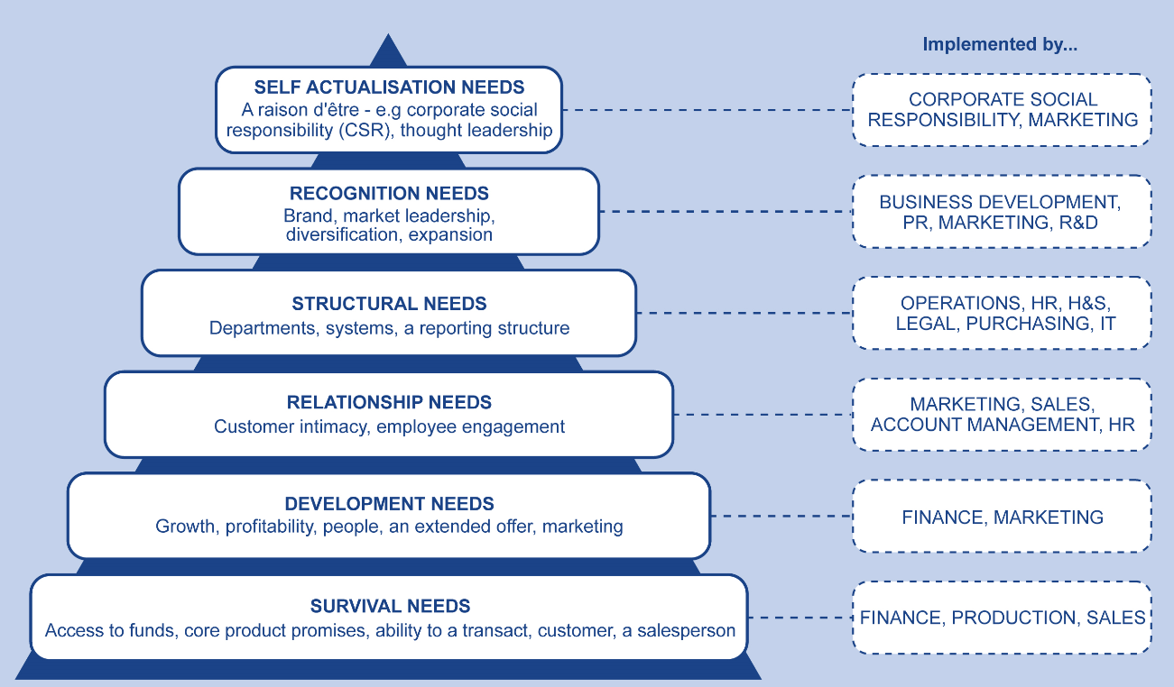
A model to understand customers’ motivations.
Use this model to understand your own company’s market position or to better understand the motivation of your customers
Maslow’s theory of needs is based on five sequential levels. He believes that people have a physiological need for food, sleep and warmth before they can move on and think about the next level of need which is safety. Beyond this people like to belong to groups and then to achieve recognition and esteem until finally, a very small proportion achieve self actualisation. This is where someone has achieved their full potential and, in Maslow’s view, only 2% of the population ever reach this level.
With some modifications it is possible to see how companies fit this model.

Slide 3
STEP 1: Positioning your company on the pyramid.
Top of pyramid
Ask these questions... | To position yourself on the Pyramid
To what extent can you claim that your company makes the world a better place? | Companies that have goals beyond profit are towards the top of the pyramid.
To what extent can you claim to be thought leaders within you market? | Thought leaders are higher up the pyramid.
To what extent do your brand values meet customers needs? | Brands that add value to customers are higher up the pyramid.
What does your brand stand for? | Companies that develop strong brands are higher up the pyramid.
How strongly engaged is your workforce with the aims and purpose of the company? | Alignment of the company workforce with the purpose of the company moves you up the pyramid.
How well structured is your company to meet the needs of customers? | A company in the middle of the pyramid can be expected to be well organised and have good structures.
What is your understanding of customers and their needs? | Companies in the centre and top half of the pyramid have a deep understanding of customers needs.
How strong is your Net Promoter Score? | A high Net Promoter Score (50 or more) is a sign of a company high up the pyramid.
What is your success at launching new products? | A company that has more than a third of its products that are less than five years old will move to the centre of the pyramid.
How do you segment the market – on demographics, on behaviour or needs? | Simple segmentation is based on firmographics and this is towards the bottom of the pyramid. Needs based segmentation moves up the pyramid.
How strong is you customer value proposition? | A strong CVP will place you towards the centre of the pyramid.
What is you principal challenge – obtaining sufficient funds, differentiating our product, solving customers problems? | If the principal challenge is obtaining funds, you are likely to be towards the bottom of the pyramid.
How far ahead do you look in our business plan – a month, a year, five years? | If your horizons are short-term you are likely to be at the bottom of the pyramid.
Bottom of pyramid

Slide 4
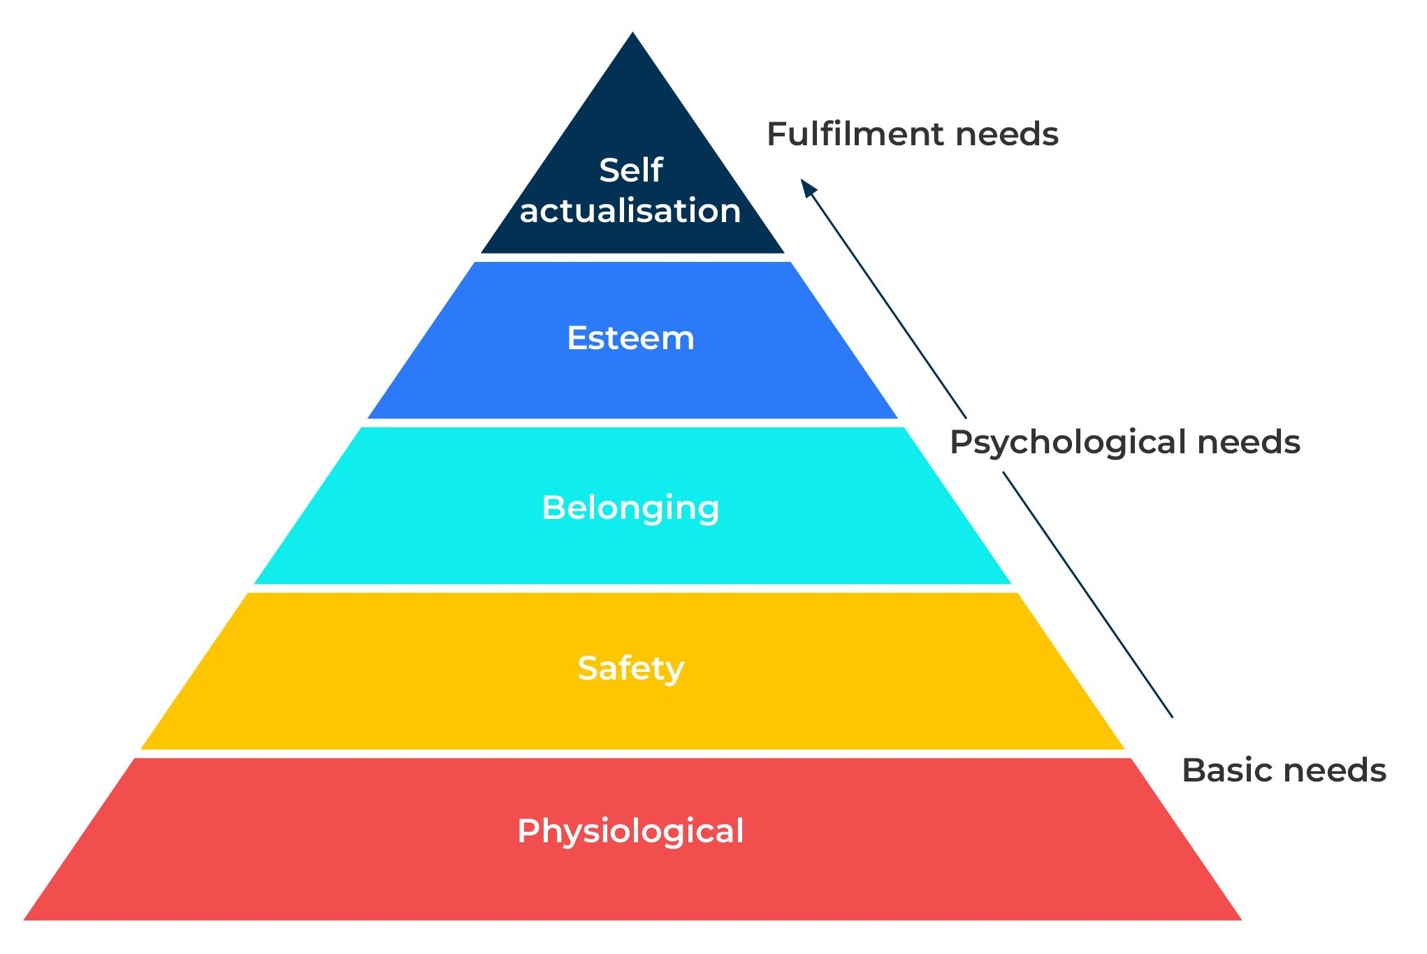
STEP 2: Using the hierarchy of needs in communications
It is easier to recognise needs at the bottom of the pyramid than it is at the top. It is therefore easier to develop communication messages that address needs at the bottom of the pyramid. The earliest and simplest promotions were factual. They showed the product and described it - “Drink Coca-Cola, delicious and refreshing”. Today promotions are more likely to play upon the emotions and address needs that are higher up the pyramid - “Taste the feeling”. “Share a Coke with…”. In this more sophisticated role, promotions seek to fit products to lifestyles and aspirations. They have moved on from simply saying “I am here, buy me!”
Maslow’s Hierarchy of needs
How does your product meet these needs?
What message would engage people with these needs?

Slide 5
STEP 3: Use the hierarchy to motivate your workforce.
The hierarchy of needs can be used as a motivational model and has an application in human resources. Consider the following contributions you can make to your workforce and see to what extent you are fulfilling their needs. Rate your company on a scale from 1 to 10 on the various factors that motivate your workforce.
Motivational factors | Score out of 10
Celebrate success
Encourage ideas
Encourage people to think for themselves
Give recognition
Praise people
Show respect
Stretch people with new work
Delegate – giving responsibility
Get to know people
Give people a challenge
Involve people in decision-making
Keep people informed
Let people know what is happening
Make work interesting
Make it a safe place to work
Provide training
Set goals
Team building
Treat people as individuals
Incentives – employee of the month
Pay people enough
Workplace environment is the right temperature
Meets needs of self actualisation and esteem
Self-actualisation
Esteem
Belonging
Meets needs of belonging and safety
Safety
Meets physiological needs
Physiological

Slide 6
Things to think about.
Marketers must get the basics right. They must have the right product, at the right price, in the right place. However, emotions are what distinguish companies and drive demand. The most effective communications and segmentations are based on the top end of Maslow's hierarchy. They address psychological and fulfilment needs.
Use focus groups and qualitative research to understand emotions and use quantitative research to measure and quantify how important these emotions are for your customers.

Slide 7
Thank you.

