Slide 1
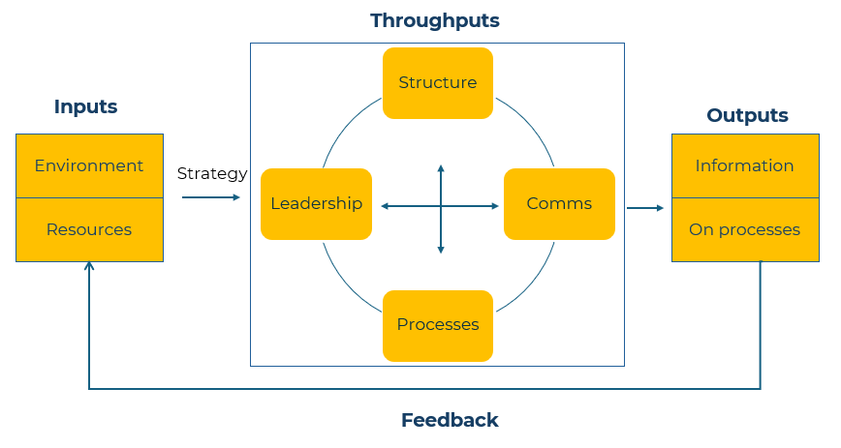
Nadler & Tushman Congruence

Slide 2
A business model to improve performance.
Use this framework to understand how components of a business work efficiently together
Use this model to focus on measures and targets that are necessary to achieve a strategy or much improved performance
Throughputs
The Nadler-Tushman Congruence Model is a tool for analysing organisational effectiveness, guiding strategic decision-making, and driving growth and innovation within your organisation.
It provides a structured framework that can help you diagnose problems, identify opportunities, and develop effective strategies for achieving your organisational goals.
Structure
Comms
Processes
Leadership
Inputs
Outputs
Environment
Information
Strategy
Resources
On processes
Feedback

Slide 3
Establish Inputs: Define goals and objectives
STEP 1
The starting point is to clearly articulate the goals and objectives of your organisation. These may include financial targets, market share goals, customer satisfaction metrics, etc.
Vision and Mission :
What is the purpose of your business?
Where do you see your business in the future?
Market and Customers:
Who are your target customers?
What are their needs, preferences, and pain points?
How do you differentiate yourselves from competitors?
How satisfied are your customers?
Products and Services:
How do your offerings meet customer needs?
What areas of innovation or improvement are you focusing on?
Financial Goals:
What are your revenue, growth and profitability targets?
How do you plan to allocate financial resources effectively?
Operational Excellence:
What operational efficiencies do you aim to achieve?
How can you improve processes and workflows?
What measures are in place to ensure quality and reliability?
Employee Engagement and Development:
How do you attract and retain top talent?
How do you foster a culture of continuous learning and development?
Social and Environmental Responsibility:
What are your commitments to social responsibility and sustainability?
Market Expansion and Growth:
What are your plans for expanding into new markets or segments?
How do you plan to grow your customer base?

Slide 4
Work out a strategy
STEP 2
Having answered questions in Step 1 you will have clear objectives. You now need a strategy to meet those objectives. A strategy is the steps you must take. It is a roadmap for how you will navigate challenges, capitalise on opportunities, and achieve long-term success. It will guide decision-making at all levels of your company and ensure alignment between actions and goals.
What do you want to achieve?
Who are your target customers?
Where is your competitive advantage?
What will be your offer that will meet customers’ needs and beat the competition?
What resources do you have to achieve your objective?

Slide 5
Identify the “Throughputs”
STEP 3
We are working our way through the four key components of the Nadler-Tushman model:
Inputs,
Throughputs,
Outputs,
Feedback.
Step 3 requires you to address the Throughputs. You should examine the internal processes and activities within your company. Evaluate its organisational structure, communication channels, decision-making processes, leadership styles, and other operational aspects.
Collect relevant data and information pertaining to each component of the Throughputs.
This may involve reviewing documents, conducting interviews, surveys, and analysing performance metrics.

Slide 6
Analyse the “Outputs” and “Feedback” mechanisms
STEP 4
In Step 4 you evaluate the results or outcomes of the organisational processes. This may include products, services, financial performance, customer satisfaction, employee satisfaction, etc.
You must also assess the feedback mechanisms used in your company to gather information about your organisational effectiveness. This may involve performance metrics, customer feedback, employee surveys, market research, etc.
Analyse the alignment or congruence between inputs, throughputs, outputs, and feedback. Identify areas where there is alignment and areas where there are misalignments or gaps. This is key as it will show up where action is required.
It also takes you into a feedback loop in which you evaluate the Inputs to see if you have assessed them correctly and if any changes have taken place.
Use the findings from the analysis to diagnose challenges, and opportunities. Determine what factors are contributing to organisational effectiveness and what factors are hindering it.
Based on the diagnosis, develop action plans to address issues and capitalise on opportunities. Determine specific strategies, initiatives, and interventions to improve alignment and enhance organisational effectiveness.

Slide 7
Monitor and evaluate
STEP 5
The final step is to continuously monitor and evaluate the impact of the changes implemented. Use the feedback mechanisms to assess progress towards your organisational goals and objectives. Make adjustments as needed to ensure ongoing alignment and effectiveness.
Using this framework will help you in assessing the alignment between different components of your organisation. By identifying areas of misalignment, you can make targeted interventions to improve coherence and effectiveness.

Slide 8
Thank you.

