Slide 1
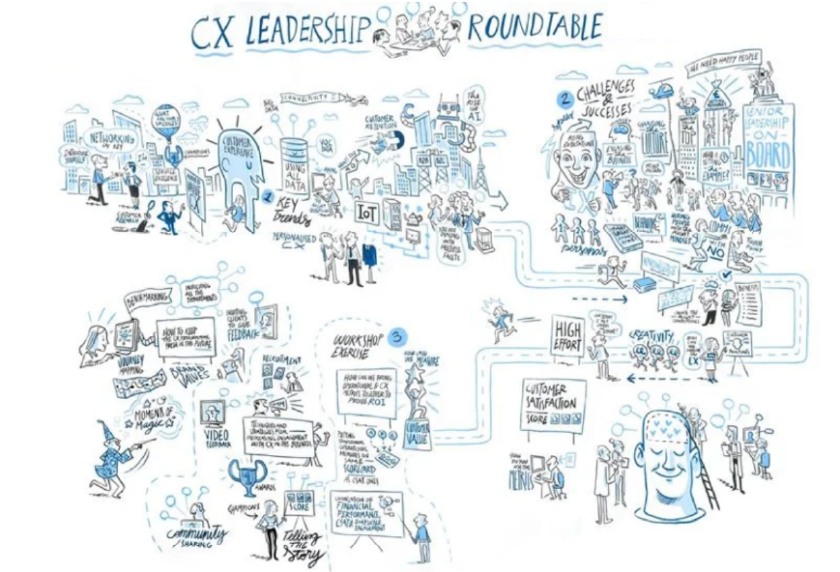
Graphic Recording

Slide 2
A business tool to capture a meeting.
Use this framework to record and maintain interest in an event
Graphic recording, also known as visual recording or sketchnoting, involves creating a visual representation of discussions, ideas, and key points during a meeting or event.
It offers a range of benefits, including:
increased engagement,
improved comprehension,
effective communication,
enhanced memory retention.
It serves as a powerful tool for facilitating productive and collaborative meetings while adding a creative and dynamic dimension to the communication process.

Slide 3
Preparation.
Clarify the purpose of the graphic recording. Determine the key objectives, topics, or themes that need to be visually captured during the session. Ensure you have the necessary materials, such as large sheets of paper, markers, pens, and any other tools you might need. Consider using a flip chart, whiteboard, or digital tablet based on the context.
 | Complete these boxes
What is the purpose of the meeting/event?
What do you want to capture at the meeting?
Where will the meeting be held? Who will do the recording? How will you cope with eventualities such as inclement weather, the artists failing to show, you haven’t all the necessary equipment?

Slide 4
Capture.
If you are capturing the outcomes, don't hesitate to ask questions to gain a deeper understanding of the topics being discussed. Use visual metaphors to enhance understanding and make the content more memorable. Colour coding could help. Use short phrases, keywords, or labels to convey information. Avoid overwhelming the visuals with too much text. Create a visual hierarchy to prioritise information. Group related ideas or topics together to create a sense of organisation. Use lines, borders, or whitespace to visually separate different sections.
 | Complete these boxes
What is being said that needs capturing/recording?
How best to show the themes and findings from the event?

Slide 5
Finalising and distribution.
Before concluding the session, review the graphic for accuracy, completeness, and clarity. Make any necessary edits or additions to enhance the visual representation. Capture a high-quality image of the graphic using a camera or scanner. This serves as a digital record and can be shared with participants or used for documentation. Share the graphic with participants, either physically or digitally, to reinforce key messages and provide a visual summary of the session.
 | Complete these boxes
Who should see the graphic? What key message do you want it to communicate?
What actions will result from the event and the graphic?
How could you do things better next time?

Slide 6
Thank you.

