Slide 1
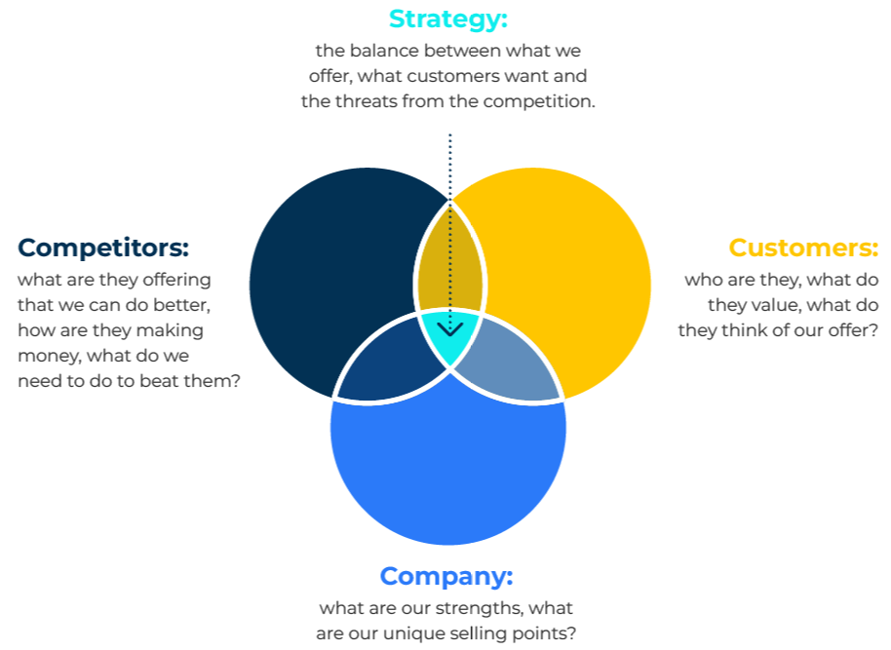
3C Framework

Slide 2
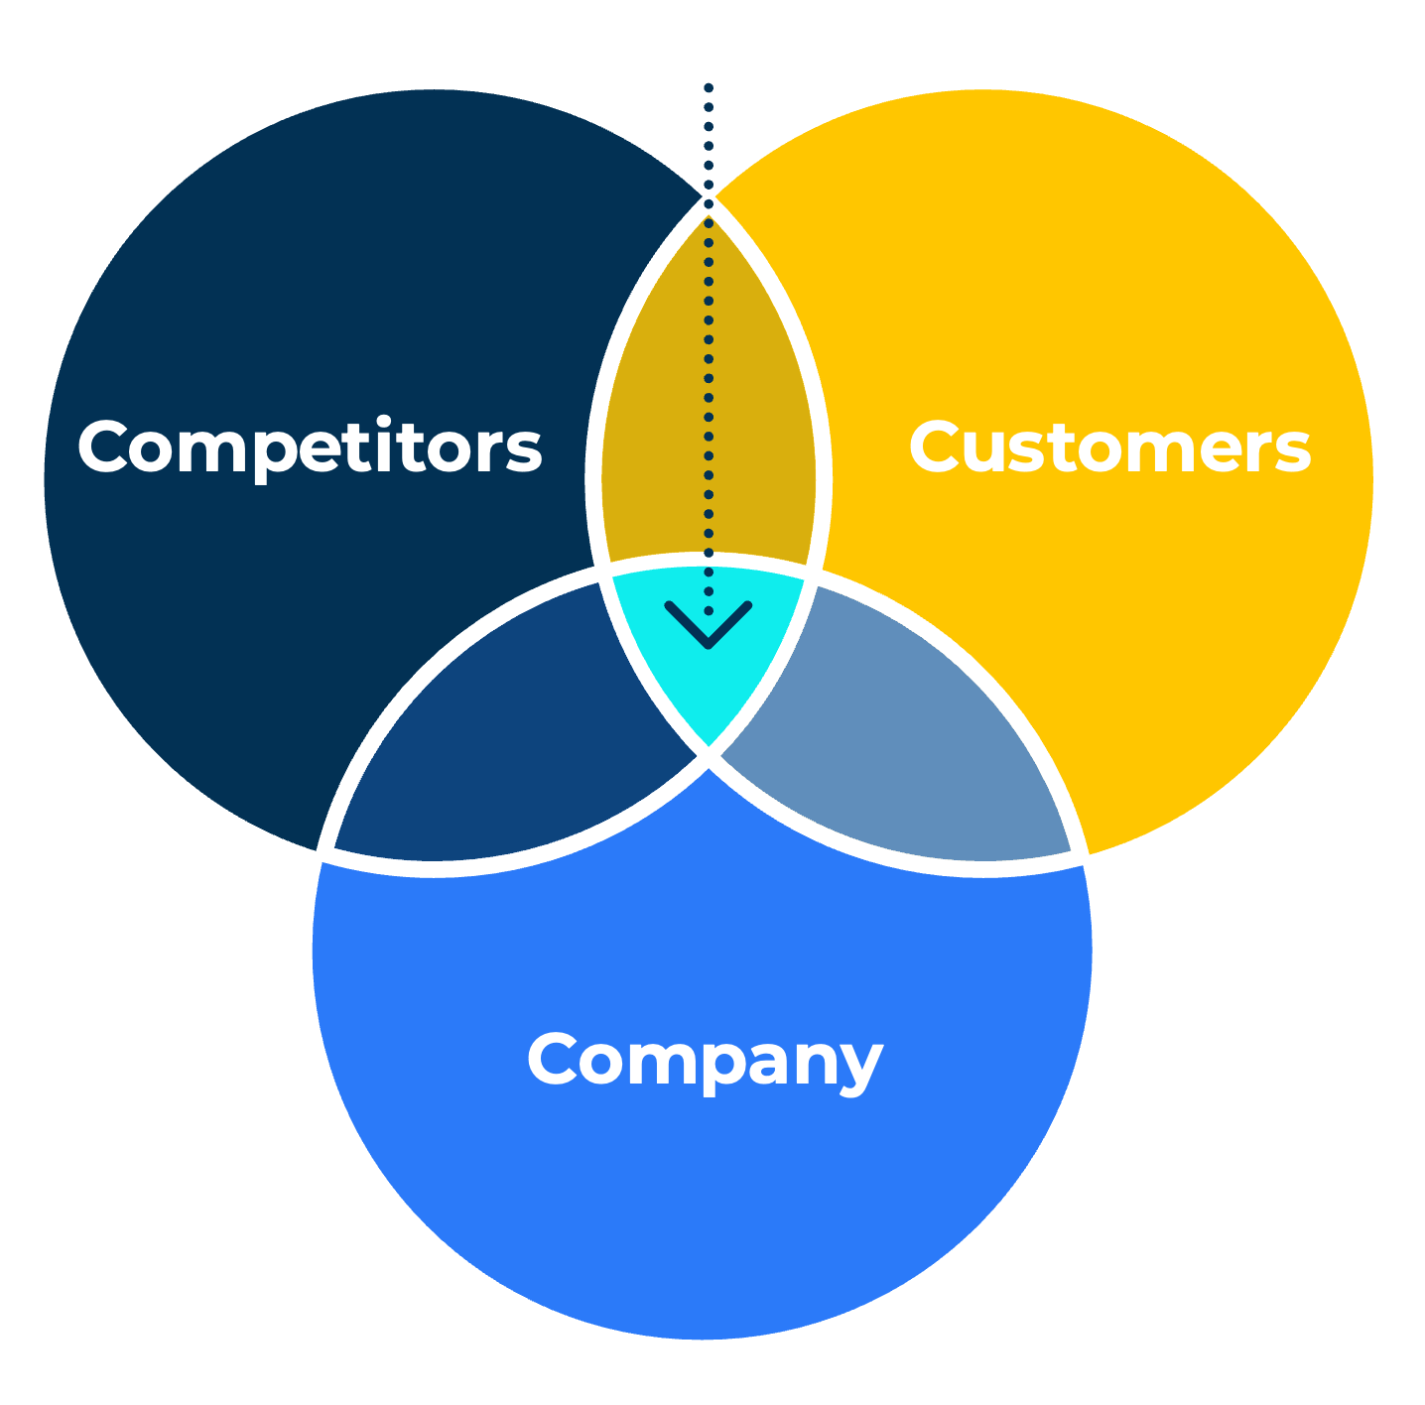
Strategy linking customers, competitors and company.
Use this model to maximise a company's strength relative to the competition
This model from Kenichi Ohmae proposes a framework in which three elements are in balance:
Competitors. It is important to understand competitors’ strengths. For some firms it may be a cost advantage while for others it could be their reputation and brand strength
Customers. Customers will buy from companies they believe offers them better value, better service or in some way a competitive edge. Ohmae recommends segmenting customers according to their different needs and behaviours.
Company. A company needs to understand its competitive advantage. Things that are difficult to do could be outsourced. If they are outsourced it may be necessary to manage in-house costs in order to ensure there is no loss of competitive advantage.
Strategy

Slide 3
Find the sweet spot.
Look for where your strengths beat the competition and equal what customers want
The strategy to beat the competition can only be devised after balancing the strengths of the company and its unique selling points, and understanding of customers and what they value, and the way in which the companies offer is better than the competition. Focusing on just one or two of these “Cs” would not be sufficient to be successful in the marketplace.
In the Venn diagram consider the questions posed next to Competitors, Customers and Company. You are looking for the point in the middle where what you offer meets with what customers want and what competitors find hard to deliver.

Slide 4
The importance of questions “why and how?”
Why do customers want to buy from you? How are you better than the competition?
First focus on just one thing – the thing that matters most to customers. What is thing and why is it important?
How can you provide what customers want in a way they want it?
Now think about your competitive advantage and how you can achieve it at a reasonable cost.
Having understood the competition see if you can recognise a relative strength in your company as perceived by your customers.
Bearing in mind what customers want and your competitive strength, develop an offer that gives customers what they want and that doesn’t copy what competitors offer.

Slide 5
Things to think about.
Make sure your resources are organised to deliver what customers want
What is the critical success factor within your company?
How could you make better use of your resources?
Why do people buy your competitors’ products?
What above all else do your customers value from the products you supply?
What is your company's single relative strength versus the competition?

Slide 6
Thank you.

