Slide 1
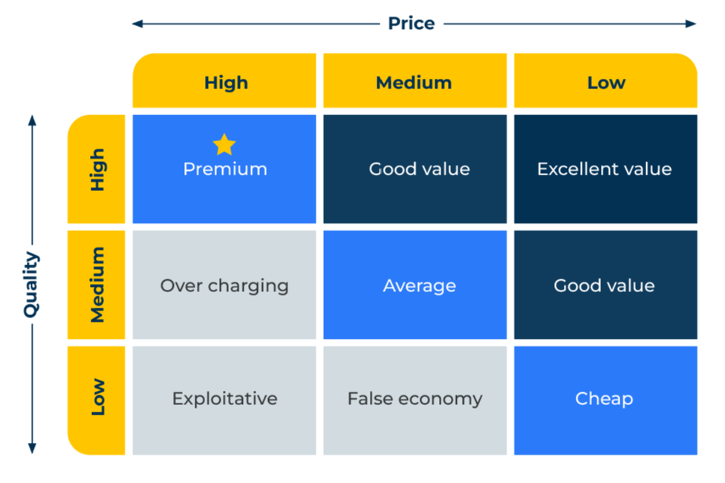
Price Quality Strategy

Slide 2
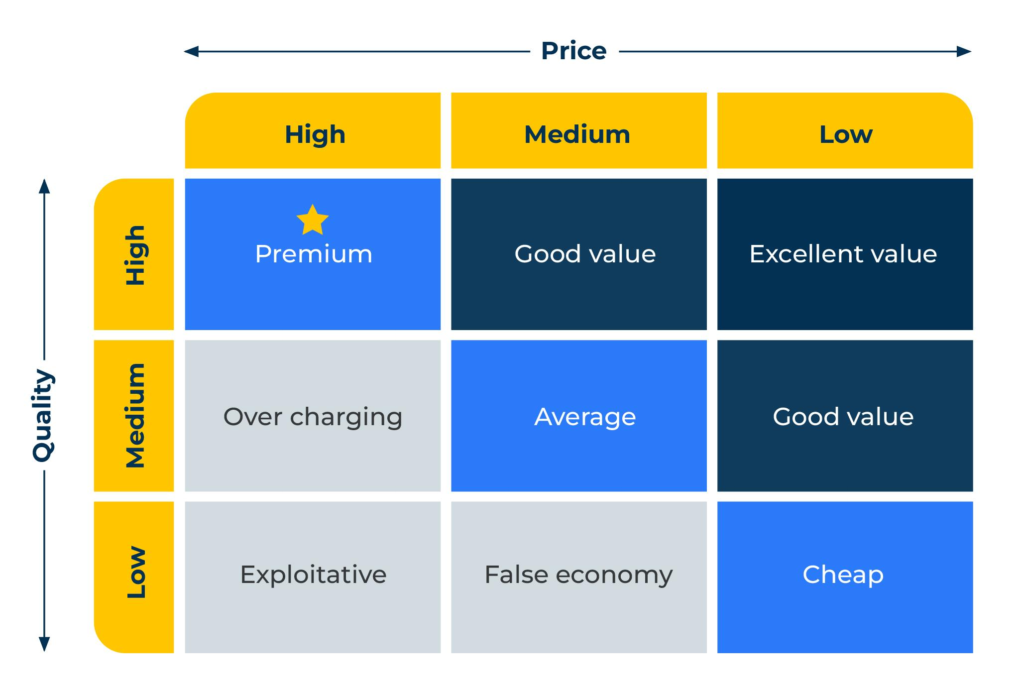
A business model for guiding a pricing strategy.
Use this model to find out the value perceptions of your product
This is a model proposed by Philip Kotler. He sees three levels of price – high, medium and low. He also recognises three levels of quality – high medium and low. The combination of these levels of price and quality result in nine pricing strategies.
There are only six possible combinations that produce viable pricing strategies as three would not work – high price/low quality, medium price/low quality, and high price/medium quality. These inappropriate strategies are shaded pink in the figure opposite.

Slide 3
Six steps to develop the strategy.
First decide where your product sits in terms of its quality – high, medium or low. On what basis can you say this?
Now select your price objective – is it to maximise profit, maximise market share, achieve a fast penetration of the market, achieve product quality leadership? Will your price strategy be high, medium or low?
Estimate the demand you will achieve at the price/quality strategy you are considering.
Check your costs to determine whether you will make an acceptable profit.
Consider how you will position your product against the competition and in particular what will differentiate it and generate demand.
Set your final price.
Where does your price sit in the Kotler matrix?
Does it make sense?

Slide 4
Other pricing strategies.
Kotler's paradigm does not cover all pricing strategies. It was never meant to do so as it focuses on the relationship between quality and price. However, the pricing strategist should also be familiar with the other pricing options. These include:
Cost pricing strategies. These are very common strategies used by manufacturing companies who calculate the variable cost of the products they make and add what they think to be a suitable gross margin. There are variations of cost pricing strategies such as marginal cost pricing whereby the manufacturer, eager to fill capacity at the factory, will be prepared to sell some products to certain groups of people (e.g. exports) at a price that barely covers the cost of manufacture but make some contribution to overheads. Such strategies are employed by product orientated companies whose main goal is to keep the production line as full as possible.
Specialist strategies. These are pricing strategies to achieve a particular objective. For example, predatory pricing (illegal in many countries) could be employed to undercut competitors and put them out of business, despite delivering no profit.
Psychological pricing. For some products it is not possible for the customer to fully understand the quality of what they are buying. Their perceptions could be manipulated to make them believe a high price is worth it. Psychological pricing can be used with wines, perfumes and luxury goods. Here the company chooses a pricing strategy which is higher than is merited by the quality of the products but which is justified in the eyes of consumers because of the products status.

Slide 5
Other things to think about.
Many companies have a pricing strategy built on legacy. Prices have been set a number of years ago and adjusted (usually upwards because of inflation) year-on-year. Use Kotler’s pricing grid to see if your prices are appropriate for your target audience.
How does your pricing strategy for the product you have been addressing fit with other pricing strategies within your company?
How will your pricing strategy address the different segments of the market?
What discount strategy will you adopt for volume sales?
How will the pricing strategy fit within channel pricing?
How will warranties and services fit in with your product pricing strategy?
Are your customers obtaining enough value from your pricing strategy?
Are you achieving sufficient profits from your pricing strategy?

Slide 6
Thank you.

