Slide 1
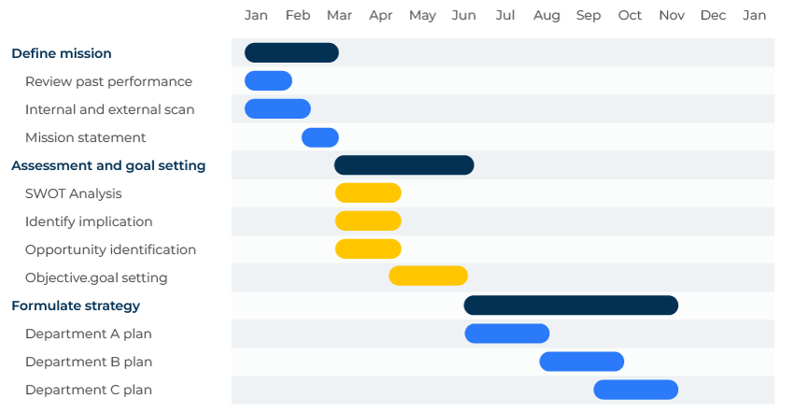
Gantt Charts

Slide 2
A business tool to improve productivity.
Use this framework to plan and execute projects
Gantt charts are valuable tools for improving business efficiency by enhancing project visualisation, supporting resource management, facilitating communication, and aiding in decision-making and change management.
They provide a structured and organised approach to project planning and execution, contributing to successful project outcomes and overall business efficiency.

Slide 3
How to prepare a Gantt chart.
When Henry Gantt invented his bar chart in 1910 there were no computers. He marked his lines on paper and this approach is still relevant today. It doesn't need special skills and the results can readily be shared with a team.
However, computers have increased the sophistication of Gantt charts. Spreadsheet software such as Microsoft Excel and Google Sheets have good familiarity and they allow for easy customisation to suit specific project needs.
And now there are specialised project management software such as Microsoft Project, Asana, and Trello that automate the creation and updating of Gantt charts, saving time and reducing errors. Some of these tools may have a learning curve, and users may need training to use advanced features effectively. However, many professionals find that specialised project management software strikes a balance between automation, collaboration, and flexibility, making it a popular choice for managing Gantt charts in various projects.

Slide 4
Benefits of Gantt charts.
Time Tracking: Gantt charts can be used for tracking progress against the planned schedule. This helps identify tasks that slip behind schedule.
Deadline Adherence: With clear timelines and milestones, Gantt charts contribute to better time management. Teams have a visual representation of the project's critical path and key deliverables.
Planning and Sequencing: Gantt charts aid in the initial planning and sequencing of tasks. They provide a roadmap for the project, allowing teams to see the big picture and understand how each task contributes to the overall project goals.
Coordination: Teams can coordinate their efforts more effectively when they have a shared understanding of the project timeline and dependencies. Gantt charts facilitate collaboration and alignment among team members.
Identifying Critical Path: Gantt charts help identify the critical path in a project—the sequence of tasks that, if delayed, would affect the overall project timeline.
Scenario Planning: Gantt charts support scenario planning by allowing teams to simulate the impact of potential risks or changes in task durations. This helps develop contingency plans and mitigate risks before they become issues.
Transparency: Gantt charts enhance transparency with clients and stakeholders. Sharing Gantt charts provides them with a visual overview of project progress, timelines, and upcoming milestones, fostering better communication and expectations management.
Client Involvement: Gantt charts enable clients to see how their requirements translate into project tasks and timelines. This enhances client satisfaction and ensures that expectations align with project realities.
Data-Driven Decisions: Gantt charts provide project managers and decision-makers with a data-driven overview of project status. This information enables informed decision-making, such as reallocating resources, adjusting timelines, or making changes to project scope.
Impact Assessment: When changes occur during a project, Gantt charts help assess the impact on the timeline and resource allocation. This enables teams to make adjustments efficiently and minimize disruptions.
Change Communication: Gantt charts can be used to communicate changes to team members and stakeholders, ensuring that everyone is aware of modifications to the project plan.

Slide 5
They help visualise tasks.
Clarity: Gantt charts provide a clear visual representation of tasks, their start and end dates, and dependencies between tasks. This clarity helps teams understand the project structure, sequence of activities, and their interdependencies.
Communication: The visual nature of Gantt charts facilitates communication among team members, stakeholders, and project managers, ensuring everyone is on the same page regarding project timelines and milestones.
Things to think about:
Break your tasks down into components that can be shown on a Gantt chart together with who should do what, by when.

Slide 6
They help in resource management.
Resource Allocation: Gantt charts help in assigning and managing resources effectively. By visualising task durations and resource requirements, businesses can optimize resource allocation, preventing overloading or underutilisation of team members.
Identifying Bottlenecks: Gantt charts make it easier to identify potential bottlenecks in the project timeline, allowing for proactive resource adjustments to maintain efficiency.
Things to think about:
Use Gantt charts to plan production schedules, new product development, marketing plans, holidays – anything that involves resources, people and timelines.

Slide 7
Thank you.

