Slide 1
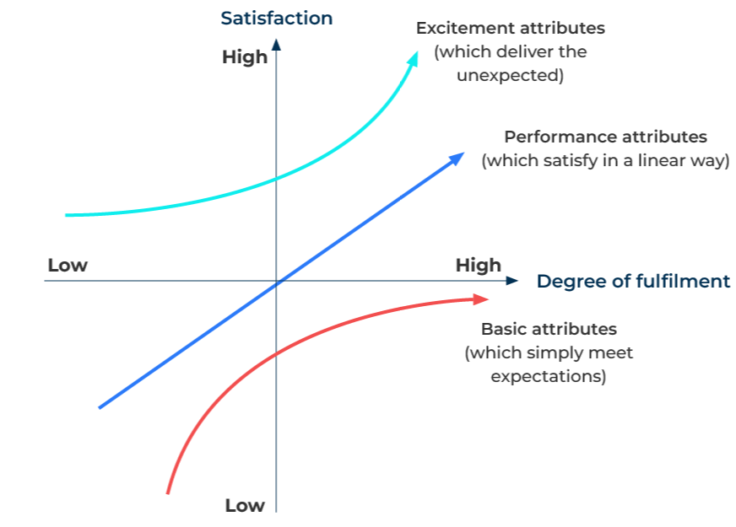
Kano

Slide 2
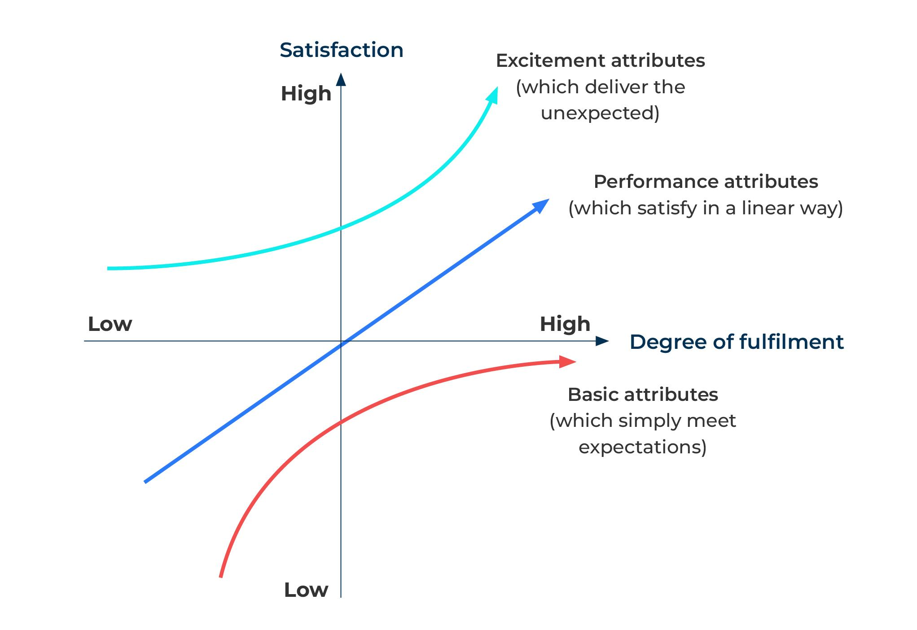
A business model to identify purchase motivations.
Use this model to identify the factors that make compelling customer value propositions
This model was developed by Dr Noriaki Kano.
Dr Kano demonstrates that blindly fulfilling customer requirements risks missing out on what customers really need and want. His model of customer satisfaction is based on different types of customer expectations
Basic – attributes/features that are hygiene factors and have to be in all products. Any improvement on these factors will improve satisfaction but not by a huge amount.
Performance – attributes/features in a product that, when improved, generate a proportional increase in satisfaction.
Excitement – these are attributes/features that, when added to a product, significantly improve satisfaction.

Slide 3
Develop Kano questions.
Step 1
Kano questions have two parts:
How do you feel about a particular feature? (These are the functional questions)
How would you feel if you did not have the feature? (These are the dysfunctional questions)
In response to each question respondents are asked whether or not:
I like it
I expect it
I'm neutral
I can tolerate it
I dislike it

Slide 4
The interpretation grid.
The following grid enables you to classify the different attributes
Dysfunctional (feature absent)
How would you feel if you did not have the feature?
Like not having
Expect not to have
Live with not having
Dislike not having
Don’t care
Like having
Q | E | E | E | P
R | I | I | I | B
R | I | I | I | B
R | I | I | I | B
R | R | R | R | Q
Expect to have
Don’t care
How do you feel about a particular feature?
Functional (feature present)
Live with having
Dislike having
Customer requirement is:
E = Exciting and attractive
B = Basic and must have
P = Performance
Q = Questionable
I = Indifferent
R = Reverse

Slide 5
Execute the survey.
1
2
3
4
5
Choose your target audience
Consider confining the audience to customers only in the first instance
Decide which attributes you want to test
Carry out some qualitative/depth interviews to find out what the attributes should be
Develop your questionnaire
Take care with the functional and dysfunctional questions. For example, the functional question could be "If you can have delivery in less than 24 hours, how do you feel?". The dysfunctional question would be "If delivery takes longer than 24 hours, how do you feel?“
Also ask how important an attribute is to the customer.
Run the survey online
The many questions are best asked online. This will require you to have a good list of email addresses of customers and a strong motivation for them to reply.
Analyse the results
Develop a scale for the analysis which takes into consideration the functional and dysfunctional scales – for example:
Functional: -2 (Dislike), -1 (Live with), 0 (Neutral), 2 (Must-be), 4 (Like);
Dysfunctional: -2 (Like), -1 (Must be), 0 (Neutral), 2 (Live with), 4 (Dislike);
Importance: 1 (Not at all Important), …, 9 (Extremely Important.)

Slide 6
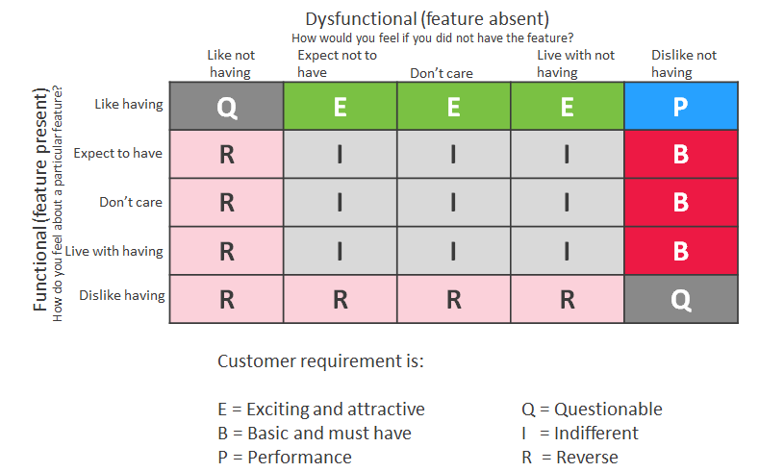
Focus on the positive.
The attributes that matter to the customers are those contained in the yellow box as identified in the grid below:

Slide 7
Things to think about.
The Kino tool can play an important role in innovation. It can be used to find out the improvements or innovations that could excite people about the product. They are the things that would make the product special and differentiated.
An alternative tool for the same purpose could be SIMALTO.

Slide 8
Thank you.

