Slide 1
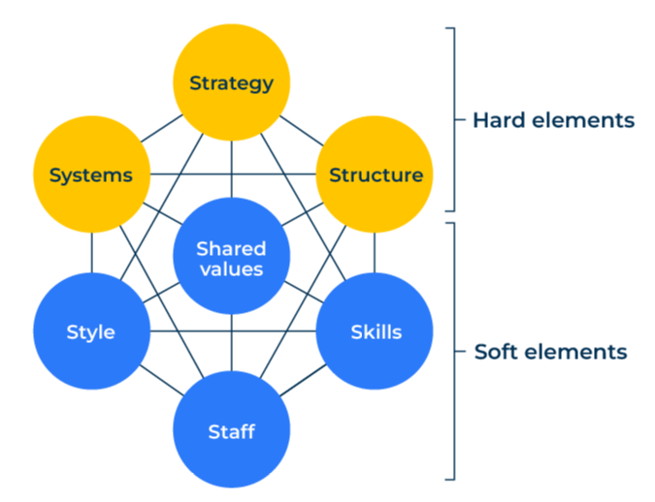
McKinsey 7s

Slide 2
A business model that provides a “health check”.
Use this model to find out if your business is on track and what needs rectifying
The McKinsey 7S model is made up of seven components of a company, all interrelated and each one needs to be in good health.
The seven components are shown in the diagram opposite. The top three components (strategy, structure, systems) are considered “hard” elements in that they can be defined and managed precisely. The bottom four components (style, shared values, skills, staff) are considered “soft” because they are less tangible and more influenced by culture.
In using this tool you need to work out where you have any deficiencies and so where improvements are required. This may require changes in processes within the company. It will also require all departments within the company to be aligned to the changes.

Slide 3
STEP 1: Questions to ask about your strategy.
This first series of questions on strategy are about the long-term and at a high level. They seek to answer the questions “where are we going?” and “how can we get there?”.
Questions about strategy | Score out of 10
What is your company's vision (long term goal) for what it wants to achieve?
What is the mission statement? (The statement which indicates how the vision will be achieved).
What are the values of your business and how it behaves?
How far ahead does your company plan extend?
What resources do you have to achieve this plan?
Who are the people who will make the plan?
Wherever your score is 7 out of 10 or below:
What are your recommendations for improvement?
Who will be responsible for the improvement?
Which departments will be affected?
How will you monitor the effect of the changes?

Slide 4
STEP 2: Questions to ask about your systems.
Ask yourself questions about your systems to determine how efficient they make your company.
Questions about systems | Score out of 10
How integrated are your systems within the company?
To what extent do they deliver against the business goals rather than departmental goals?
To what extent does your company control your various systems through one stakeholder?
How effective is this stakeholder in running your systems?
Thinking of the systems themselves, how good are they at enabling your company to work quickly and efficiently?
How secure are your systems (vulnerable to failure and with a backup should this happen)?
Are your systems regularly tested?
Do you have a centralised financial budget for your systems?
Is this sufficient for your current and future needs?
Wherever your score is 7 out of 10 or below:
What are your recommendations for improvement?
Who will be responsible for the improvement?
Which departments will be affected?
How will you monitor the effect of the changes?

Slide 5
STEP 3: Questions to ask about your structure.
The structure of your company is the scaffolding that strengthens it. Ask yourself the following questions:
Questions about structure | Score out of 10
Does your company have an organisational chart? How up-to-date is this?
How clear are people's job descriptions within your company?
How clear are reporting lines within your company?
To what extent do key members of staff have a deputy that could replace them tomorrow, should this be necessary?
To what extent are managers overburdened by having more than eight people report to them?
How fair are salary structures within the different job roles within your company?
How are salaries and remuneration linked to performance?
How empowered are people within your company?
Wherever your score is 7 out of 10 or below:
What are your recommendations for improvement?
Who will be responsible for the improvement?
Which departments will be affected?
How will you monitor the effect of the changes?

Slide 6
STEP 4: Questions to ask about your style.
The style of your company is very much related to culture and how this emanates from the leadership team:
Questions about style | Score out of 10
To what extent do the leaders of the company set good examples in their workplace behaviour?
How would you rate your company on gender equality?
How would you rate your company on ethnic equality?
How would you rate your company on meritocracy?
How would you rate your company in terms of its work ethic?
How would you rate your company in terms of the way it looks after its staff?
Wherever your score is 7 out of 10 or below:
What are your recommendations for improvement?
Who will be responsible for the improvement?
Which departments will be affected?
How will you monitor the effect of the changes?

Slide 7
STEP 5: Questions to ask about your staff.
Your company’s workforce are one of its most important assets. Answer the following questions:
Questions about staff | Score out of 10
How well resourced is your company in terms of its staffing levels?
How good is your company at recruiting the right staff?
How good is your company at training staff?
How good is your company at motivating staff?
How good is your company and getting a good demographic balance of staff?
How good is your company at keeping staff?
Wherever your score is 7 out of 10 or below:
What are your recommendations for improvement?
Who will be responsible for the improvement?
Which departments will be affected?
How will you monitor the effect of the changes?

Slide 8
STEP 6: Questions to ask about your skills.
Your company’s workforce are one of its most important assets. Answer the following questions:
Questions about skills | Score out of 10
How skilled are your staff compared to those in competitive companies?
How quickly can you train your staff to achieve the necessary skills?
To what extent do you evaluate skills to see how they can be improved?
What opportunities have you identified for replacing human skills with automation?
To what extent do you measure productivity within your company?
How productive is your workforce compared to competitive companies?
Wherever your score is 7 out of 10 or below:
What are your recommendations for improvement?
Who will be responsible for the improvement?
Which departments will be affected?
How will you monitor the effect of the changes?

Slide 9
STEP 7: Questions to ask about shared values.
Your company’s shared values describe the culture of your company. Answer the following questions:
Questions about shared values | Score out of 10
What importance does your company attach to company culture?
What is the consistency of shared values within your company?
How good is your company at generating strong teams?
How good is the company at directing the values that it wants sharing?
How important do you consider your company’s DNA in determining its future success?
Wherever your score is 7 out of 10 or below:
What are your recommendations for improvement?
Who will be responsible for the improvement?
Which departments will be affected?
How will you monitor the effect of the changes?

Slide 10
Things to think about.
Every successful business has to be aligned with the needs of its customers. This should be borne in mind when examining the strength of the 7s elements. To what extent does each of them deliver against customers’ needs?
Companies are made-up of people and they are involved in every one of the 7s elements. When reviewing each of the 7s elements it is worth asking “Have we got the right people? Are they connecting successfully with their colleagues?”

Slide 11
Thank you.

