Slide 1
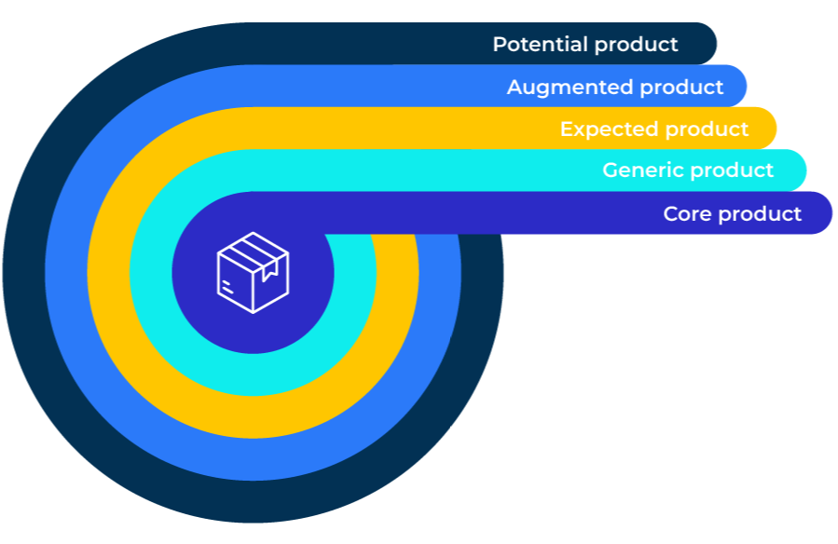
Kotler’s 5 Product Levels

Slide 2
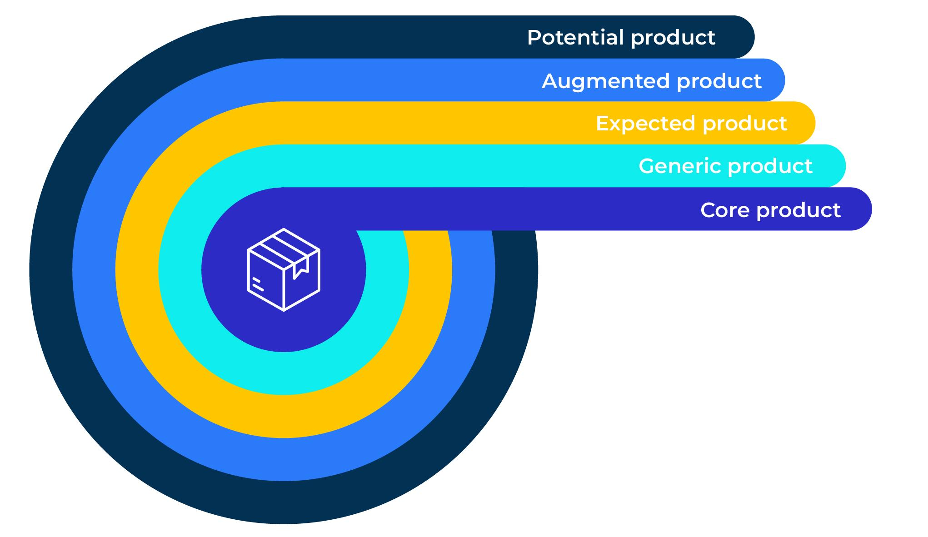
A model to add value to a product or service.
Use this model to find out how to differentiate your product/service and add value
This model was developed by Philip Kotler.
A company competes in its market by ensuring that its basic or core product is enhanced by additional offerings. Customers’ needs are satisfied by basic products whereas their “wants” are satisfied by the additional offerings.
Customers have different needs and wants and they must be satisfied on all levels.

Slide 3
What is your core product?
Customers buy core products to fulfil a need
Why do people buy your product? What are their core needs?
What benefit do they get from purchasing your product?
On a scale from 1 to 10 how successful is your product at meeting customers core needs?
In terms of meeting customers core needs to what extent is your product better or worse than the competition (-2 is much worse than the competition, +2 is much better than the competition)?
Core need (the reason they buy the product) | Benefit they get from the product | Success of product at meeting core needs (out of 10) | Competitive strength of feature (-2 to +2 )
What are the opportunities for improving the core product?

Slide 4
What are your generic products?
Generic products are made up of the various qualities and features of your products
What features does your product contain that meets customers’ needs?
What benefit does the customer get from each feature?
How important is this feature on a scale from 1 to 10 (where 10 is important)?
To what extent is this feature better or worse than the competition (-2 is much worse than the competition, +2 is much better than the competition)?
Product features that meets the needs | Benefit the features deliver | Importance of feature (out of 10) | Competitive strength of feature (-2 to +2 )
What are the opportunities for improving the generic product?

Slide 5
What are customers’ expectations?
Expectations (as the word suggests) are what people imagine they will get from the product they buy
What expectations do people have of the product? (for example that it will last for ever, that it will never break down, that it will give them status etc)
How important is each expectation on a scale from 1 to 10 (where 10 is important)?
To what extent is this expectation met buy your product (-2 is not well met, +2 is very well met)?
Expectations of the products | Importance of expectation (out of 10) | Whether the expectation is met (-2 to +2 )
What are the opportunities for improving the expected product?

Slide 6
What are augmented aspects of your products?
Augmented products are those elements that differentiate the product from the competition. These could be intangible aspects such as brand and image.
How do your customers perceive your brand to be different from the competition?
What do your customers value about your brand?
To what extent is your brand considered better or worse than the main competitor (-2 is much worse, +2 is much better)?
Aspects of the brand that differentiate | Importance of these aspects (out of 10) | Whether worse or better than the competition (-2 to +2 )
What are the opportunities for improving the augmented product?

Slide 7
Potential components of your product offer.
Products and offers have to change. We now look at the future components of the offer.
What are the unmet needs of customers about your product?
How easy is it to fulfil this unmet need?
How will fulfilling the unmet need affect demand for your product?
Unmet needs | Ease of fulfilling the unmet need (out of 10) | Effect on demand for product (out of 10)
What are the opportunities for a new and improved product?

Slide 8
Things to think about.
Improvements to a product can address core needs or the generic product. However, there are significant opportunities to improve the features or services that enhance the product.
All products can be enhanced. In order to work out what the enhancement should be, it is worth considering ethnographic research to see how customers actually use the product.

Slide 9
Thank you.

