Slide 1
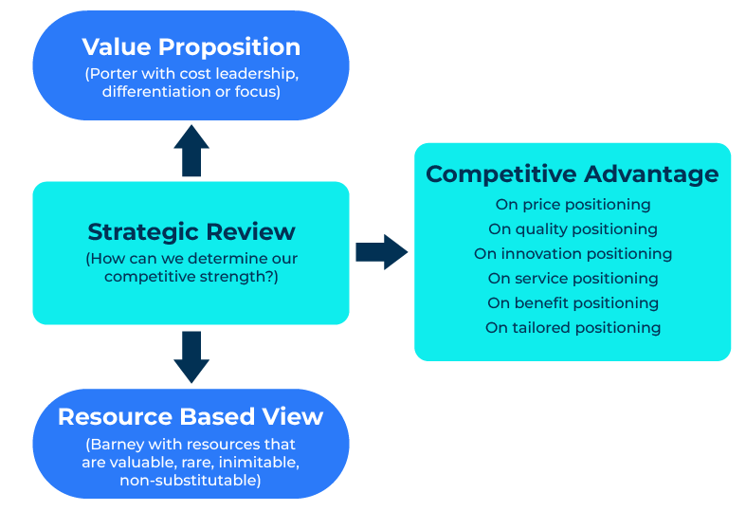
Resource Based View

Slide 2
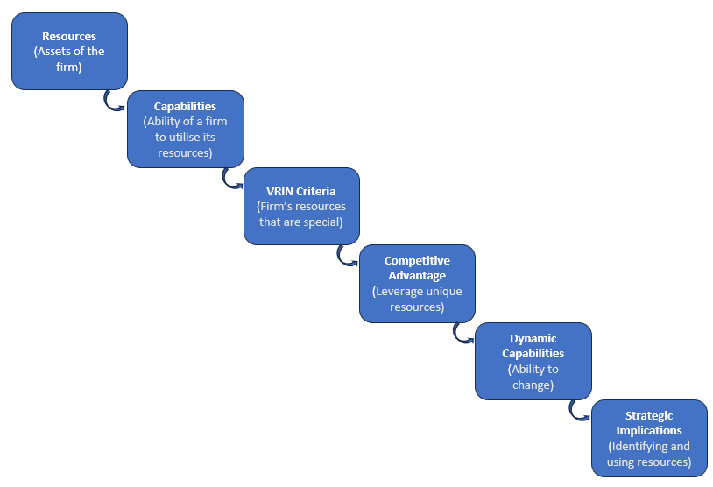
A business model to make you more competitive.
This framework will help you use resources for a competitive advantage
Jay Barney in 1991 wrote an article in the Journal of Management entitled “Firm Resources and Sustained Competitive Advantage”. His thesis was that resources underpin the competitive advantage of firms.
Resource-Based View (RBV) is a strategic management framework that focuses on the internal resources and capabilities of a firm as sources of competitive advantage. RBV suggests that a firm's unique bundle of resources and capabilities can lead to sustained competitive advantage, which is valuable, rare, inimitable, and non-substitutable (VRIN).
Resource-Based View can be a valuable lens through which to assess and develop a strategic plan. By understanding and leveraging internal resources and capabilities, a firm can position itself more effectively in the competitive landscape and build a sustainable advantage over time.

Slide 3
What are your firm’s resources?
Resources refer to the tangible and intangible assets that a firm possesses. These can include physical assets (such as machinery or technology), human capital (knowledge, skills, and expertise of employees), organizational capabilities (effective processes and structures), and intangible assets (such as brand reputation or patents).
Resources
(Assets of the firm)

Slide 4
What are your firm’s capabilities?
Capabilities
(Ability of a firm to utilise its resources)
Capabilities go beyond individual resources and represent the ability of a firm to utilise its resources effectively to achieve specific tasks or activities. Capabilities are often embedded in the organisation's routines, processes, and culture. They are the ways in which a firm combines and deploys its resources to create value.

Slide 5
What are your firms VRIN criteria?
According to RBV, for a resource to provide a sustainable competitive advantage, it must possess four key attributes:
Valuable: The resource must enable the firm to exploit opportunities or defend against threats.
Rare: The resource must be relatively scarce in the industry.
Inimitable: Competitors should find it difficult to replicate or imitate the resource.
Non-substitutable: There should be no equivalent or easily replaceable resource.
VRIN Criteria
(Firm’s resources that are special)

Slide 6
What is your firm’s competitive advantage?
The goal of the RBV framework is to help firms achieve and sustain a competitive advantage by leveraging their unique, valuable, and difficult-to-replicate resources and capabilities. This competitive advantage can lead to superior performance and profitability.
Competitive Advantage
(Leverage unique resources)

Slide 7
What is your firm’s dynamic capabilities.
RBV recognises the importance of a firm's ability to adapt and change over time. Dynamic capabilities refer to the capacity to reconfigure resources and capabilities in response to changing market conditions, technological advancements, or other external factors.
Dynamic Capabilities
(Ability to change)

Slide 8
What are the strategic implications?
RBV has significant strategic implications. Firms following the RBV approach should focus on developing, acquiring, and protecting key resources and capabilities. The strategic planning process involves identifying core competencies, aligning resources with strategic goals, and continually assessing the competitive landscape.
Strategic Implications
(Identifying and using resources)

Slide 9
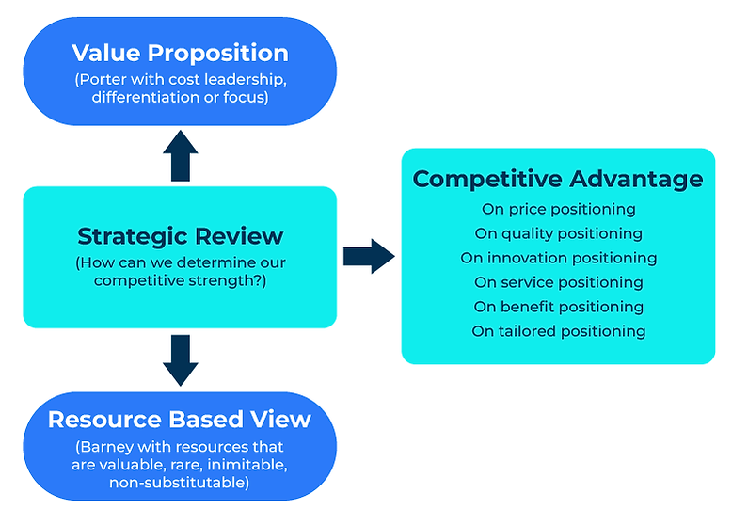
Don’t forget to consider Porter
Michael Porter's view on competitive advantage takes into consideration the external marketplace and suggests a firm should position itself on cost leadership, differentiation or focus. Think about this as well as RBV.
At the end of the day you need to decide if your competitive advantage is based on price, quality, innovation, or service.
Use both frameworks.

Slide 10
Editable framework.
Value Proposition
(Porter with cost leadership, differentiation or focus)
Use this to add your own text and edit to suit your own branding
Competitive Advantage
On price positioning
On quality positioning
On innovation positioning
On service positioning
On beneﬁt positioning
On tailored positioning
Strategic Review
(How can we determine our competitive strength?)
Resource Based View
(Barney with resources that are valuable, rare, inimitable, non-substitutable)

Slide 11
Thank you.

