Slide 1
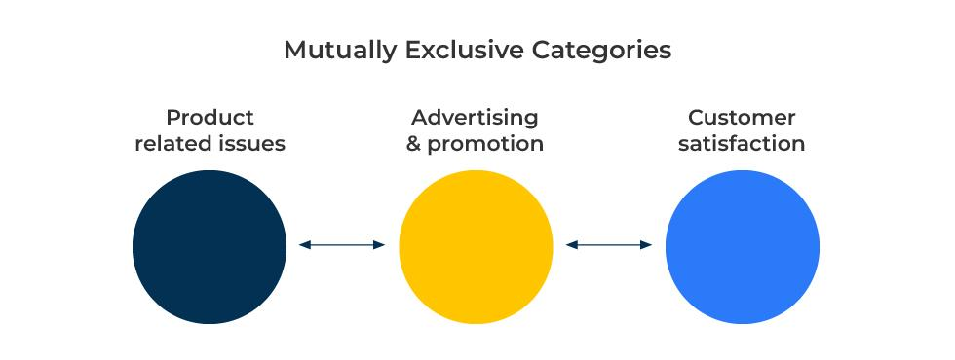
MECE

Slide 2
A model to structure an analysis.
Use this model for a structured and systematic approach in problem-solving, analysis, and decision-making
The MECE framework is an acronym, which stands for Mutually Exclusive, Collectively Exhaustive. The framework ensures that information is organised in a way that avoids redundancy and ensures comprehensive coverage of a problem or situation.
There are two components to the MECE framework:
Subject matter that does not overlap one with the other. These are the Mutually Exclusive (ME) components of the analysis.
Subject matter that is inter-connected. These are the Collectively Exhaustive (CE) components of the analysis.

Slide 3
Consider categories for analysis that are mutually exclusive.”
Mutually Exclusive (ME): These factors could be age groups of people that do not overlap, industry groups that do not overlap, or factors that drive customer sales (as in the example below).
Mutually exclusive factors are in distinct categories: Every piece of information or option fits into only one category.
Mutually exclusive factors avoids double-counting: Because the categories are mutually exclusive, there is no double-counting and it helps maintain clarity in the analysis.

Slide 4
Consider subjects for analysis that may overlap.”
Collectively Exhaustive (CE):
This ensures comprehensive coverage: The CE aspect of MECE requires that the categories collectively cover all possible options or aspects related to the problem or situation. Nothing is left out as the framework aims to be all-encompassing in its coverage.
This also ensures there are no gaps: Every relevant factor or option is considered. The goal is to address the entire spectrum of possibilities to avoid overlooking critical elements.
In the example on the right market factors (eg demand) and operational factors (eg inventory levels) are likely to be interdependent. Both of these could be affected by external factors such as changes in the demography of the customers.

Slide 5
Things to think about.
What are the factors that need analysing? Make sure you have a comprehensive listing of all of them.
Which of these factors are mutually exclusive in that there is no overlap, one with the other?
Which of these factors is collectively exhaustive in that there is overlap between them?
How do the factors influence and relate to the problem you are analysing?
How will you present the analysis? Will it add clarity by dealing with the mutually exclusive factors and the collectively exhaustive factors separately?
Which are the most important factors and how can they be addressed to make an improvement?

Slide 6
Thank you.

