Slide 1
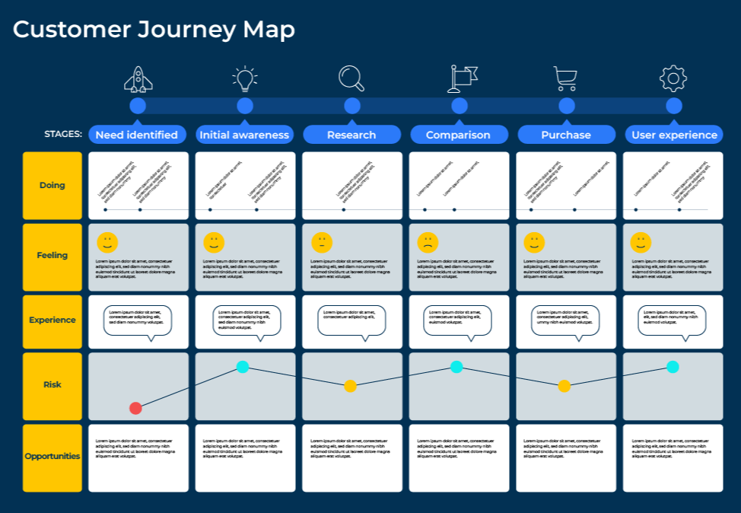
Customer
Journey Maps

Slide 2
Improve customer experience.
Use this model to find out how customers react to your offer at different stages during the buying process
A customer journey map is made up of a spine (the major stages that the customer goes through in the life cycle with the supplier) and all the moments of truth during each of these stages.
Most customer journey maps begin with you hypothesising how your customers act and feel at each stage of the journey. This process typically begins in a workshop of people from different parts of your company and debating what they believe to be the spine and all the moments of truth. When this hypothesised customer journey map is finished, research might be carried out amongst a number of customers to validate and refine it.

Slide 3
Agree on segment.
STEP 1
Customer journey maps should be prepared for selected groups of customers – a segment. The first step is to agree on the segment for which the map will be prepared.
There will be specific decision-makers within the segment and they should be listed. Decision-makers may change during the customer journey. For example, at the beginning of the journey a technical person may identify a need. Later on in the journey other people could become involved such as procurement managers, finance managers, logistics managers etc.
Decide on the segment you will address and the various decision-makers who are involved.
Titles of decision-makers/influencers | Roles and responsibilities

Slide 4
Initial workshop.
Step 2
Bring together a cross-section of people within your company who have a direct or indirect influence on the customer journey. Likely candidates will come from sales, marketing, finance, logistics, technical, production – indeed every department.
Convene a manageable number of participants – say between 10 and 20 people.
Appoint a moderator who will lead the workshop and who is familiar with customer journey mapping.
Between half a day and a day will be required for the workshop.
The moderators should introduce the concept of the customer journey and explain the process of the workshop and the expected output.
From the outset people should be told the segment of customers for which the customer journey will be prepared.
As a warmup session, the moderator could ask everyone to spend half an hour debating the key factors which are believed to influence the decision makers in their choice of supplier.
The sessions could be run in plenary or work groups depending on how many people attend the workshop. At the end of each group activity the moderator should run a feedback session to ensure that everyone is at the same level of understanding.

Slide 5
Setting the spine.
STEP 3
The first part of the customer journey map is to agree the major stages. These stages are likely to broadly follow the AIDA model (awareness, interest, desire, action) with as many variations as is appropriate. The following is shown as an example:
Write in the components of the spine for your customers:
Awareness | Interest | Decision | Service set-up | Service delivery | Relationship strengthening | Concern | Leave | Return
Components of the spine

Slide 6
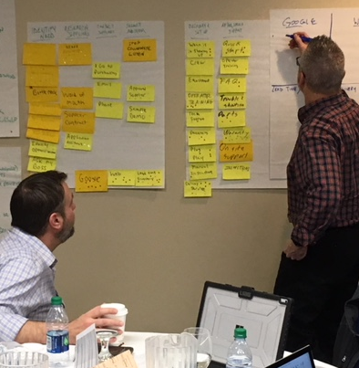
Determine the moments of truth.
STEP 4
The hardest part of the exercise is determining all the moments of truth (MOT). These are the points in the customer journey when the customer has some sort of interaction with the supplier. These moments of truth should be determined within each of the major stages of the customer journey as identified on the spine. Typically people write down the moments of truth on post-it notes and stick them below the headings of the spine which are listed on flipcharts. People should be encouraged to list as many MOTs as possible at this stage. The post-it notes are tidied up later into an Excel chart as in the example below (it should be noted that many more moments of truth were mentioned but have been cropped):
Awareness | Interest | Decision | Service set-up | Service delivery | Relationship strengthening | Concern | Leave | Return
How customers become aware of Company X | How customers become interested in doing businesses with Company X | The things that help customers make the decision to do business with Company X | What Company X does when setting-up a new customer account | The day-to-day elements involved in the delivery of the agreed service | What Company X does to develop on-going relationships and delight its customers | How Company X deals with concern and complaints | What Company X does when a customer wants to leave | How we win back previous lost customers
Trucks / Livery | Prospect material | Proposal / presentation | Customer site visit | phone / fax / email for order | Additional product installs | Receiving complaints | Leaving phone call | Prospects lists
Brands - portfolio | Promotional offers | Face-to-face visits | Customer site assessment | Customer places order | Customer training | Following up complaints | Stop ordering altogether | AM contact plan
Brand - umbrella / corporate | Existing product lines | Agreement | Welcome call | Customer places order - phone call | Business Dev. Manager | Price rise letter | Visit | Lapsed customer call
CSR | Customer Referrals | Negotiations | Account creation | Product delivery | Free service extras | Standard AM calls | Last chance' visit
Website | Key advisors | Site visit | Credit check | Couriers | Hospitality / contact | Missing deliveries | Debt recovery
Trade press | Cold calling | Ongoing contact | Credit application | Account manager visits | Key account programme | Failed deliveries | Debt chasing

Slide 7
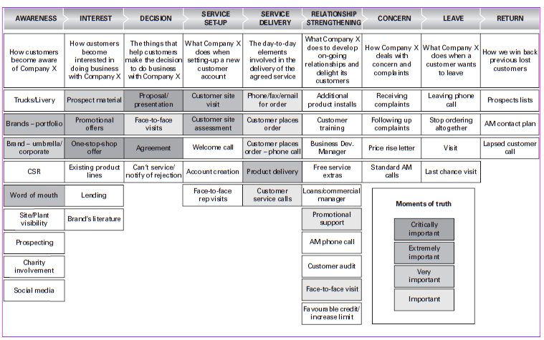
The importance of the moments of truth.
STEP 5
Once all the moments of truth have been established and listed as post-it notes, participants should be asked to mark the post-it notes using some notation which indicates the level of importance of the MOT at that stage of the journey. At a later stage when the map is being finalised, the moments of truth can be coded or shaded to indicate their importance, as per the example below:

Slide 8
Determine the pain and pleasure points.
STEP 6
In the same way that the moments of truth are categorised according to their importance, another notation should be found to indicate which of the moments of truth cause pain for the customer and which are please the customer. The example below shows pain points. A similar exercise would show pleasure points.
Awareness |  | Interest |  | Decision |  | Service set-up |  | Service delivery |  | Relationship strengthening |  | Concern |  | Leave |  | Return
How customers become aware of Company X |  | How customers become interested in doing businesses with Company X |  | The things that help customers make the decision to do business with Company X |  | What Company X does when setting-up a new customer account |  | The day-to-day elements involved in the delivery of the agreed service |  | What Company X does to develop on-going relationships and delight its customers |  | How Company X deals with concern and complaints |  | What Company X does when a customer wants to leave |  | How we win back previous lost customers
Trucks / Livery |  | Prospect material |  | Proposal / presentation |  | Customer site visit |  | phone / fax / email for order |  | Additional product installs |  | Receiving complaints |  | Leaving phone call |  | Prospects lists
Brands - portfolio |  | Promotional offers |  | Face-to-face visits |  | Customer site aseessment |  | Customer places order |  | Customer training |  | Following up complaints |  | Stop ordering altogether |  | AM contact plan
Brand - umbrella / corporate |  | Existing product lines |  | Agreement |  | Welcome call |  | Customer places order - phone call |  | Business Dev. Manager |  | Price rise letter |  | Visit |  | Lapsed customer call
CSR |  | Customer Referrals |  | Negotiations |  | Account creation |  | Product delivery |  | Free service extras |  | Standard AM calls |  | Last chance' visit
Website |  | Key advisors |  | Site visit |  | Credit check |  | Couriers |  | Hospitality / contact |  | Missing deliveries |  | Debt recovery
Trade press |  | Cold calling |  | Ongoing contact |  | Credit application |  | Account manager visits |  | Key account programme |  | Failed deliveries |  | Debt chasing
Advertising |  | Pre decision visits |  |  |  | Credit follow-ups / verification |  | Account manager phonecalls |  | Account manager |  | Incomplete deliveries |  | Find alternative supplier
Sponsorship |  | Hospitality |  |  |  | SLA / T&Cs |  | Invoice |  | Site visits |  | Late installs |  | Collection letter
Company reps |  | Warm calling |  |  |  | Handover |  | Credit notes |  | AM visit |  | Staff Churn |  | Account manager contact
Employees |  | Customer service |  |  |  | First order |  | Follow-up credit control |  | Forum venues |  | Credit control
Customer Referrals |  | Lending |  |  |  | Regular contact with AM or similar |  | Customer communication |  | Loans / commercial manager
Word of mouth |  | Brand's literature |  |  |  | Face-to-face rep-visits |  | Customer service calls |  | Promotional support
Site / Plant visibility |  |  |  |  |  |  |  |  |  | AM phonecall
Prospecting |  |  |  |  |  |  |  |  |  | Customer audit
Charity involvement |  |  |  |  |  |  |  |  |  | Face-to-face visit
Social media |  |  |  |  |  |  |  |  |  | Favourable credit / increase limit
Pain points
Extremely painful
Very painful

Slide 9
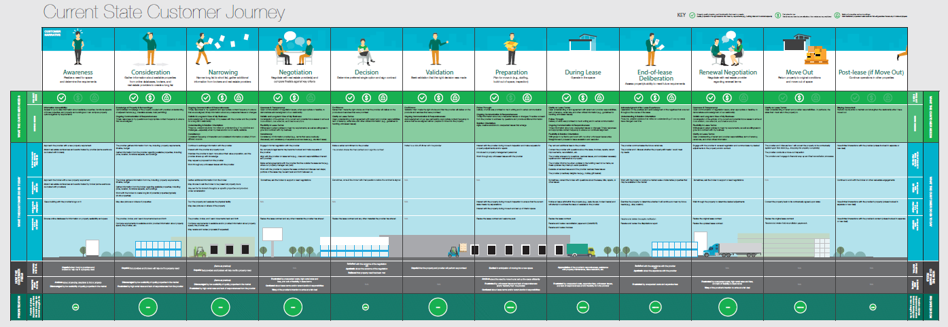
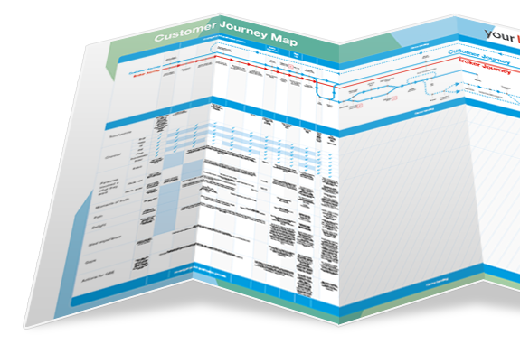
Validate the map.
STEP 7
Once the internal workshop has created the customer journey map, there will be some outcomes that can be actioned immediately. The workshop team will almost certainly have recognised things it can do to improve the customer journey. Some could be internal processes which are unseen by the customer. Other things can be plotted on the customer journey map besides moments of truth. For example, it may be interesting to identify the strength of customers emotions at different stages or their interactions with other decision-makers and influences. The customer journey map is a flexible model.
Not all customer journeys are validated with external customer interviews. However, it is good practice to interview in depth a number of customers (up to 30) to obtain a deeper understanding and check out the validation of the stages, the MOTs, the problems and possible solutions.
Once the customer journey map is finalised it can be given to a visualisation team who produce wall posters or flashcards to remind people in your company about the moments of truth and what actions are required.

Slide 10
Things to think about.
Define the spine of the customer journey. The starting point is nearly always awareness, and the last point could be return (ie indicating a lost customer returning to the fold)
For each stage on the spine of the journey list all the interactions (touchpoints) between the customer and the company
Go through every touchpoint and market according to:
Which are essential which are performed well from the customers point of view
Which are pain points for the customer
Which touchpoints customers would be prepared to pay for
Once the journey map is validated, turn it into an infographic and consider posting copies around the company to raise awareness of the importance of delivering excellent customer experience

Slide 11
Thank you.

