Slide 1
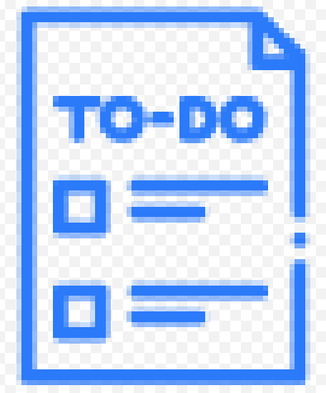
To-do Lists

Slide 2
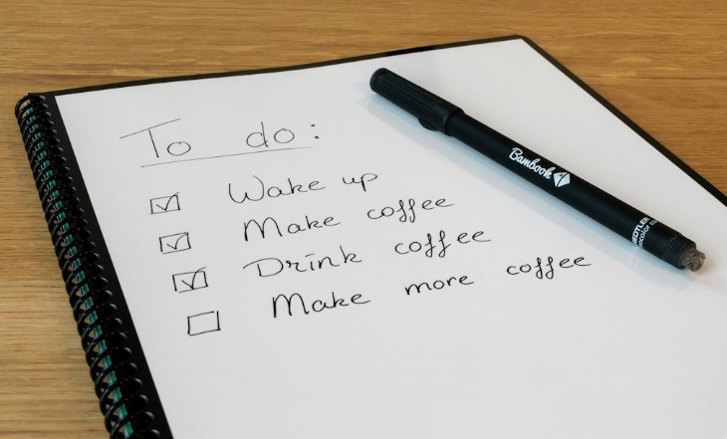
A business tool for improving productivity.
Use this framework to help you manage your time more effectively
Using to-do lists effectively can significantly increase productivity by helping you prioritise tasks and stay organised.
While to-do lists are a popular and effective productivity tool, different individuals find other methods more suitable for their preferences and working styles. These could include mind mapping, Kanban boards, and the Eisenhower Matrix.
The key to using a to-do list effectively is to make it a dynamic tool that aligns with your workflow and helps you manage your time efficiently.

Slide 3
Identify tasks and prioritise them.
Start by listing all the tasks you need to accomplish. Prioritise them based on urgency and importance. Decide which are urgent and which are important. The urgent/important tasks are the priority.
 | Complete these boxes
What do you have to do today?
What is the most urgent thing you have to do?
Can you get rid of some of the less important things quickly so that they are off your mind?

Slide 4
Break down tasks and be realistic about accomplishing them.
Break larger tasks into smaller, more manageable sub-tasks. This makes it easier to focus on one step at a time and reduces the feeling of overwhelm. Be realistic about what you can accomplish in a given time frame. Overloading your to-do list can lead to frustration and decreased motivation.
 | Complete these boxes
Don’t write down “to build a house”, write down “to find an architect”.
How many things do you have on the list? Have any been carried over from yesterday?
Is your list achievable?

Slide 5
Set times for carrying out the tasks.
Allocate time blocks for different tasks. This helps create a structured schedule and ensures that you allocate enough time for each task. Attach deadlines to tasks whenever possible. This adds a sense of urgency and helps you prioritise tasks accordingly. Regularly review your to-do list. Check off completed tasks, reassess priorities, and add new tasks as needed. This keeps your list up-to-date and relevant.
 | Complete these boxes
When will you carry out each task?
Consider using a digital scheduler for allocating the tasks?
Keep refreshing the list?

Slide 6
Don’t get distracted.
Identify and minimise potential distractions when working on tasks. This might involve turning off notifications, finding a quiet workspace, or using techniques like the Pomodoro Technique (a time management method that uses a kitchen timer to break work into 25 minute intervals, separated by short breaks). If your to-do list becomes extensive, categorise or label tasks based on projects, urgency, or type. This helps you quickly identify and focus on specific areas.
 | Complete these boxes
Where and how can you locate to get the tasks done?
Be prepared to limit the tasks you set yourself?
Can you delegate any of the tasks?
Reward yourself for completing a task?

Slide 7
Consider other tools.
Time Blocking: Instead of listing tasks, schedule specific blocks of time for different activities. This helps in focusing on one task at a time and can enhance time management.
Kanban Boards: Use a visual board with columns like "To-Do," "In Progress," and "Done." Tools like Trello or physical boards with sticky notes can help track the progress of tasks.
Mind Mapping: Create mind maps to visually organise thoughts and tasks. This can be helpful for brainstorming and planning complex projects. Software like XMind or MindMeister can be used for digital mind mapping.
Goal Setting Systems: Focus on setting and achieving specific goals rather than listing individual tasks. Systems like OKRs (Objectives and Key Results) or the SMART criteria (Specific, Measurable, Achievable, Relevant, Time-bound) can be effective.
Automation Tools: Use automation tools to streamline repetitive tasks. This could involve setting up automated reminders, calendar events, or using scripts to handle routine processes.
Task Management Apps: Explore task management apps that go beyond traditional to-do lists. Apps like Asana, Monday.com, or Jira offer more robust features for team collaboration and project management.
The Two-Minute Rule: If a task takes less than two minutes to complete, do it immediately. This rule, popularised by productivity expert David Allen, helps in quickly addressing small tasks without the need for a dedicated list.
Eisenhower Matrix: Categorise tasks based on urgency and importance using the Eisenhower Matrix. This system helps prioritise tasks into four quadrants: urgent and important, important but not urgent, urgent but not important, and neither urgent nor important.

Slide 8
Thank you.

