Slide 1
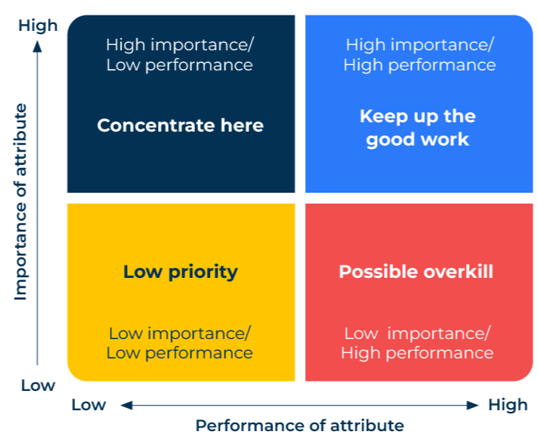
Importance Performance Matrix

Slide 2
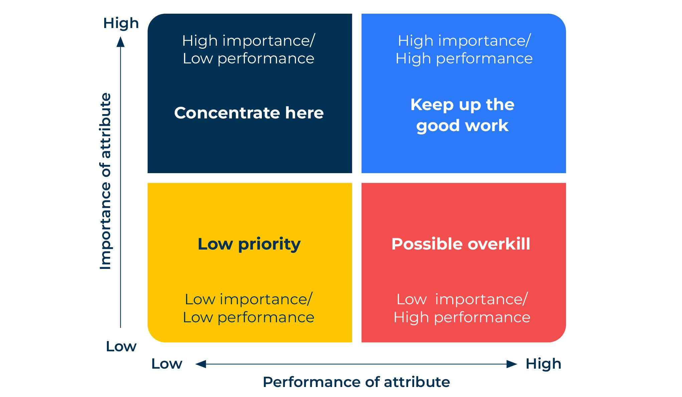
Working out how to be more competitive.
Use this model to improve the effectiveness of marketing programs
This framework by John Martilla and John James uses measures of attributes to find out what is important and how well the attributes are performed.
It is especially useful in assessing customer satisfaction.
Various elements of customer service are rated in terms of importance and satisfaction and analysed in a grid which shows where to improve performance.

Slide 3
Decide on the service factors to be measured.
Martilla and James based their framework on a car dealer. They listed 14 attributes that were measured in terms of importance and performance. Work out which attributes are important to your customers. Develop questions aimed at customers to find out (on a scale from 1 to 10) how important each attribute is to them and how your company performs on that attribute.
Job done right the first time
Fast action on complaints
Prompt warranty work
Able to do any job needed
Service available when needed
Courteous and friendly service
Car ready when promised
Perform only necessary work
Low prices on service
Clean up after service work
Convenient to home
Convenient to work
Courtesy buses and rental cars
Send out maintenance notices

Slide 4
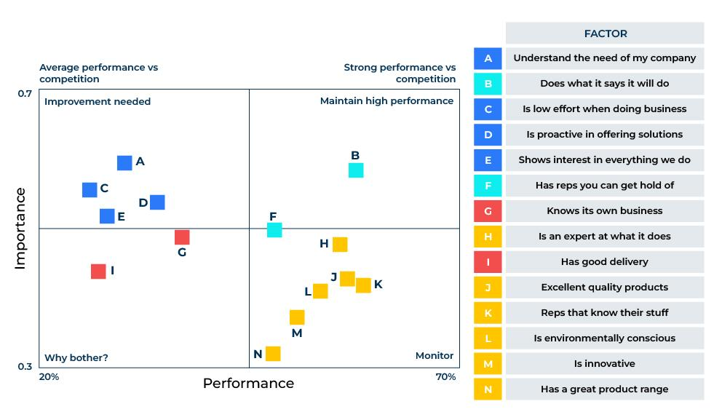
Things to think about.
What are the attributes that are considered important to your customers when they decide to do business with you?
What is the mean score of importance and performance on these attributes?
When plotted on an importance – performance grid, where do the attributes fall and what actions do they suggest?
How do these measures vary between loyal customers and not so loyal customers?
What strategies are needed to bring the not so loyal customers closer on board?
Example of an importance/performance grid from market research scores

Slide 5
Thank you.

