Slide 1
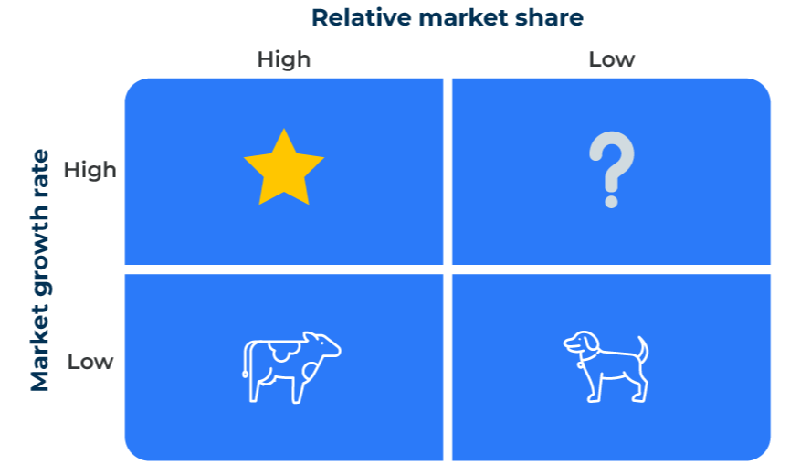
Boston Matrix

Slide 2
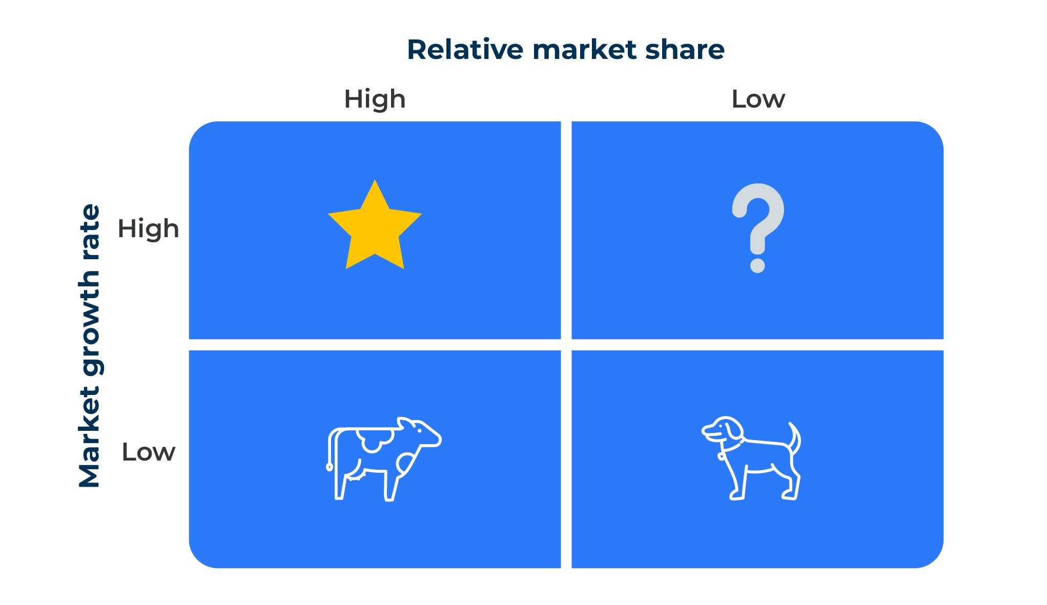
Plan a product/business unit portfolio.
Use this model to decide the future of your product or business portfolio
The Boston Matrix is useful when considering the future of a portfolio of products or strategic business units. The two axes of the matrix are the strength of the product/SBU as measured by its market share and its growth rate.
In the diagram high relative market share is on the left and low is on the right. Sometimes these positions are reversed with high relative market share on the right. It doesn’t matter as long as you have your products/SBUs under the right label.
You should first decide which market segment or target audience is relevant to the products or SBUs you are considering. It is the market share and growth within this segment that matters.

Slide 3
Define your market.
STEP 1
At the outset you should be clear as to the market you are addressing with the BCG matrix. For example, Kellogg's share of the "breakfast market" will be quite small whereas it share of the "breakfast cereal market" would be larger. Each share of the "cornflake market" would be larger still. So the first question is, "In what market are you really competing?". Do you make grass cutting machines or do you focus only on grass cutting machines for golf clubs?
We make grass cutting machines
We make mowers for non domestic use
We make mowers for golf clubs
Be clear which market you will address in the matrix

Slide 4
Calculate your relative market share.
Sometimes there is limited intelligence on market share. Precise data would be nice but it isn't absolutely necessary. It is relative market share we are interested in (and this is within the market sector where the product or business competes).
For each product group/business unit estimate whether the market share is:
Higher than most of the competition = High
About the same as most of the competition = Medium
Lower than most of the competition = Low

Slide 5
Calculate your market growth rate.
Future Growth Rates
Market growth rate can also be estimated. This is a strategy model and looks for performance over years rather than months. For each product groups/business unit estimate future growth rates over the next three years (here are some suggested breaks):
8% per annum or more = High
Above zero and below 7% per annum = Medium
Zero or negative growth = Low
Alternately, scales from 1 to 5 (5 = High) could be used to position the product groups/business units.

Slide 6
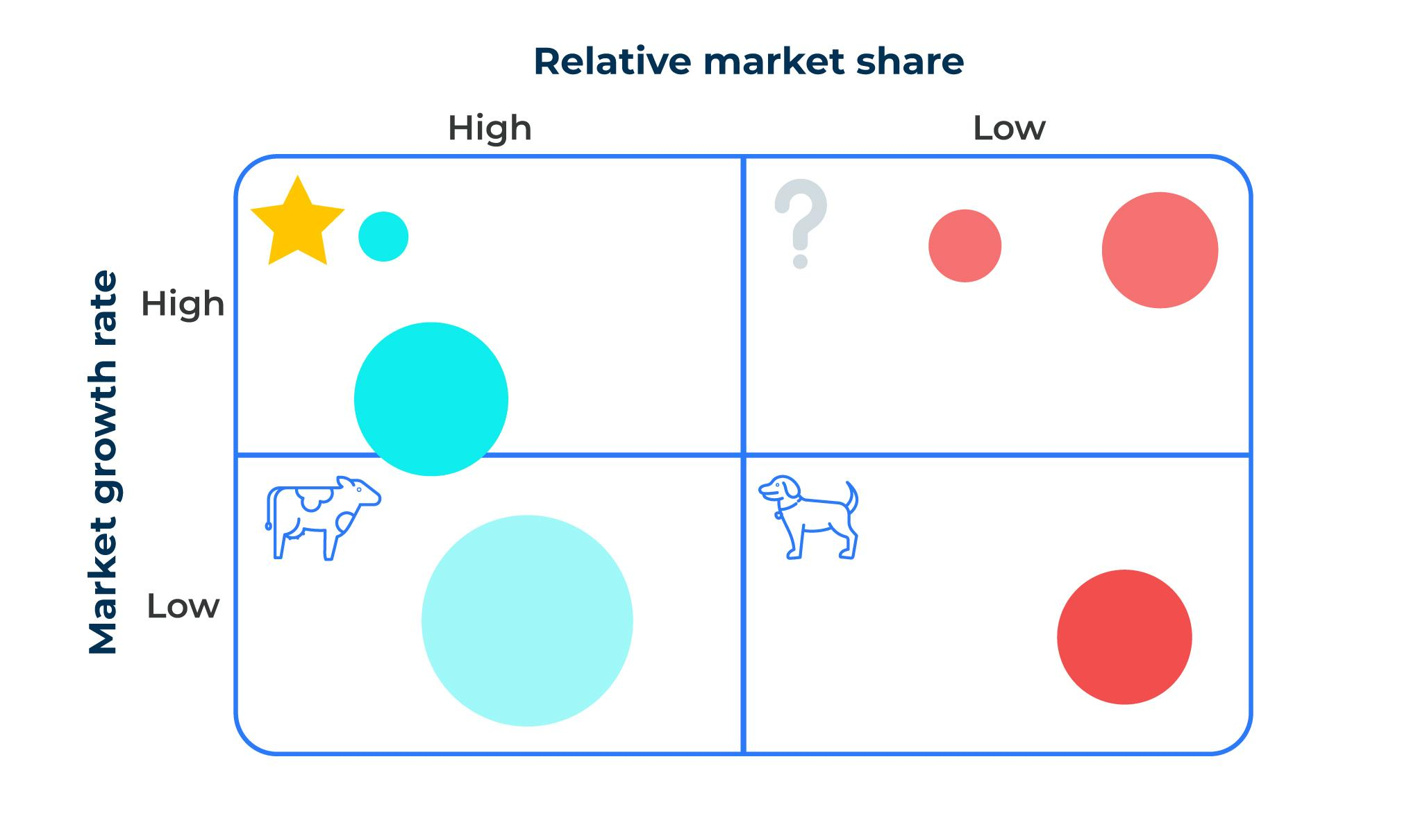
Plot positions of the products on the matrix.
STEP 4
Plot the various product groups/business units on the matrix. It is helpful to make the size of the circle approximately equal to the size (revenue) of the product group/business unit.

Slide 7
Interpret the position of each product.
STEP 5
The tool is intended to help strategic thinking, particularly to suggest an appropriate balance between products within a portfolio. There are no hard and fast rules though there are some generalities.
Stars are attractive because of their high share and high growth rate. However, they can burn a lot of cash. So too can question marks which haven’t yet achieved high market shares. This means that a balanced portfolio requires products that can generate cash to help future growth and this can come from cash cows and dogs. Too many stars would put too much strain on cash resources. Too many cash cows and dogs could indicate growth problems for the future.
Dogs have an unfortunate name, suggesting that they should be eliminated from the portfolio. A company in this quadrant could have a low market share and low growth rates and yet to be extremely profitable – think the iMac or the BIC disposable razor.
The key to interpreting the matrix is balance and direction. Are there too many or too few products in a quadrant? Can any of the products in a quadrant be moved – can question marks be turned into stars and can dogs be turned into cash cows?

Slide 8
Things to think about.
The key is to get a balanced portfolio
Bear in mind the importance of a balanced portfolio for your products and brands. A good number of “question marks” are needed in the hope that one or more will become “stars”. However, they are a drain on finances and are the reason why “cash cows” are so important to provide the necessary funding for future growth.
If it is difficult to place products/SBUs in the Boston Matrix, consider using the Directional Policy Matrix (another framework on this site).

Slide 9
Thank you.

