Slide 1
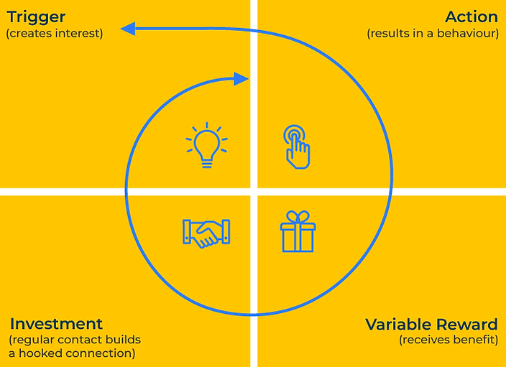
Hooking Customers

Slide 2
A business model to win more business.
Use this framework to attract customers for life
Nir Eyal's Hook Model is a framework designed to explain how products can create habit-forming experiences and retain users or customers over time.
The Hook Model consists of four key components:
Trigger,
Action,
Variable Reward,
Investment.
The Hook Model is often represented as a loop, emphasising the cyclical nature of habit formation. Users go through the Trigger-Action-Variable Reward-Investment loop repeatedly, and over time, a habit is formed. Successful products and experiences that leverage the Hook Model become integral to users' routines and lifestyles.

Slide 3
Create interest - Triggers.
You create interest with internal and external triggers. External triggers are cues in the external environment that prompt users to take action. They can be further classified into "paid triggers" (advertisements, notifications) and "earned triggers" (word of mouth, media coverage). Internal triggers are internal emotions or states that drive users to take action. Internal triggers are often linked to emotions such as boredom, loneliness, or curiosity.
 | Complete these boxes
What are the external triggers that prompt interest in your products/services? Which of these triggers are paid for and which are “earned”?
What are the internal triggers that prompt interest in your products/services? What are the emotions that drive people to want your products?
Which of the above are most important and why?

Slide 4
Make things happen - action.
The action phase involves the behaviour that the user takes in response to the trigger. This could be clicking a link, scrolling through a feed, searching for information, etc. The model emphasizes the importance of making the action as simple and frictionless as possible. The easier the action, the more likely the user is to engage.
 | Complete these boxes
What do people do when they are triggered to take action?
How easy is it for people to take action?
What could we do to make it easier for people to take action?

Slide 5
Rewards for action.
Users are more likely to be engaged if the rewards they receive for their actions are variable and unpredictable. Variable rewards trigger the brain's pleasure centres and create a sense of anticipation. Rewards can be both intrinsic (emotional satisfaction, sense of accomplishment) and extrinsic (points, badges, social recognition).
 | Complete these boxes
What rewards do people get for buying/using our products?
How variable are these rewards? How could we make them more variable?
How can we build the intrinsic and the extrinsic rewards for our customers?

Slide 6
Editable framework.
Trigger
(creates interest)
Action
(results in a behaviour)
Use this to add your own text and edit to suit your own branding
Investment
(regular contact builds a hooked connection)
Variable Reward
(receives beneﬁt)

Slide 7
Thank you.

