Slide 1
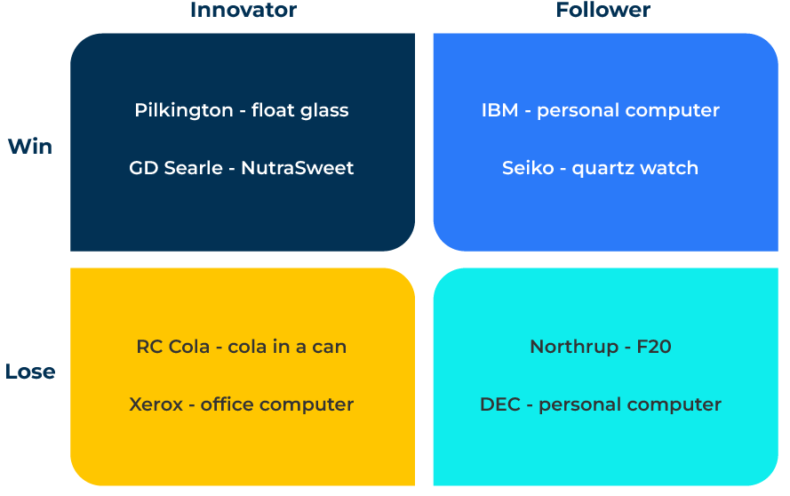
Teece Model

Slide 2
A business model to improve competitiveness.
Use this framework to get a competitive advantage from innovation
The Teece Model, developed by Professor David J. Teece, is a framework that focuses on dynamic capabilities and their role in shaping a firm's competitive advantage. Dynamic capabilities refer to a firm's ability to integrate, build, and reconfigure internal and external competencies to address rapidly changing environments. The Teece Model emphasizes the importance of dynamic capabilities in sustaining a competitive edge over time.
The model promotes strategic flexibility, emphasising that firms should be open to experimentation and willing to adjust their strategies in response to the market. This adaptability is crucial for navigating uncertainties and seizing new opportunities.
The Teece Model shifts the focus from static resources to dynamic capabilities, encouraging firms to continually innovate, adapt, and orchestrate their resources effectively in the face of evolving market conditions. This approach is particularly relevant in today's fast-paced and unpredictable business environment.

Slide 3
How does your company adjust to change?
Teece's model encourages firms to view competitive advantage through the lens of dynamic capabilities rather than static resources. This perspective is crucial in dynamic and uncertain business environments where adaptability and agility are essential. It highlights the importance of resource orchestration, which involves efficiently combining and reconfiguring a firm's internal and external resources. This capability enables a company to respond effectively to changing market conditions and technological advancements.
 | Complete these boxes
How agile do you consider your company? What evidence to you have of this agility?
Where do you have a competitive advantage? To what extent does advantage arise from your agility to change?
How attuned is your company to technological change? How much do you spend on R&D? What proportion of your products are “new” ie developed in the last three years?

Slide 4
Managing resources and innovation.
The model underscores the role of innovation and entrepreneurship in creating and sustaining a competitive advantage. It recognises that successful firms need to continuously innovate, not only in terms of products and services but also in the ways they organise and manage their resources. Teece emphasises the uniqueness of a firm's capabilities and the idea that competitive advantage is often firm-specific. This means that a one-size-fits-all approach may not be effective, and firms need to tailor their strategies based on their unique set of resources and capabilities.
 | Complete these boxes
On a scale from 1 to 10 how entrepreneurial is your company? What is the evidence for this?
How are staff encouraged to take risks and do new things?
Which competitors are successful at quickly adjusting to market changes? How do they do this?

Slide 5
Adapting to change in the long term.
The Teece Model acknowledges that industries and markets are subject to rapid and unpredictable changes. Firms must possess the ability to adapt to these changes through continuous learning, innovation, and the ability to reshape their capabilities to stay competitive. Teece argues that competitive advantage is not only about current efficiency but also about the ability to sustain and enhance competitiveness over the long term. Firms that can build, deploy, and adapt their dynamic capabilities are more likely to achieve sustainable success.
 | Complete these boxes
What changes are taking place in your market? Which of these changes can you identify as opportunities?
How is your company learning from innovation and change?
What evidence do you have that your company places a premium on adaptation to change? Eg not cutting R&D when profits are squeezed.

Slide 6
Plot your position on the grid.
Now think about where your company and other companies in your market sit on the grid. Which are innovators and which are followers and which companies are winning and which are losing?
How can your company move into the northwest corner of the grid? Which companies does it have to beat to do so?
What resources or changes within your company are necessary to establish a position for the long term in the northwest corner?

Slide 7
Editable framework.
Innovator
Use this to add your own text and edit to suit your own branding
Follower
Win
Lose

Slide 8
Thank you.

