Slide 1
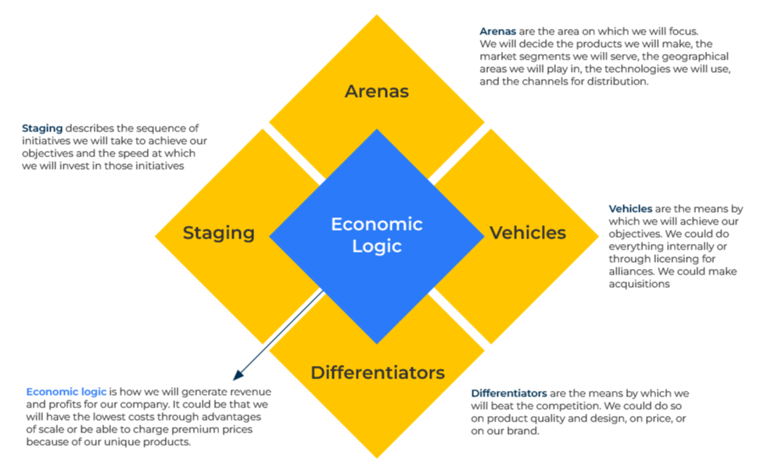
Strategy Diamond

Slide 2
Choices to be made when developing a strategy.
Use this model for entering new markets
The framework was proposed by Donald Hambrick and James Fredrickson in an article called "Are you sure you have a strategy?" in Academy of Management Executive in 2001. It is based on 5 choices that can be made about a business seeking to expand.
The framework recognises that a number of choices have to be made if a company wants to grow. Decisions have to be taken on what to do and equally what not to do if the strategy is to work. An attraction of the model is its simplicity which means it can be used at any level in an organisation
The Strategy Diamond has five interrelated components

Slide 3
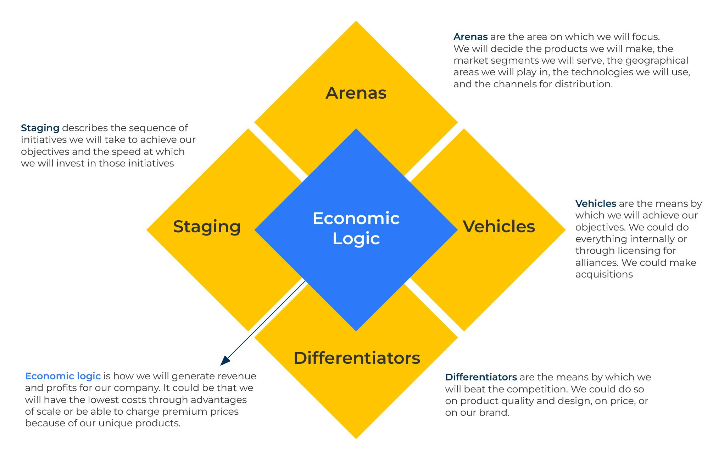
The choices to be made - arenas.
Arenas determine the products that will be made and the segments that will be served
The arenas are the options of where the company can be active. It is its area of focus. For example a company could produce different products or operate in different geographies, segments or channels to market. In developing a strategy it is necessary to decide in which arena the company will compete. The challenge is to focus on that (or those) that offer the greatest opportunities and which fit most neatly with the company’s capabilities.
.

Slide 4
The choices to be made - differentiators
Differentiators show how the company will succeed against competition
The framework then considers how the company can compete in the market place. This is critically important because whatever is selected here will be the means by which the company will attempt to beat the competition. It could differentiate itself on product quality or design, on price or on its brand. This part of the diamond has similarities to Porter’s generic strategies as it demands consideration of what will draw customers to the company and that will enable it to beat the competition. Again there are choices. Do you focus on such as superior quality, attractive price, image or speed to market?
.

Slide 5
The choices to be made - vehicles.
Vehicles determine how the offer will be produced and served to the market
Vehicles are the means by which the company will achieve its objectives. For example, it could decide to do everything itself or it could work with external vehicles such as franchises, licensing or acquisitions. Much will depend on its core competences.
.

Slide 6
The choices to be made - staging.
Staging describes how the strategy will be rolled out.
The strategy has to be launched and this is likely to be in stages. The staging component considers the sequences of launch steps and the speed with which these will be applied. This isn’t always easy. On the one hand there will be pressures to move quickly and take advantage of opportunities and on the other hand it is sometimes important that a company paces itself and does not rush into implementation.
.

Slide 7
The choices to be made – economic logic.
Economic logic explains how the company will generate revenue and profits.
The aim of the strategy is to make a profit. The economic logic part of the diamond shows how the pieces fit together to deliver a suitable profit. This may be achieved by economies of scale and low-cost or premium pricing based on any special product advantages.
.

Slide 8
Things to think about.
What are the major changes taking place in the market in which you operate? How does your strategy fit with these?
What are your key resources? Does your strategy fit with these?
What are the important differentiators that separate you from the competition? How will you sustain them?
Does everyone within your organisation know the strategy? Are they all aligned with it?
Do you have sufficient resources to pursue your strategy?
Is your strategy implementable? Where within your organisation could there be any weaknesses that could stop you achieving it?

Slide 9
Thank you.

