Slide 1
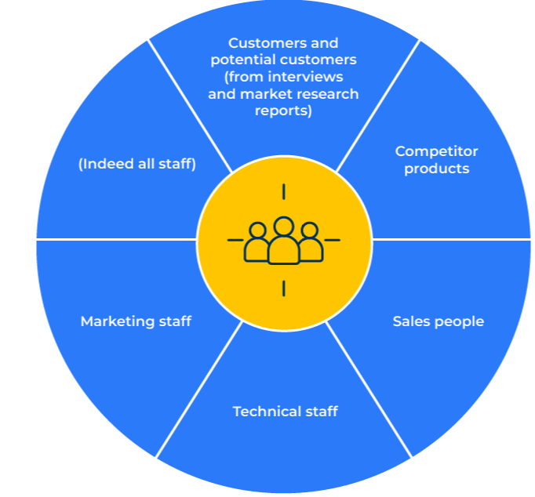
Customer Value Proposition

Slide 2
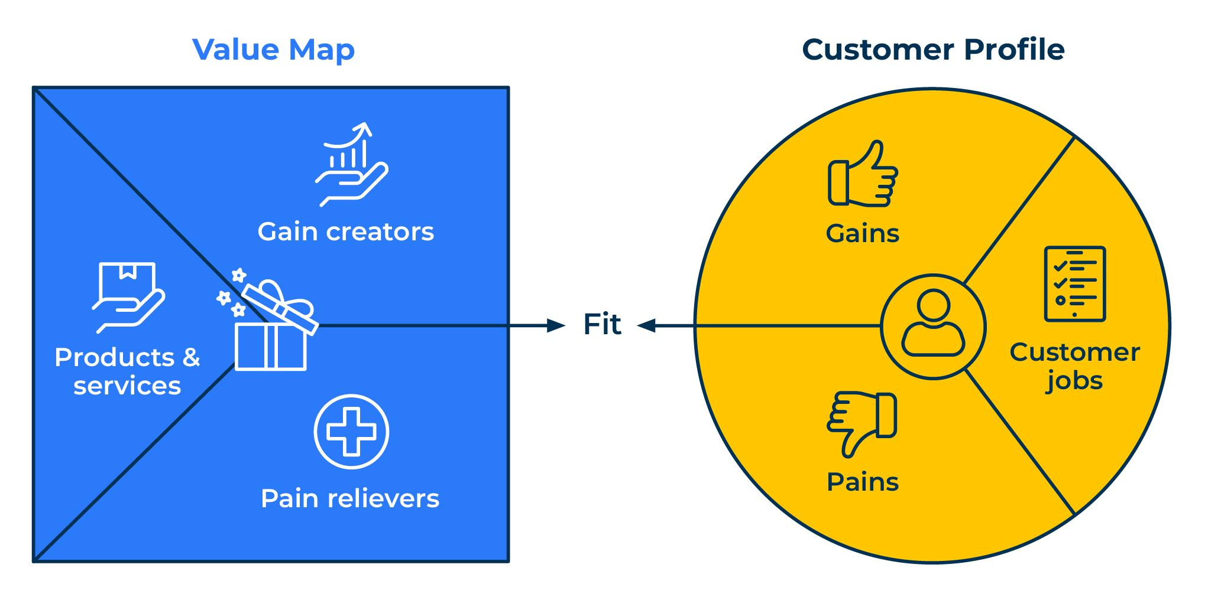
For creating a compelling purchase motive.
Use this model to build a strong message that attracts customers to your products.
In most markets, customers face a choice of alternative products and services. Many of these products and services fulfil similar needs. Customers need a reason to buy your product (or service) rather than any other. This reason could be tangible and logical or intangible and emotional. A good customer value proposition focuses on the main factors that drive customer choice.
Buyers of products look for something that will solve their problem (remove their pain), or help them benefit (provide a gain), or help them achieve a goal. Suppliers of products often ignore this and simply concentrate on trying to persuade a buyer to buy what they want to sell. The best way is to recognise the requirements of the customer and promote a product as something that will help relieve the pain, provide a gain and, of course, deliver a product or service that works. This is the fit we are looking for.

Slide 3
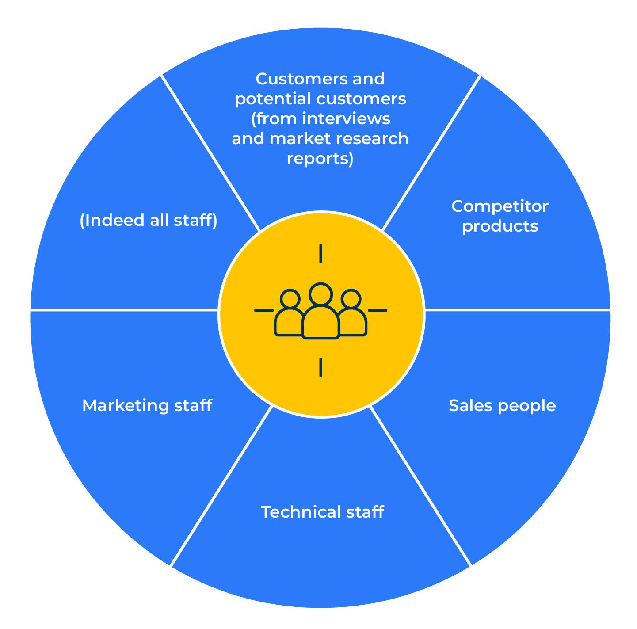
Consider all sources of intelligence.
In building a customer value proposition consideration should be given to all sources of intelligence:
Customers and potential customers (from interviews and market research reports)
Competitors products
Salespeople
Technical staff
Marketing staff
(Indeed all staff)
Customer value propositions are best built in workshops where representatives of different parts of the company can come together to debate the subject. It is possible that the workshop will find that there is a current customer value proposition and one that would be more desirable (a future customer value proposition).

Slide 4
Ask these important questions.
STEP 1
The starting point for building a customer value proposition is to listen to customers and potential customers. It is worthwhile asking customers (and potential customers) in a particular segment the following questions:
Why have customers bought your product in preference to one from another company?
Why have people who have bought a competitor’s product in preference to yours done so?
What in particular do they like about your product?
What would they change about your product if they could?
What part of your offer are people prepared to pay most for?
How different is this part of your offer to that provided by other companies?
How loyal are people to the product that they buy from you?
What drives that loyalty?
Answers to these questions together with everything else that is known about customers’ needs, wants and competitors’ products should be brought to the workshop.

Slide 5
Build personas – the target market.
STEP 2
We don’t sell to companies, we sell to people in companies. These are real people and there will be a number of them in the decision-making unit. In workshop mode consider all the people in the DMU and indicate the influence they have on choosing a supplier. We are trying to find out the key decision maker.
Titles of people in the DMU | % of influence they have on supplier choice
Total | 100%

Slide 6
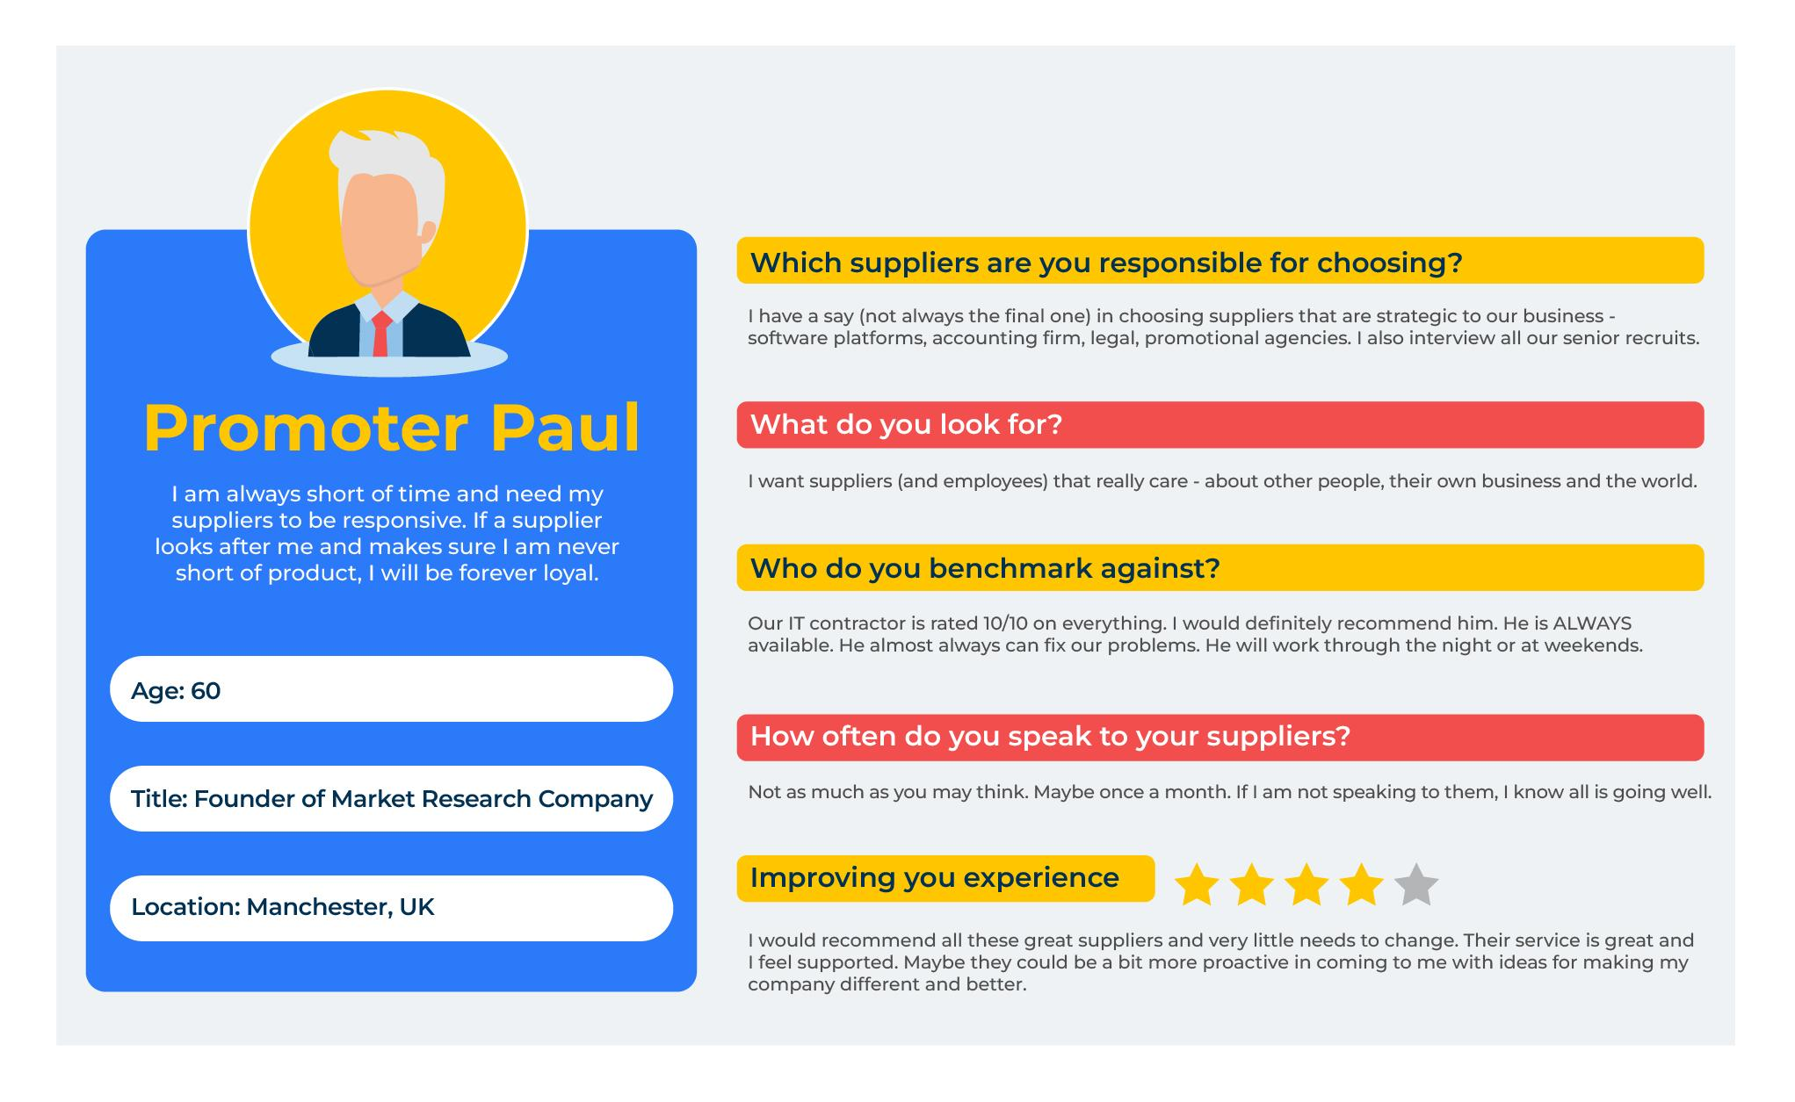
Build a portrait of the decision makers.
STEP 3
For the people who are the decision makers, we need to understand what makes them tick. We will start by giving each person a name and demographics.
Of course, there will be some generalisations in doing so but that doesn’t matter. We will be getting somebody rather than just anybody in our sights.

Slide 7
Identify the needs of decision makers.
STEP 4
And crucially, we want to know the different needs of the decision makers. This is a topic that requires considerable thought. We know the superficial needs are price, quality, delivery and availability. We want to get deeper than this and understand exactly what people value from the most important things to the little things that might make a difference. For each decision maker:
Questions | Answers
What are the primary needs of each person? Rank importance or score out of 10.
What are the unmet needs of each person or those needs that are not totally fulfilled?
What would be the “nice to haves” that would make each person feel better?

Slide 8
Compare your offer to the competition.
STEP 5
In workshop mode, compare the primary needs of customers, unmet needs or nice to haves with the products offered by competitors. Assign a score against each company/product to show to what extent it meets customers’ needs.
Needs | Our company (Score out of 10) | Competitor 1 (Score out of 10) | Competitor 2 (Score out of 10) | Competitor 3 (Score out of 10)
Primary needs: ____________ ____________ ____________ ____________ ____________
Unmet needs ____________ ____________ ____________ ____________
Nice to haves ____________ ____________ ____________ ____________

Slide 9
Plot customer needs against competitive advantage.
STEP 6
Distil all you have considered into 5 key needs. Now, take all the benefits and position them in the grid according to our comparative advantage and the importance to the customer.
Whatever is in the boxes in this shaded area is a candidate for your CVP
Our comparative advantage (5 is best)
 | 5 | 4 | 3 | 2 | 1
5
4
3
2
1
Importance to customer (5 is most important)

Slide 10
Build an elevator pitch.
STEP 7
The mistake most people make when developing CVPs is to throw everything and the kitchen sink into it. We must be strict and only include things that our customers value and where we are superior. The key is to make the CVP pithy. It should be short, snappy, and something that can be communicated in the few seconds we have if we are in an elevator pitching to an important prospective customer in our segment. Build an elevator pitch using the following framework.
Headline | The Elevator pitch
Target audience | For you dear customer…
Value | …we know you value xxx…
Superior | …and our product is the best on the market because xxx…
Profit | … which means you will benefit by xxx…..
Call to action | …let me suggest the next step is xxx.

Slide 11
Pass the CVP through the 3D test.
STEP 8
We need to constantly challenge the CVP to make sure that it delivers. Here is a chance to improve it by putting it through the 3D test. If it gets a score of less than 8/10 on any of the 3Ds, work on the CVP to improve it.
To what extent is the CVP | Score out of 10 | In what way is it…..?
Desirable (does it meet what people need?)
Distinctive (in what way does it stand out from other companies’ CVPs?)
Defensible (what “proof points” have we got that it will do what we say?)

Slide 12
Launch, monitor, adjust.
STEP 9
And now the hard work - implementing the new CVP. How are you going to communicate it internally so everyone speaks the same language? How are you going to launch it to customers – what changes will need to be made to the website, ads, brochures and most important in a b2b environment, how will the salesforce use it? Who will take responsibility for launching the CVP in these different areas, what is the timetable, and what could potentially derail it?
Where the new CVP will be used | Who will manage and monitor the launch? | Deadline for launch | Potential barriers (and solutions)
The sales force
Website
Marketing materials
etc

Slide 13
Things to think about.
The key to developing a good value proposition is to understand your customer. Make sure you know your customers’ pains, gains and needs.
Have in mind a very clear persona of the target for your customer value proposition
when developing your customer value proposition, focus on just one or two of the most important benefits of your product. Don't present the customer with a laundry list that will dilute the importance of all the attributes

Slide 14
Thank you.

