Slide 1
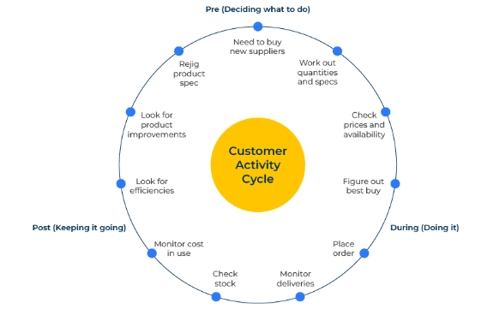
Customer Activity Cycle

Slide 2
Three stages in building loyalty.
Use this model to lock in customers and give them more value
The customer activity cycle originated with Sandra Vandermerwe, a professor of international marketing and services at the University of London's Imperial College. The framework suggests that an end user of a product works through three stages:
The PRE stage: this stage is full of decisions. Here the customer is working out what the problem is and deciding what to do.
The DURING stage: now the end user is “doing things”. In this stage it is important that the supplier has processes in place that can deal with problem solving.
The POST stage: winning the customer is only half the battle. It is important that the customer stays loyal and it is in this POST stage that loyalty is created.

Slide 3
Identify moments of truth and then lock customers in.
The starting point of the customer activity cycle is to identify key moments of truth at different stages of interaction with the customer. A moment of truth is that point when a customer engages with the brand and when the interaction causes the customer to form an opinion about it.
It is now necessary to work out what activities are needed to meet customers' needs and offer more value.

Slide 4
Things to think about.
Who are the end users of your products or services?
What do you know about the engagement of your offer with end-users in the PRE stage (when they are deciding what to buy), the DURING stage (when they are making the purchase), and the POST stage (when they are using the product)?
In each of these stages, what attributes of your offer are used and valued by end-users?
What attributes of your offer are not used am therefore junk to end-users?
How can you change or add to your offer to make it more appealing to end-users at different stages of the activity cycle?

Slide 5
Thank you.

