Slide 1
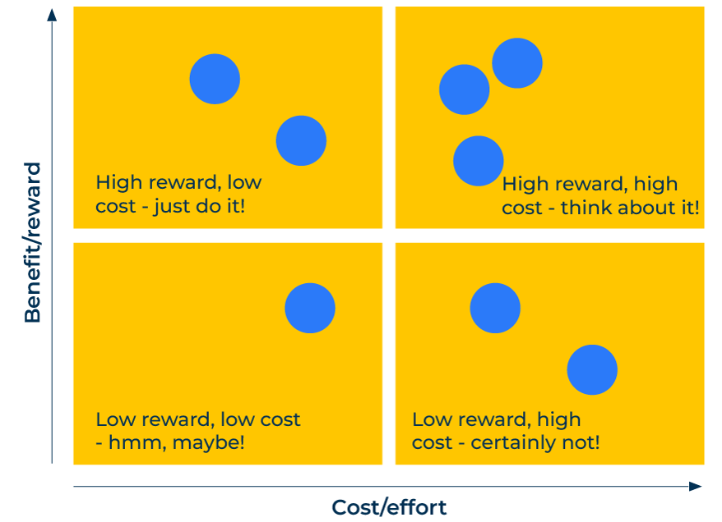
Cost Benefit Analysis

Slide 2
A business model to improve profitability.
Use this framework to determine priorities for different investments
Cost-Benefit Analysis (CBA) is a valuable tool in strategic planning, helping companies evaluate the potential benefits and costs of various courses of action. Integrating cost-benefit analysis into your strategic planning ensures that decisions are informed by a thorough assessment of economic viability and are aligned with your overall objectives.
The matrix opposite shows how if you consider the benefits against the costs, you can determine four paradigms:
Low cost, high reward – no brainer, just do it.
Low cost, low reward – maybe, it depends on what cost and what reward.
High cost, high reward – again maybe, depending on the costs and the rewards
Low reward and high cost – don’t bother.

Slide 3
Define your objectives.
Clearly define the strategic objectives you aim to achieve. Identify alternative strategies or projects that could help achieve these objectives.
 | Complete these boxes
What are you seeking to achieve? Is it market share, market leadership, cost advantages, brand recognition etc?
What are the various means by which you could achieve these objectives?
What specific actions will be needed?

Slide 4
List all costs and benefits.
Figure out the costs associated with each alternative, including initial costs and ongoing operational expenses. Identify and quantify the potential benefits, both tangible and intangible, associated with each alternative.
 | Complete these boxes
Make a comprehensive list of all the actions and specifically why they are required – ie what will be the benefits?
Make estimates of all the costs of the actions. What will be the initial costs, the ongoing costs, how long will those costs go on for?
What will be the benefits in terms of business efficiency, growth in the market, profitability? What will be the benefits to customers?
What will be the timing of the costs and the benefits? For those costs and benefits that stretch into the future, what discount rates should be applied to future costs and benefits to account for the time value of money?

Slide 5
Calculate the return on the investments.
Calculate the ROI for each alternative by dividing the net benefits by the total costs. This provides a percentage that represents the return on the investment. Determine the point at which the benefits equal the costs, known as the break-even point. This helps in understanding when the investment becomes profitable.
 | Complete these boxes
What is the return on the investment for each action?
How long will it be before the investment breaks even?
How could changes in key variables (e.g., cost, revenue, discount rates) impact the outcomes?
How do the various investments stack up against each other in terms of cost and benefit? Which actions should be actioned?

Slide 6
Share and monitor.
Clearly communicate the results of the cost-benefit analysis to relevant stakeholders. This transparency is crucial for gaining support and understanding for the chosen strategic direction. Continuously monitor and evaluate the actual costs and benefits as the strategy is implemented.
 | Complete these boxes
Who within the company needs to be involved in carrying out the analysis? Who within the company needs to approve it? Who needs to know about it?
There will be changes to the costs and the benefits so keep a track on them and review where necessary?

Slide 7
Editable framework.
High reward, low cost - just do it!
Use this to add your own text and edit to suit your own branding
High reward, high cost - think about it!
Beneﬁt/reward
Low reward, low cost
- hmm, maybe!
Low reward, high cost - certainly not!
Cost/effort

Slide 8
Thank you.

