Slide 1
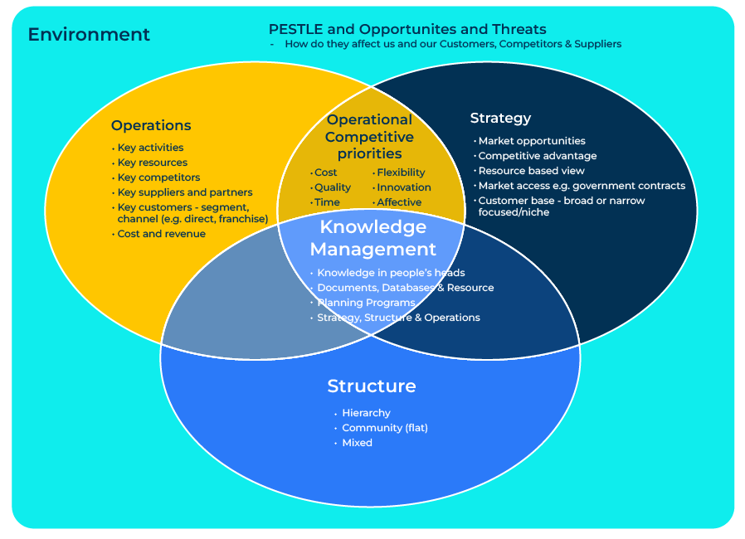
ESSO
Environment, Strategy, Structure, Operations

Slide 2
A business model to direct a strategy.
Use this framework of building blocks to develop a business strategy
The ESSO framework, also known as the Environment, Strategy, Structure, and Operations framework, is a model used to analyse and integrate key elements in the strategic management of an organization. It provides a comprehensive view of how external and internal factors influence each other.
The ESSO framework provides a structured approach to strategic management by emphasising the interconnectedness of environmental factors, strategic choices, organisational structure, and operational processes.
By using this framework, businesses can enhance their ability to align internal elements with external conditions and execute strategies effectively.

Slide 3
Research the environment.
Analysis: Assess the external environment by conducting a comprehensive analysis of factors such as economic conditions, market trends, technological advancements, regulatory changes, and competitive forces. Understand how these external factors may impact your business.
Strategic Implications: Identify opportunities and threats that arise from the external environment. Align your business strategy to leverage opportunities and mitigate threats. For example, if there is a technological shift, consider how your business can adapt and capitalise on emerging technologies.
 | Complete these boxes
Carry out a PEST (political, environmental, social and technological) analysis to provide a picture of the macro forces.
Carry out a SWOT (strengths, weaknesses, opportunities and threats) to establish the strategic position of your company.

Slide 4
Determine a strategy.
Formulation: Develop a clear and robust business strategy that aligns with your company’s goals and objectives. Consider how your strategy can capitalise on strengths, address weaknesses, take advantage of opportunities, and mitigate threats identified in the environmental analysis.
Alignment: Ensure that your strategy aligns with the external environment. For example, if there is a trend towards sustainability in the market, your strategy might include initiatives for environmentally friendly products or processes.
 | Complete these boxes
Where does your company sit in the market today? Where do you want the company to be in 5 years time?
How do you intend to get there bearing in mind the PEST and SWOT analyses you have carried out?

Slide 5
Look at the structure of your company.
Organisational Design: Align your company structure with your chosen strategy. Consider factors such as the level of centralisation, delegation of authority, and the coordination mechanisms needed to implement your strategy effectively.
Flexibility: Design a structure that allows for adaptability and flexibility, especially if your business operates in a dynamic environment. A flexible structure can better accommodate changes in strategy or shifts in the external environment.
 | Complete these boxes
How appropriate is the structure of your company to achieving its goals? Does it have the right plant, investment, people, management and skills to be successful?
How flexible is your company? How good is it to reacting to changes in the environment and in the market place?
Who is going to ensure that the company follows the dedicated goals and plans set out in the strategy?

Slide 6
Check out your operations.
Implement your strategy through effective operational planning and execution.
 | Complete these boxes
Are your day-to-day operations aligned with the strategy and are you moving in the intended direction?
Do you regularly assess and refine your operational processes to enhance efficiency and effectiveness?
Is there coherence and alignment among the environment, strategy, structure, and operations?
Does each element support and reinforce the others to create a holistic and integrated approach to strategic management?
Are there feedback loops that allow the company to continuously monitor changes in the external environment, assess the effectiveness of the strategy, and adjust both structure and operations accordingly

Slide 7
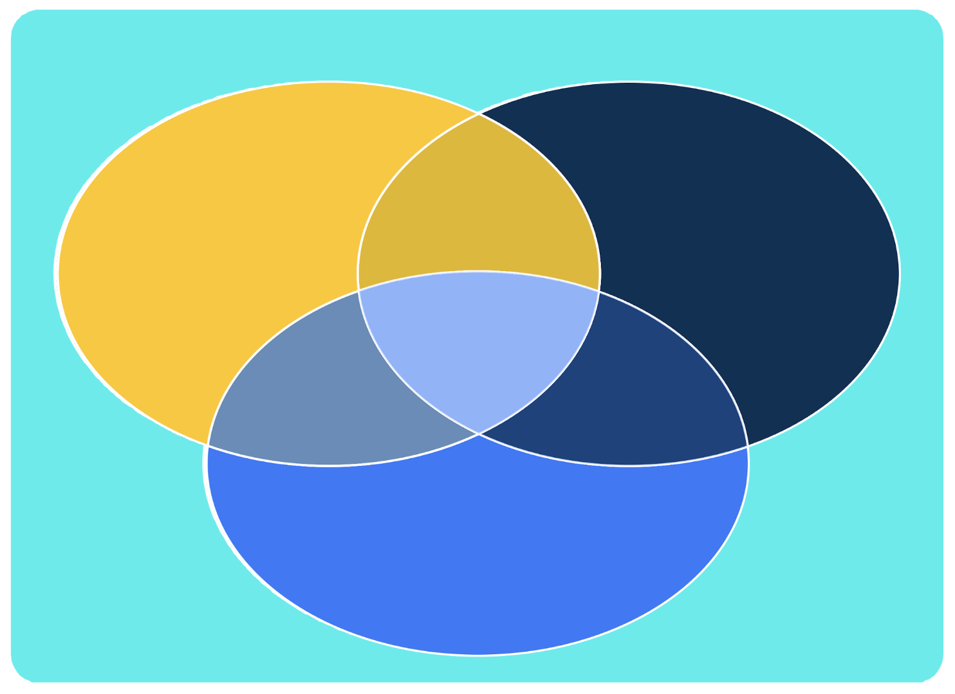
Editable framework.
Environment
PESTLE and Opportunities and Threats
-How do they affect us and our Customers, Competitors & Suppliers
Use this to add your own text and edit to suit your own branding
Operational Competitive priorities
Operations
Strategy
Knowledge Management
Structure

Slide 8
Thank you.

