Slide 1
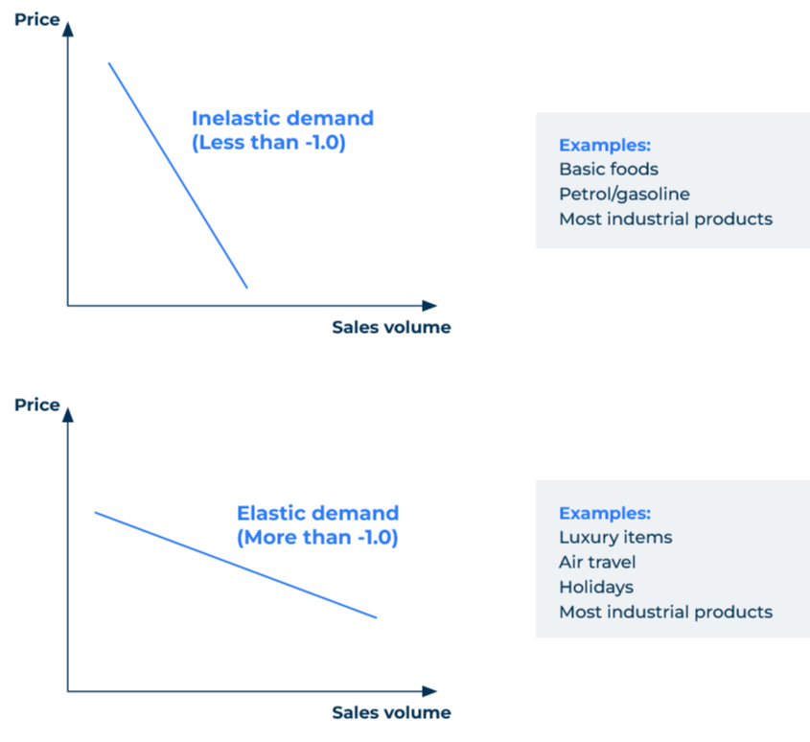
Price elasticity

Slide 2
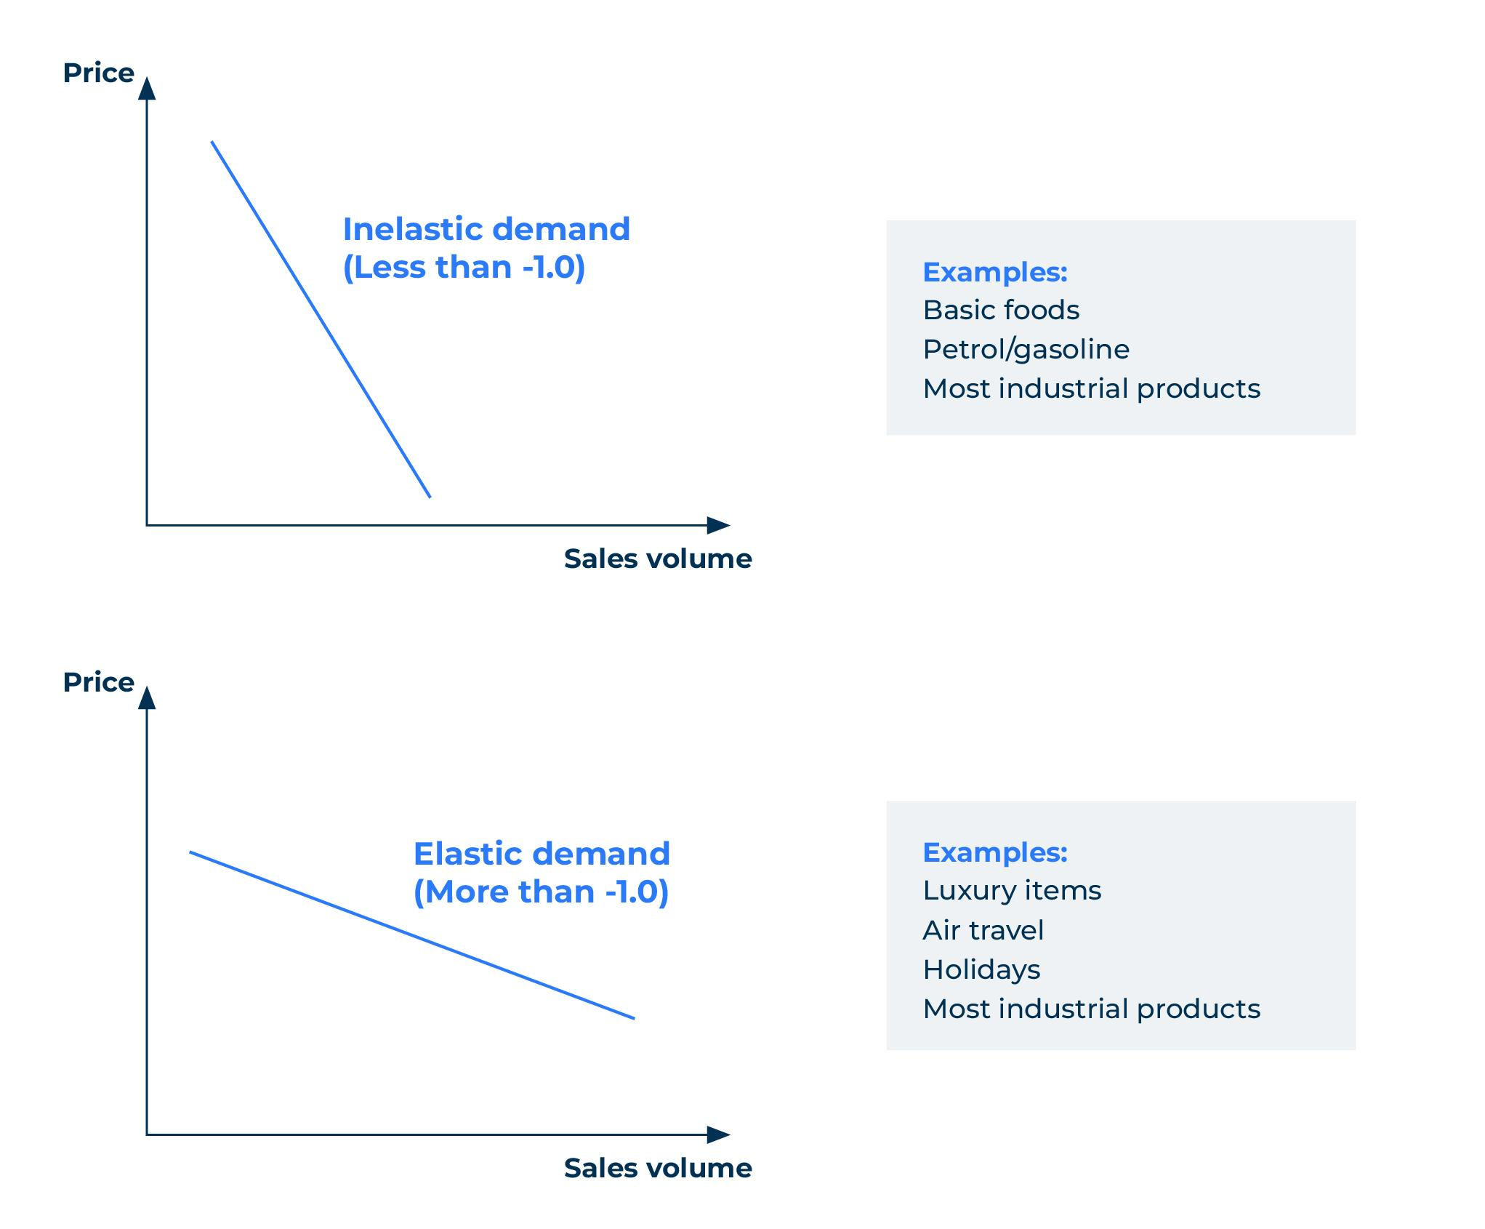
A model for working out price/volume relationships.
Use this model to find out if you could benefit from raising or lowering your prices
In general if you raise your prices you will sell less and if you lower them you will sell more. That is the theory. Few businesses know the relationship between price and volume.
If you raise your prices by 10% and sales fall by 10% this is regarded as a neutral position and referred to by economists as elasticity of demand of -1.0 (note that the minus indicates the negative relationship and the demand curve slopes to the right – see the diag).
If you raise your prices by 10% and sales fall by only 5% this is referred to as inelastic demand. In this case the price elasticity of demand would be -0.5.
If you were to reduce your prices by 10% and as a result sales increased by 15% the demand would be considered elastic and the elasticity of demand would be -1.5.

Slide 3
Quick check on price elasticity
A quick check on the price elasticity of your products can be achieved by considering the following statements. You have 50 points to spend across the different factors. Allocate the points according to the degree to which you think the statement truly applicable to your product:
 | Attributes of your products | Spend 50 points across these factors
1 | Luxury/indulgence product that isn’t absolutely necessary
2 | Product can be easily substituted for another
3 | Product has low switching costs
4 | Product is considered to be a commodity rather than differentiated
5 | Product is strongly supported by patents
6 | Product is strongly branded
7 | Product is written into specifications
8 | Limited availability of product
9 | Product is consumed not for its own sake but in the production of something else
10 | Strongly supported by personal service
 | TOTAL | MUST SUM TO 50
If points spent on attributes 1 to 4 is 25 or more the product is price elastic
If points spent on attributes 5 to 19 is 25 or more, the product is price inelastic

Slide 4
Calculating the price elasticity.
You can calculate the price elasticity for your products using the following formula:
Percentage change in volume
Price elasticity =
Percentage change in price
If you do not have real sales data to plug into this formula, consider asking a sample of customers and potential customers:
“Assuming the price of the product you currently purchase increases by 5%, how much more or less will you buy?” -10%, -5%, The same, +5%, +10%
And repeat the question for:
a price increase of 10%,
a price reduction of 5%
a price reduction of 10%.
This will generate data for calculating the price elasticity. Hypothetical questions of this kind are always subject to bias but they should give some indication as to the degree of price elasticity.

Slide 5
Things to think about.
Understanding the price elasticity of your product is vital. Many business to business companies are fearful of losing custom by pricing too high and so they undercharge. Use the checklist in the previous page to get a high level view of whether your product is elastic or inelastic and consider using research to give a more precise figure.
It should also be borne in mind that the price elasticity of your product will be determined by the degree to which you communicate its value. Differentiated products with strong brands tend to be inelastic and can command higher prices.

Slide 6
Thank you.

