Slide 1
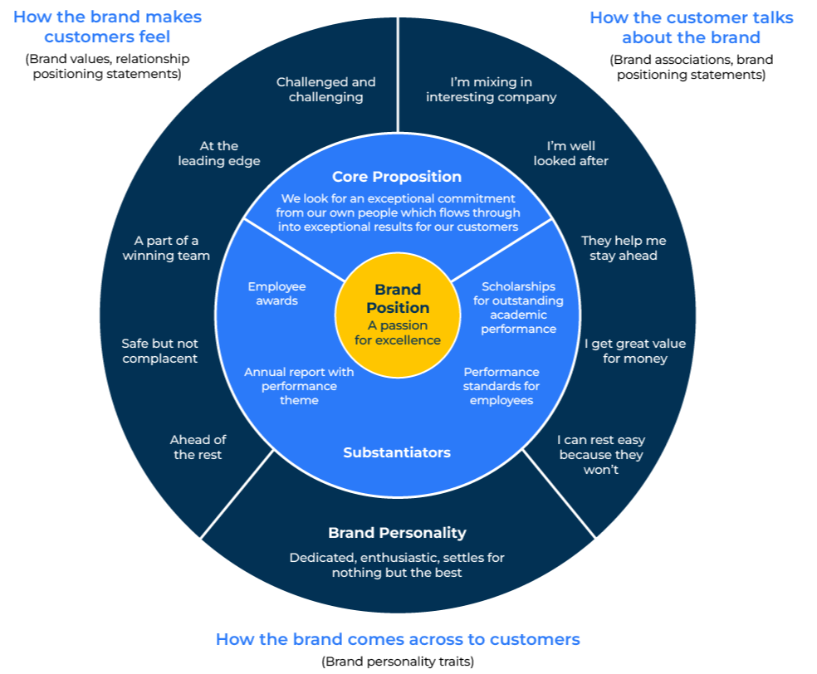
Bullseye Brand Positioning

Slide 2
Use your brand to strengthen your position.
Use this model to find the core values of a brand
In a world that is crowded with brands it is important that a brand stands out – in a good way. Cutting through the fog created by other brands and offerings isn't easy. A good brand occupies a clear and simple position in the minds of customers. And of course, the brand must deliver against its promise or people will go elsewhere.
The bullseye brand positioning framework brings together many elements of a brand to distil them into just a word or two that describes its essence – what it stands for. It is a framework to determine and develop a brand position. This brand position can be used to communicate it to everyone in the organisation so they know where it stands and its purpose. Importantly it is also used to position the brand in the shelf space of customers' (and potential customers') minds. The whole purpose of having a strong brand position is to ensure that the brand is distinctive, differentiated and desirable and so has a competitive advantage.
This is a flexible tool. What you are trying to arrive at is a mantra for your brand. Start broad and work your way into that understanding.

Slide 3
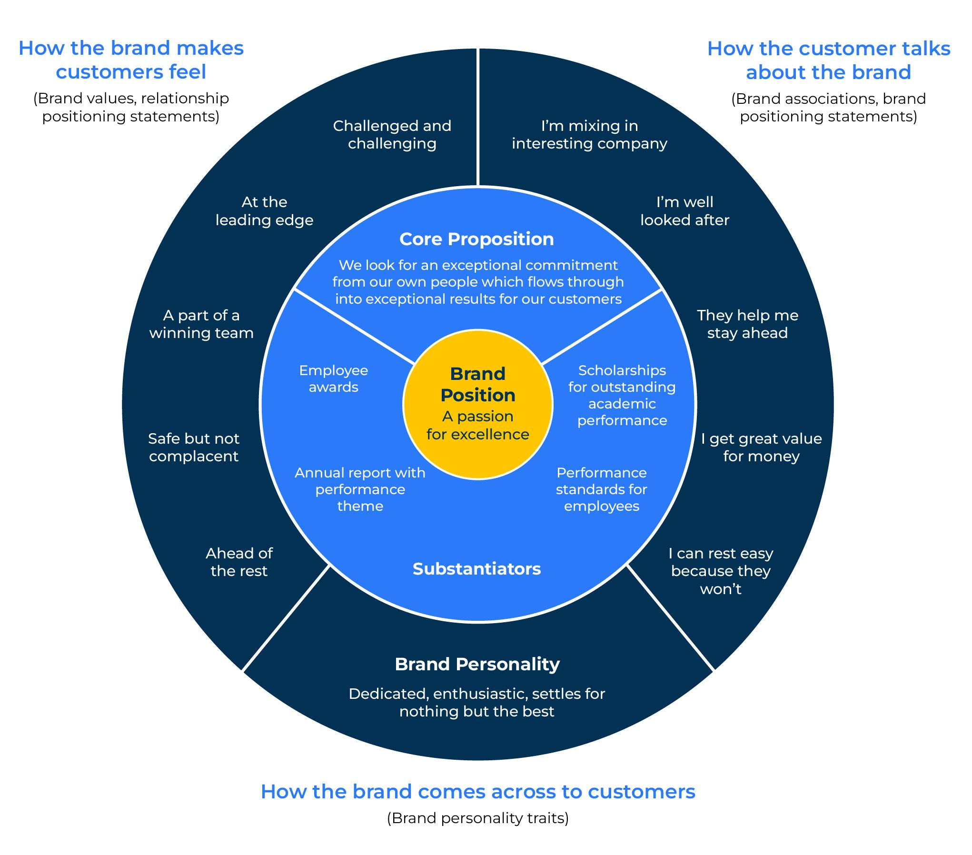
You are aiming for the centre.
The bullseye framework collects and analyses how customers feel about a brand, determines what makes it special, shows how the position can be substantiated, and distils it into just a couple of words – the brand essence or the brand mantra.
The steps outlined in the following pages show how to do so by starting on the outside and working to the centre
In the example opposite see how everything that is known about the brand feeds into the centre which states the brand essence.

Slide 4
Collect data on competitors and customers.
STEP 1
The first step is to find out how your brand is positioned against competitors and in the eyes of customers.
Collect all the logos of competitors and position them in groups on one page. Which are similar? How does your logo stand out and look different?
Now it is time to build the bullseye. You need to start by asking what customers and potential customers think of your company (ie the brand)? Crucially, how does your brand make them feel and how do they refer to the brand?
Two questions to ask customers/potential customers are:
When you talk about brand x, to a friend or colleague, what do you call it?
When you think of brand x, how does it make you feel?

Slide 5
Develop a brand personality.
A brand that is successful has a distinctive personality. This personality sets it apart from other brands. Using the intelligence you have collected on how your brand is different from the competition and what customers think about it, write down what do you believe to be the personality of your brand.
The personality of your company should refer to its characteristics and behaviour that are embedded within it. These are things that drive the values of the company and explain why it does what it does. It may be helpful to imagine that the company is a person in which case you could ask questions such as:
If the company was an animal, what sort of animal would it be? Why do you say this?
If the company was a person, what sort of person would it be - what would be its gender, age, where would it live, what is its family background, what are its aspirations, what type of car does it drive, what music does it listen to, what type of clothes does it wear etc?
If this company was a person and it left a room containing its friends and acquaintances, what would they say about the company now it has gone?

Slide 6
Develop a core proposition.
STEP 3
The brand needs a core proposition. This is a statement that shows the unique benefits that the company offers its customers. It shows how the company provides value to its customers and why it is better than its competitors.
Questions to ask here are:
When people buy your product what job is it fulfilling for them?
How will buying your product make life better for the customer?
Why should the customer buy from you and not your competitors?

Slide 7
Identify substantiators.
STEP 4
A brand is a promise to deliver certain values. This promise must be fulfilled otherwise customers will be disillusioned. A good brand should have indicators/substantiators that prove it is doing what it said it would do.
Imagine that you are in a court of law and have to present evidence that demonstrates that your brand is successfully delivering against its promise. What evidence would you present?
Other questions to ask are:
What are the awareness levels of your brand amongst different target audiences?
How satisfied are customers as measured by a Net Promoter Score or other customer satisfaction scores?
What internal metrics demonstrate that your employees understand your brand values?

Slide 8
The brand essence.
From all the work you have done you need to arrive at the centre of the bullseye with a short distillation of one, two or three words that describe the brand. This is the brand essence.
The brand essence isn‘t a tagline or something that will be shouted out in every promotion. Rather, it is a guiding principle for the brand.
This guiding principle should be shared with your advertising and promotional support teams who need to work to brand guidelines. Everything that is communicated about your company should speak to the brand essence.
This includes people within your company. They should understand the brand essence and your brand values. The way the phone is answered, the way emails are written, the way people think of customers’ needs should all bear in mind the brand essence.
If and when all the promotions and everyone within the company speak the same language about the brand, it will strengthen it and differentiate it from the competition. Customers will see the company as offering more than a product - they will be recognise values that come with the product and this will be manifest in premium prices or an increase in market share.

Slide 9
Things to think about.
Go back over some of the questions we have been talking about
Do you have a position for your brand at the present? Is this position the best one for the brand?
Why do you think people buy your product?
Having bought your product, how do you think they feel about it?
In what way do you think your product it seen to be different from the competition? In what way is it better? In any way is it thought to be worse?
If your brand was an animal, what would it be? If it was a person, how would you describe that person?
How would you describe the personality of your brand?
What single word or short sentence describe the essence of your brand?
What evidence do you have to substantiate that your brand perceptions are valid?

Slide 10
Thank you.

