Slide 1
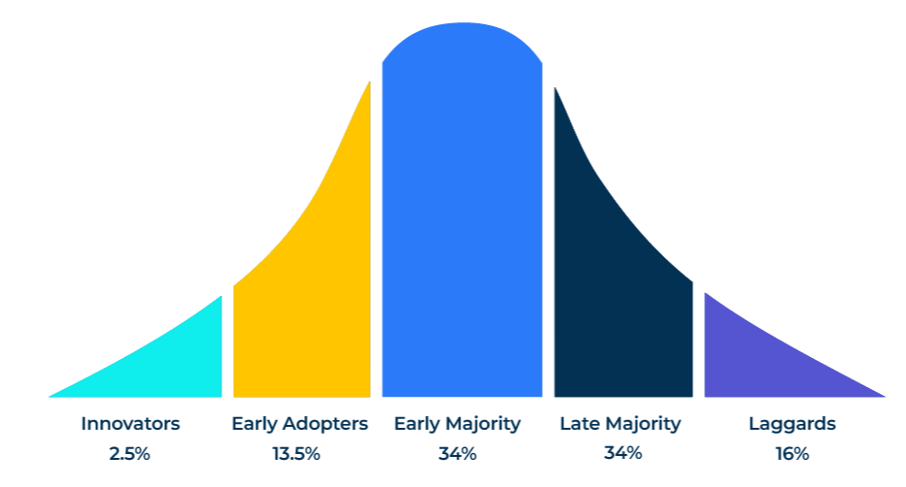
Diffusion of Innovation

Slide 2
For launching new products and services.
Use this model to find out the potential success of your new products and at which segment they should be targeted.
New products are not uniformly embraced by everyone at the same time. Some people are more attracted or more disposed to new products than others. Finding out who these people are can help a marketer when launching new products.
According to Everett Rogers people can be classified into five groups according to their reception of new products:
Innovators – always the first to want to own and sample new products.
Early adopters – following quickly behind the innovators these people are also very interested in new products.
Early majority – a large proportion of the market that turns to new products when they feel confident they will meet their needs.
Late majority – a large and sceptical group who will only use new products when they feel certain that they have been well tested.
Laggards – finally, people who will buy the new product when there are almost no other options.
Our aim is to devise questions that will classify people into these five categories in order to target the most receptive groups.

Slide 3
Devise the questions.
Sample a representative selection of your target audience. Ask the following questions which will position people according to Rogers’ five groupings:
Which of the following statements best aligns with your view on new technologies
New technology is important and I would be one of the first to use a new product or service (identifies innovators)
I may not be one of the first users, but I use new technology before most others (identifies early adopters)
I prefer to wait until the early problems are worked out (identifies early majority)
I am not in any hurry to buy or deploy the latest technologies (identifies late majority)
I would always wait as long as possible and only deploy new technologies when there is no alternative (identifies laggards)

Slide 4
Compare the results with benchmarks.
Now compare the survey results of your population with those of benchmark such as Rogers.
Ask yourself the questions:
Are there sufficient innovators and early adopters to make the launch of the new product worthwhile?
How much will it cost and how long will it take to reach and convert the innovators and early adopters?
Innovators
Early Adopters
Early Majority
Late Majority
Laggards
Laggards
Benchmark:
Rogers (1962)
2.5%
13.5%
34%
34%
16%
Your survey results:

Slide 5
Profile and target the receptive audience.
STEP 3
Build a profile of the innovators and early adopters and target them with appropriate messages. If you achieve a good penetration of innovators and early adopters you will cross the chasm and reach a mass market.
Defining characteristics of the target audience (Physical, emotional, psychological)
Basic needs | Unmet needs from the innovation
Key Demographic Characteristics
Example of customers

Slide 6
Things to think about.
A useful segmentation of your customers is to understand where they sit in terms of the diffusion of innovation. This will enable you to promote new products and services where they will be more readily received.
In B2B markets, radical innovations can take a number of years to gain traction.
Aim to get your new products accepted by opinion leaders who will influence the rest of the market.

Slide 7
Thank you.

