Slide 1
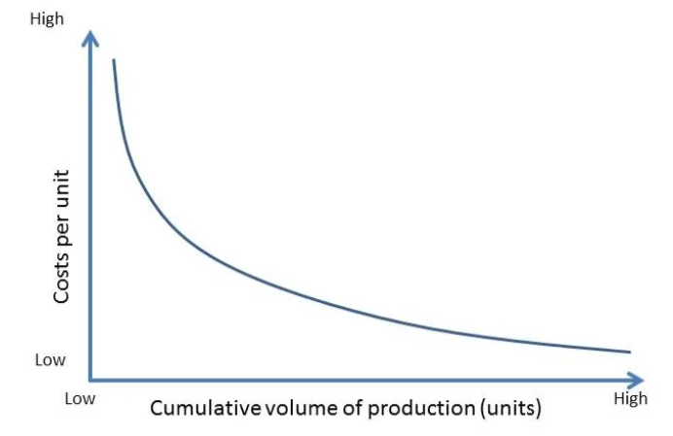
Experience Curve

Slide 2
A business model to improve cost advantage.
Use this framework to determine your pricing strategy
The Experience Curve, often associated with the learning curve, is a concept that suggests that as a company produces more units of a product or service, the cumulative production experience leads to improvements in efficiency and cost reduction. Leveraging the experience curve can significantly contribute to the execution of a business strategy.
The more a company produces, the more experience it gains in production processes, leading to increased efficiency and reduced costs. This learning effect can be a powerful driver for cost reduction.
As production volumes increase, the per-unit cost tends to decrease due to economies of scale. This reduction in average cost allows a company to offer more competitive pricing, contributing to strategic positioning in the market.

Slide 3
Pricing strategy.
Reduced costs from the experience curve can make products more price-elastic, meaning that demand becomes more responsive to price changes. This elasticity can open up new market segments or allow the company to capture a larger share of the existing market. The experience curve can support a penetration pricing strategy, where a company initially sets lower prices to gain market share rapidly. As costs decrease, the company can maintain competitive pricing while improving profitability. This can facilitate global expansion by making products more competitive in international markets.
 | Complete these boxes
What is your company’s pricing strategy? If you have a cost advantage is this used towards your company goals? Are these growth or profitability; short term or long term?
Who sets prices in the company? Who drives efficiencies? Is the strategy of the company to achieve global domination?
As your company becomes more global, how does the competition change?

Slide 4
Achieving price leadership and profitability.
The cost advantage gained through the experience curve can enable a company to become a price leader in the industry. This competitive pricing can attract price-sensitive customers and potentially drive competitors out of the market. By consistently reducing costs through experience, a company can maintain higher profit margins or choose to pass cost savings on to customers, depending on its strategic goals.
 | Complete these boxes
How do your costs compare with those of others in your industry – at home and overseas?
How are you achieving cost leadership? How easy is it going to be to keep cost leadership?
At the prices you can charge for your products, how profitable is your company?
Is your strategy to build market share through low prices or pocket the cash through higher prices? Which fits with your long term strategy?

Slide 5
Driving innovation.
The experience curve aligns with principles of continuous improvement and operational excellence. Companies can use the experience gained to implement Kaizen methodologies, streamline processes, and enhance overall operational efficiency. Experience doesn't only lead to cost reduction but can also drive innovation. With accumulated knowledge, companies can innovate in product design, manufacturing processes, and other areas to stay ahead of the competition..
 | Complete these boxes
How innovative is your company compared to the competition? How much of the innovation is driven by the experience curve?
Is the innovation in your company more about processes or about product improvements? How sustainable are these innovations?
To what extent is the company agile in its learning? Can it move quickly to adapt to changes in the market?

Slide 6
Editable framework.
Use this to add your own text and edit to suit your own branding
High
Cost per unit
Low
Low
Cumulative volume of production (units)
High

Slide 7
Thank you.

