Slide 1
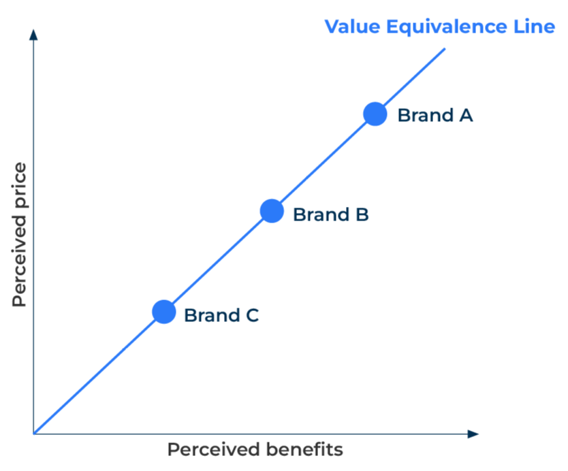
Value Equivalence Line

Slide 2
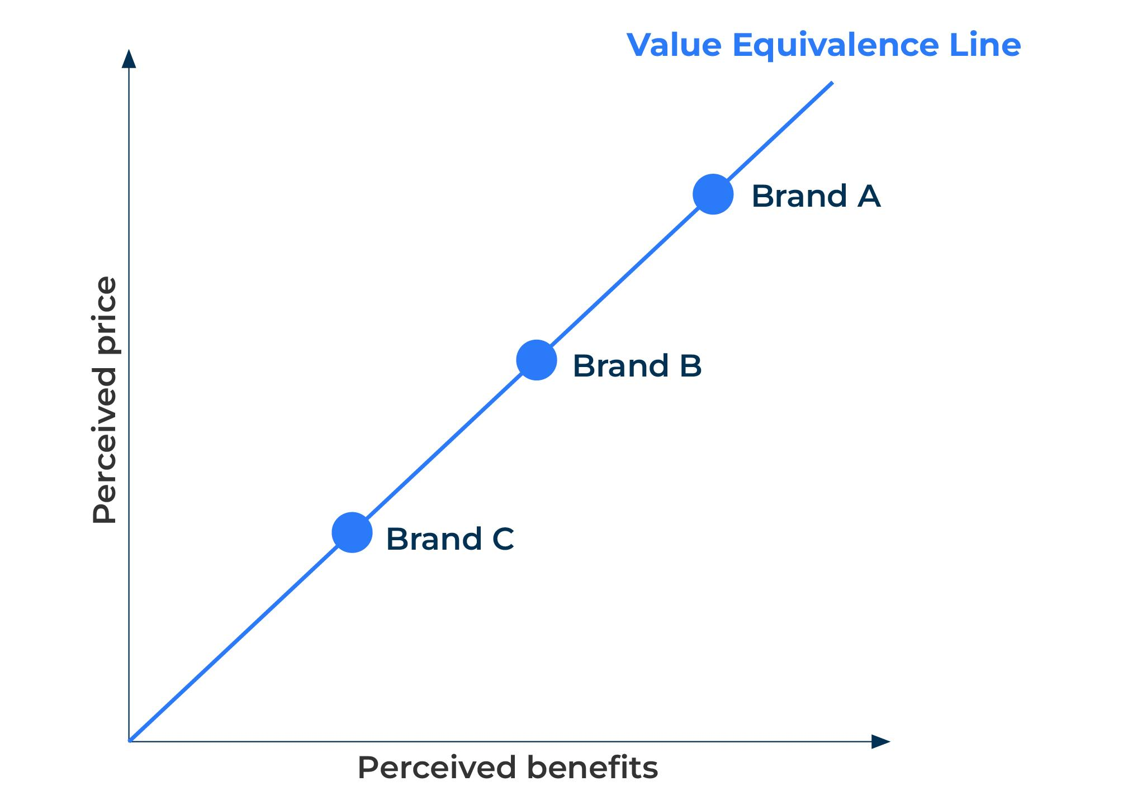
A to determine a price strategy.
Use this model to find out if your price and benefits are in line with market perceptions
Within any class of product there is likely to be a premium offer and an economy offer. The premium offer by its very nature will have more features and benefits than the economy offer and can be expected to have a higher price. Products or brands can be plotted on a graph in which the Y axis reflects the perceived price and the X axis the perceived benefits. The line that bisects the X and Y axis is the value equivalence line (VEL). This is illustrated in the figure opposite which shows a premium product (Brand A) a medium product (Brand B) and an economy product (Brand C).

Slide 3
Determine perceptions.
In order to establish a brand’s position on the value equivalence line ask customers/potential customers the following questions:
How would you rate this brand on the benefits you receive compared to the benefits you receive from other brands?
Significantly better
Somewhat better
Neither better nor worse
Somewhat worse
Significantly worse
How would you rate this brand on its prices compared to the prices of other brands?
Significantly better
Somewhat better
Neither better nor worse
Somewhat worse
Significantly worse
Answers to these questions can be plotted on a graph.

Slide 4
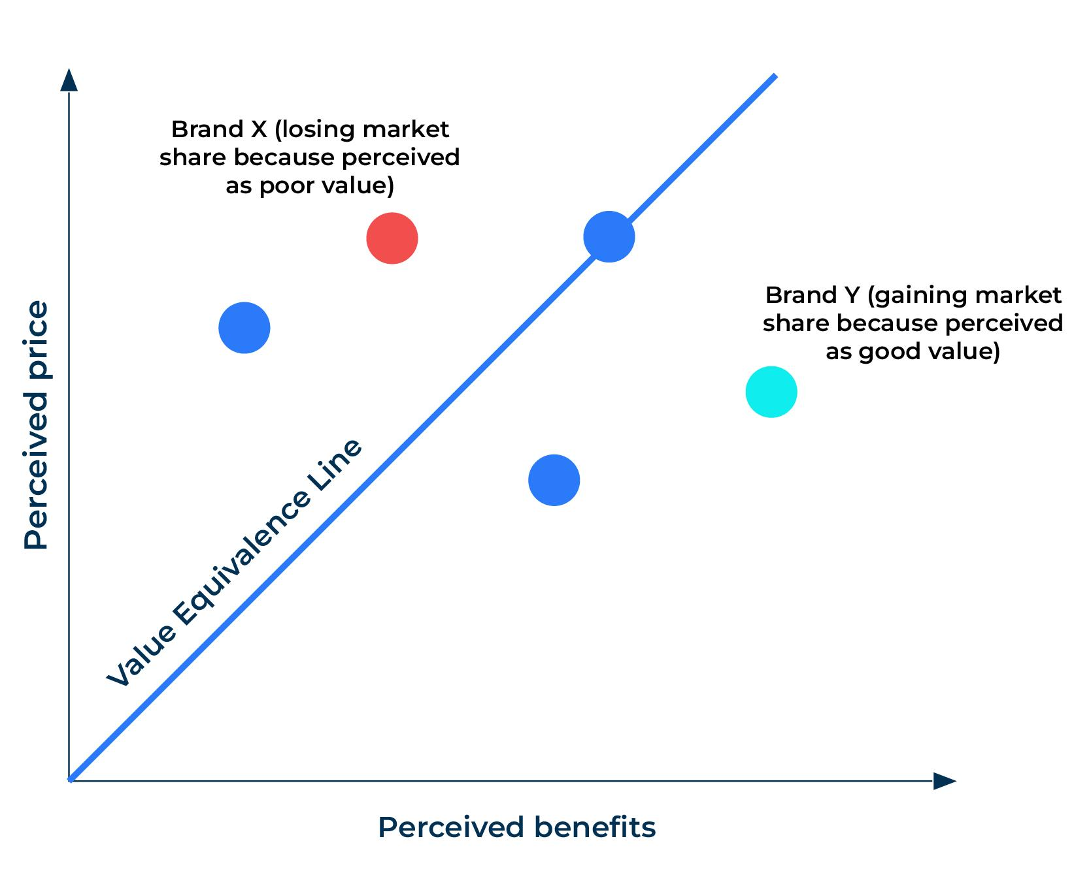
Determining a price/benefits strategy.
The location of the brands on the graph relative to the value equivalence line determine possible strategies:
Brand X is considered to have a high price relative to its benefits and other brands that are available. The owner of brand X must consider whether the perceptions about its benefits are wrong (in which case a new communication strategy will be required to set the story right), or the benefits are too few, or the price is too high.
Brand Y is in the favourable position of being perceived to offer considerable benefits for its price. It is therefore a product that is seen to offer good value for money and can be expected to gain market share. The owner of Brand Y has the options of leaving the price as it is and capturing more market share, raising the price to bring the brand close to the value equivalence line and increase its profitability, or take cost out of the brand by removing some of the benefits and increase in profitability.

Slide 5
Other considerations.
The value equivalence line is a useful tool in determining a competitive strategy. It is important that the perceptions on price and benefits are obtained from customers and potential customers of the brand rather than based on the judgements of a brand manager.
It is also important to understand the perceptions of the key benefits. For example, in Brand X on the previous slide, one strategy is to increase the perceived benefits of this brand. However, this raises the questions “which benefits and by how much should they be increased?”. Market research aimed at customers could provide answers.
A sufficiently large survey of customers and potential customers could yield a sample that compares perceptions on price and benefits between members of different segments. This could help the segmentation strategy become more focused by offering a better alignment of value for each group of customers.

Slide 6
Things to think about.
Understanding where your brand sits on the value equivalence line is important in determining future strategy. If it is to the right-hand side of the line you can carry on winning market share or raise prices. However, if it is to the left-hand side of the line it is necessary to find out why it has adverse perceptions in order to win back share. A product at the left-hand side of the line could be over priced, it could lack sufficient features and benefits or it could be failing to communicate them.
The position of a brand in the market is based on perceptions. Perceptions are created by customer experiences, word-of-mouth, and promotions. What perceptions do your customers have and how are you influencing them in the right way?

Slide 7
Thank you.

