Slide 1
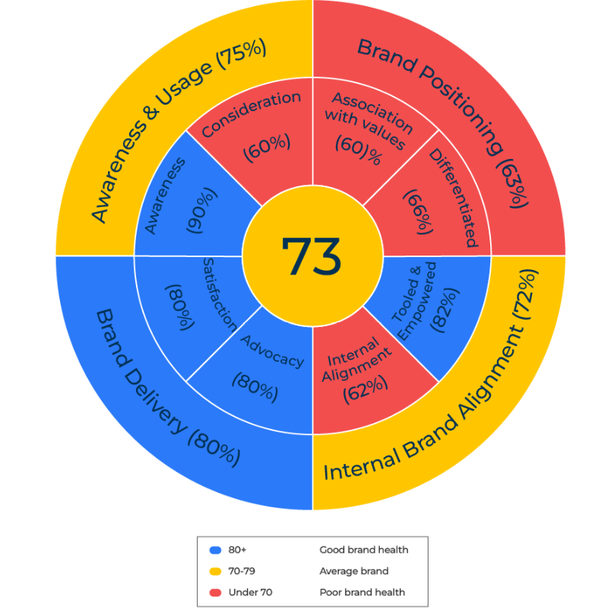
Brand Audit

Slide 2
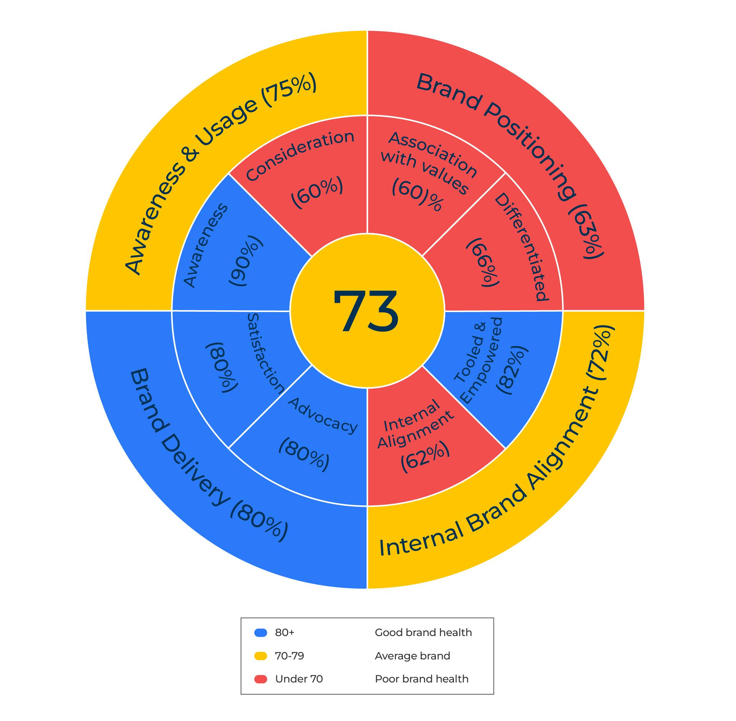
This framework is for strengthening the brand.
Use this model to improve your brand awareness, positioning and brand delivery
The various scores in the four components of the brand health wheel can be added up to produce an overall brand score (where the maximum is 100).
The scores shown in the diagram are by way of example. The awareness and usage score of 75% is an average of the two components of awareness (90%) and consideration (60%). The brand positioning score of 63% is an average of the value associations and differentiation. (And so on).
The score of 73 in the centre is an average of the four main metrics around the edge. You can see how a brand wheel such as this could be produced for different brands competing in a market to show which is strongest.
The scores will indicate what a brand needs to do to improve its position.

Slide 3
Awareness and usage.
STEP 1
The first part of the brand audit is to establish the strength of the brand in terms of awareness, interest and use. The model is flexible and you can test whatever parts you want of the brand funnel – awareness, interest, consideration, usage and advocacy.
Two components that should be tested are “awareness of the brand” and “likely to consider the brand”. These questions should be asked “blind” of the target audience (ie without the respondent knowing the identity of the research sponsor). The percentage of people who are aware and the percentage of people who would consider the brand are built into the model.
Look at the delta between awareness and consideration. If the delta is more than 50%, questions should be asked to determine why there is such a large fall off in interest.
Two questions to ask customers/potential customers are:
When you think of product x, which brands come to mind? Try to list as many as possible in 20 seconds.
And thinking about these brands, which would you be likely to buy?

Slide 4
External brand positioning.
The second part of the brand audit is to establish the position of the brand amongst the target audience.
Here respondents are invited to say to what extent they think various words describe the company’s brand. The list of words should include those that are considered to be key attributes of the brand plus one or two other words as comparators. This word association would be asked of the target brand and competitor brands.
The question is also asked to determine how distinctive and different are the different brands.
The two questions to pose are:
I will read out a list of words which have been used to describe various brands. After each word would you tell me to what extent you think it is strongly associated with the brand, somewhat associated with a brand, neither nor, not very much associated with a brand, not associated with the brand at all.
For each brand under consideration ask: how different is this brand from any of the others you would consider on a scale from 1 to 10 where 10 means very different and 1means not different at all.

Slide 5
Internal brand positioning.
STEP 3
It is also useful to establish the position of the brand within the company that owns it in order to determine its alignment with the external perception.
People working within the company that own the brand are asked to what extent they think various words describing the company’s brand (as used in the external research) are aligned with the brand.
They would also be asked to what extent they believe employees within the company have the tools and the empowerment to deliver the brand promise.
The two questions to pose are:
I will read out a list of words which have been used to describe various brands. After each word tell me to what extent you think this word is strongly associated with the brand, somewhat associated with a brand, neither nor, not very much associated with a brand, not associated with the brand at all.
To what extent do you believe that people within the company have the tools and empowerment to deliver everything promised by the brand. 10 means they are fully able to deliver and one means they are not able to deliver at all.

Slide 6
Brand delivery.
Finally, you need to find out if the brand lives up to its promise in the eyes of the target audience.
The questions asked at this stage are similar to those posed in customer satisfaction surveys.
The two questions are:
How likely are you to recommend brand X to a colleague using a scale from 1 to 10 where 1 means not at all likely and 10 means very likely?
How would you rate your overall satisfaction with brand x on a scale from 1 (not satisfied at all) to 10 (completely satisfied)?

Slide 7
Developing the brand wheel
The brand wheel is based on the results achieved from the questions.
The arithmetic mean is taken of each of the two scores in the four quadrants. By way of example, if 90% of the target audience are aware of the brand and 60% would consider it, the awareness/consideration figure is 75%. The various percentages around the outside of the wheel are averaged to achieve the score in the centre of the wheel.
It would be good to carry out this exercise on all the brands within a competitive consideration set (in which case, the internal brand alignment would have to be omitted). The results can be used for benchmarking between companies and also over time. Use the following as an indication of overall brand strength:
Good brand health – a score of 80+
average brand health – a score of 70 to 79
Poor brand health – a score of less than 70

Slide 8
Things to think about..
It may be worthwhile starting a brand audit by focusing on a few key metrics
All the components of the brand audit are important. However, if you have to choose, the most important metrics they are:
unprompted awareness
the position/associations of the brand
its loyalty score
Is your brand big enough and strong enough to be measured in financial terms?

Slide 9
Thank you.

