Slide 1
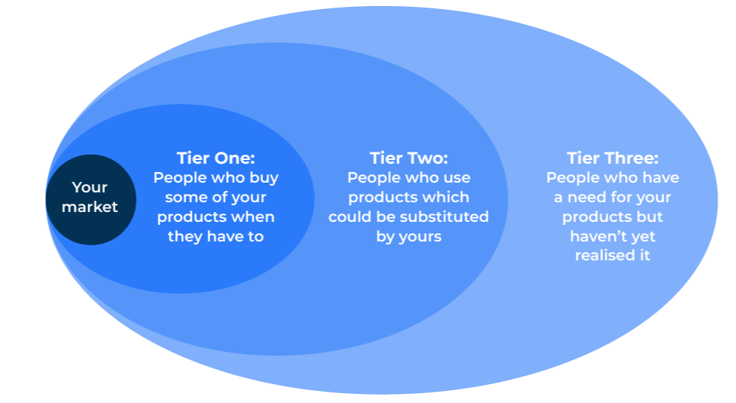
Blue Ocean Strategy

Slide 2
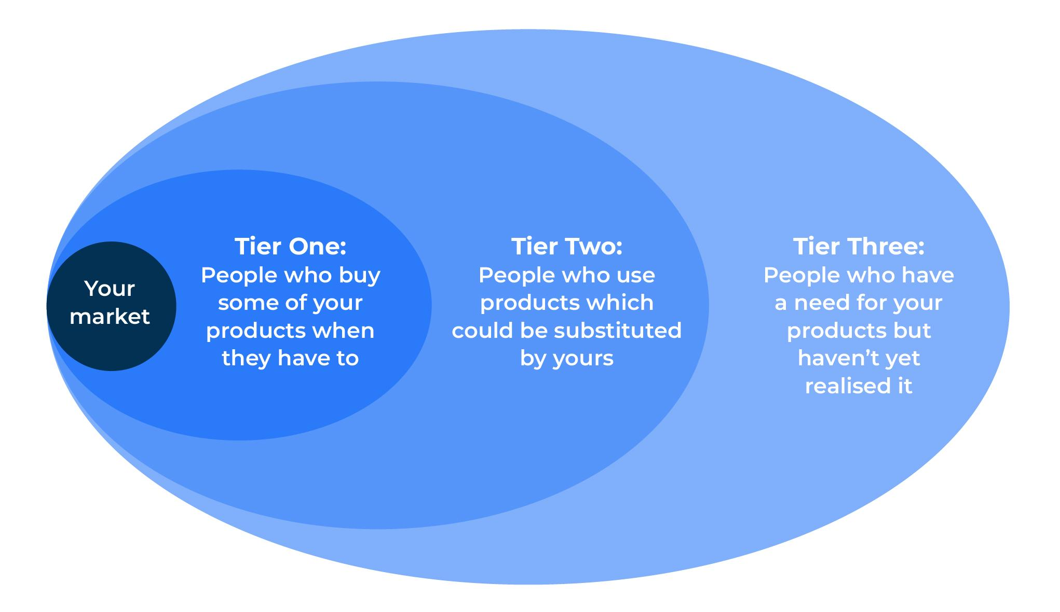
Start innovation and new product development.
Use this model to get ideas for stimulating innovation
The model will help look beyond an existing market towards groups of people who are not yet customers or do not realise that they could be potential customers. These people are observed at three different levels – Tier 1, Tier 2, and Tier 3.

Slide 3
Test the utility of the new idea.
STEP 1
The first step is to determine if the new idea is really useful to people? Is there a strong reason why someone should buy the new idea (ie product or service)? If there is no utility (i.e. demand) for the new product, there is no point progressing to the next step.
Product idea: what is the problem that the product solves? | Complete these boxes
How much do people pay at the present to solve their problem?
How do they measure value – price of product or cost in use?
What would people pay to have their problem solved by the new product/solution?
What are the features of the new product that people really value and will pay for?
Who are these people who will pay for the new product?
How likely are they to be durable in terms of their demand?

Slide 4
Test the price of the new idea.
STEP 2
Test how much people will pay for the new product and who will pay it.
Product idea: what is the problem that the product solves? | Complete these boxes
How much do people pay at the present to solve their problem?
How do they measure value – price of product or cost in use?
What would people pay to have their problem solved by the new product/solution?
What are the features of the new product that people really value and will pay for?
Who are these people who will pay for the new product?
How likely are they to be durable in terms of their demand?

Slide 5
Test the cost of the new idea.
STEP 3
Test whether or not the new product can be produced at a reasonable cost
Product idea: what is the problem that the product solves? | Complete these boxes
How much does it cost to make the current product?
How will it cost to make the new product?
What features in the current product could be removed to save cost?
What will be the cost of introducing features in the new product that are not there at the present?
What is the optimum price that people will pay for the new product?
What will be the profit at this new price?

Slide 6
Test whether to launch the new product.
STEP 4
Finally test whether the new product should be launched
Product idea: what is the problem that the product solves? | Complete these boxes
What if anything will stop or inhibit the launch of the new product?
How feasible will it be to overcome the potential barriers?
Amongst what group of people will the potential barriers be greatest – Tier 1, Tier 2, or Tier 3?
What will be the cost of overcoming these barriers?

Slide 7
Things to think about.
The key is to understand customer needs and which customers can point to a viable innovation
Really understand your customers. Look at what they buy, see how they use the products, find out what frustrates them and how they overcome these frustrations.
Look at the outliers on the extremes of your customers. What do they do? It is here that you may find your blue ocean rather than in the mainstream middle ground.
Aim for the stars and be happy if you land on the moon! Most realisable opportunities lie with tier 1 customers rather than in tiers 2 or 3.

Slide 8
Thank you.

