Slide 1
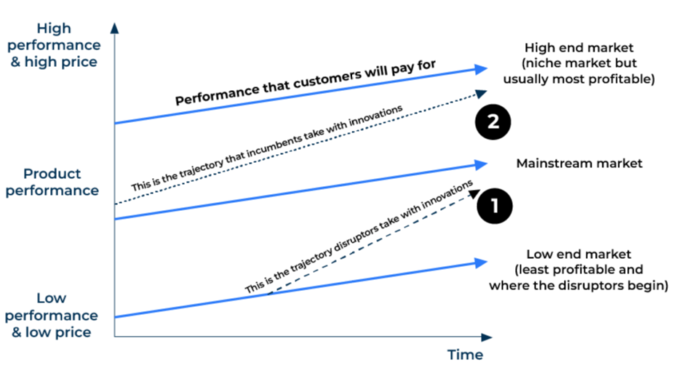
Disruptive Innovation

Slide 2
A model to beat the competition.
Use this model to find a way of exploiting a traditional cosy market.
Markets are disrupted by companies that do things radically different. Large incumbent suppliers are loath to change for fear of losing their privileged position. New entrants to a market, especially those who have little to lose, can shake up the market by offering cheaper, better, faster products that still meet market needs. It should be noted that true disruption of a market occurs only when a significant share is won, otherwise the new supplier has simply occupied a niche. Attacking the mass market usually means having a new, very cost competitive product that performs well against the more expensive incumbents.
In order to disrupt a market it is necessary to answer three questions:
Is there anything in the products or services within the current market that could be removed without any serious effect on customer demand? If yes, there could be an opportunity to remove elements of the offer, lower costs and prices and so be successful with the disruption.
Do current suppliers to the market bend over backwards to serve the needs of customers? If yes, it may be difficult to persuade customers to move to a new supplier as they will fear they may not get the product or service they currently receive.
Are incumbent suppliers making full use of all the channels to market? If no, there may be an opportunity to exploit one of the channels (particularly online) to reach customers more efficiently.
As Clayton Christensen puts it: What jobs are customers hiring products and services to get done? If you can understand this, you will be closer to working out whether your new idea will be disruptive.

Slide 3
Determine opportunities for cost removal.
Step 1
In order to severely dent incumbent suppliers it will be necessary to offer customers savings of at least 15% over the incumbents and more typically 50% plus. If the offer is less than 15%, most customers will judge the risk of switching as not worth it. With this in mind, where and how can significant cost be removed:
New and cheaper raw materials
New and more efficient methods of production
Removal of features in the product that are thought unnecessary by customers
New and cheaper ways of reaching customers
For each of these cost removal opportunities you need to ask yourself “at what price can I go to market, make an acceptable profit, and still serve the needs of customers?”

Slide 4
Determine opportunities for better service.
Most disruption is achieved by lower prices. However, Amazon has demonstrated how improved services (at attractive though not bargain basement prices) can disrupt markets. It has achieved this through competitive prices, the convenience of online ordering, the offer of a huge range of products, the support of customer recommendations, and rapid delivery to your door. What improved service can you offer customers that will make a real impact on the choice of supplier:
Improved convenience
Faster delivery
Improved warranty
More choice
Better advice
Anything else?
For each of these service factors ask yourself “how much will this be valued by customers?” As with price, customers will be looking for something that is significantly greater than a 15% improvement.

Slide 5
Determine opportunities for new channels.
There are many examples of disruptors using new technology or the advantage of online channels. These offer opportunities for significant cost savings as well as the convenience of ordering from a phone or a computer.
In many traditional markets there are established channels for selling products. These usually involve bricks and mortar distributors and retailers. Incumbent suppliers do not find it easy to rock the boat and threaten their existing distribution network by going direct to customers. This can leave an open door for disruptors.
Ask yourself:
Will customers be happy to buy online?
What advantages will online purchasing confer on customers?
What technology do you have that could protect you from copycats who will piggy back into the market once you have changed it?

Slide 6
Things to think about.
To be a successful disruptor you need to have a low cost solution that can attack the bottom end of the market. Disruptors offer cheaper products and they also offer innovative products. (Number 1 in the diagram)
If you can't compete with a low price, you may be able to disrupt the market with a highly innovative product. (Number 2 in the diagram)
Companies producing premium products find it difficult to disrupt the market.

Slide 7
Thank you.

