Slide 1
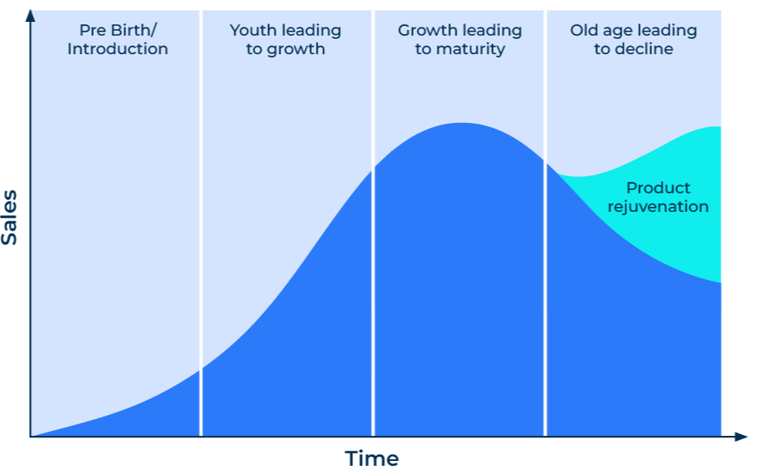
Product Life Cycle

Slide 2
A business model to determine long term strategy.
Use this model to find out what marketing and product strategy you need to adopt
Nearly all products have a life cycle. They are born, have a youthful phase, and move through maturity into old age. An old product may die or be rejuvenated. The problem with life cycles is knowing where they are on the axis of “time”.
If you know where your product lies on the life-cycle you can take certain actions and be prepared for its future.

Slide 3
Step 1: Determine your position on the life-cycle.
Consider the following scenarios to determine your position on the life-cycle.
Sales
Birth
Costs are high
Profits are low and losses are likely
Sales are low as customers need to be made aware of the product
May be little or no competition or lots of competition
Customers have to be prompted to try the product
Growth
Sales grow rapidly and achieve significant volumes
Problems may exist meeting demand
Profits increase as there are economies of scale
Competition increases and new products into the market
Opportunities may exist for higher prices
Maturity
Significant volumes mean maximum cost efficiencies
High overheads result in pressure to maintain volumes
Sales slow down as the market is saturated
brands are well-established and attempt to differentiate
Markets are segmented according to needs and behaviour
competitors begin to merge and consolidate
Price competition attempts to keep products moving
Old age
Sales volume decline
If overheads remain high, profits fall
Prices are under pressure and discounts are high
Further rationalisation of competition results in fewer products competing
Competition arises from substitute products
Time

Slide 4
Step 2: Determine your marketing objectives.
Consider the following marketing objectives depending on your position on the life-cycle.
Birth
Growth
Maturity
Old age
Sales
Marketing objectives
Gain trial by early adoption
Minimise learning requirements
Establish market share
Establish distribution
Strengthen market share
Build dealer and customer loyalty
Use product as cash cow
Consider product extensions
Time
Communication objectives
Create wide awareness
Generate interest amongst innovators
Strengthen brand preferences
Stimulate wider trials
Promote frequency of use
Suggest new uses for product
Minimum promotion
Maintain brand
Create classic niches
Communication strategy
Personal sales
Media advertising
Opening offers
Media advertising
Personal sales
Sales Promotions
Media advertising
Dealer promotions
Sales promotions
Reduce media expenditure

Slide 5
Step 3: Consider the rejuvenated life cycle.
Target audience: which segment of the market has an interest in a rejuvenated product?
Product development: what modifications will appeal to target audience that knows your product?
Branding: how will the new product be branded? What will the link be with the old product?
Timing: how will the new product be launched to dovetail with declining sales of the old product?
Price considerations: what will be the price of the rejuvenated product?
Profit: what profit can be expected from future sales volume and price?
Channel: how will the new product reach the market?
Advertising: what messages will reach the audience and potential customers?

Slide 6
Things to think about.
Knowing where your product sits in its life-cycle is important as it determines your strategy. It is particularly important to know when demand is “topping out” and moving into decline. This is a stage at which you need to decide whether rejuvenation is possible.
Remember that your communication strategy needs to change depending on where your product sits in the life-cycle.

Slide 7
Thank you.

