Slide 1
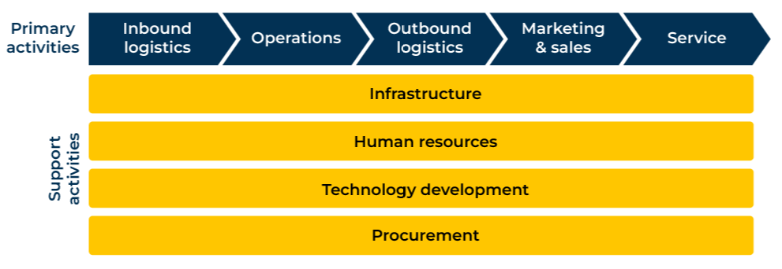
Value Chain

Slide 2
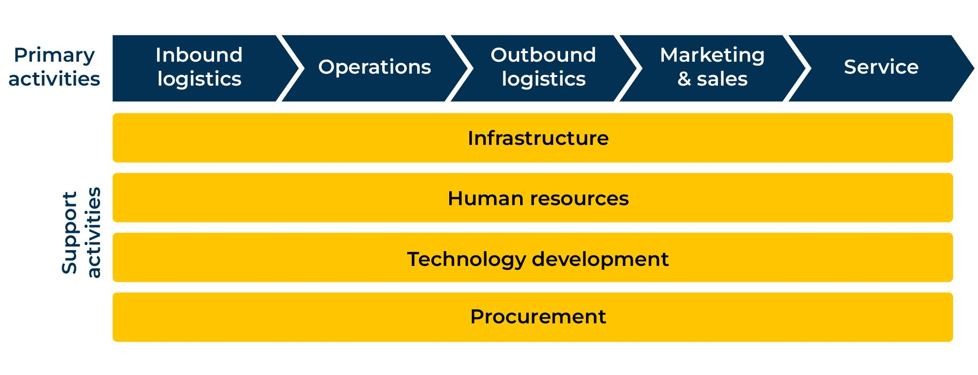
Finding value in the production process.
Use this model to ensure you capture maximum value in the manufacture and distribution of your products
Businesses create value by taking raw materials and processing them.
Michael Porter developed a value chain model that includes these primary and support activities. The application of the model can be used to determine a company’s relative cost position and create a basis for differentiation and competition.
The term “product” in the following templates refers to both products and services. Raw materials are generally physical commodities or products but they could also include services.

Slide 3
Inbound logistics.
In this first step consider the raw materials and other components or sub assemblies you buy and the way they are delivered and stored by your company. Ask yourselves the following questions:
What raw materials are you buying and what is their source?
What is the cost of the raw materials as a percentage of the total cost of the finished product you are manufacturing?
How reliable is this source in terms of delivering the right quality at the right time now and into the future?
How is the source of raw materials able to react to any changes you may have for their demand – either increasing it or decreasing it quickly?
For the quality and specification of the raw materials you are buying, what alternative sources could you consider?
What substitutes could be used for the raw materials you are using?
What would be the impact on the quality of the product you make and its cost if you were to use the substitutes?
How critical are these inbound logistics on the profitability of your company?
Where could changes be made that would improve profitability?

Slide 4
Operations.
Now consider the way the raw materials (and other bought-in components or sub assemblies) are processed within your company to produce a finished product. Ask yourselves the following questions:
What are the various processes that the raw materials go through as they are converted into finished products at your company?
What failure rates do you have throughout these various processes?
Which is the most vulnerable process where bottlenecks or failures occur?
Which is the most costly part of the process?
How could the processes be changed in any way?
What would be the investment required to change the processes (e.g. through greater automation)?
What would be the impact on productivity and profitability of making these changes in the processes?
Who is in charge of these processes? How effective is this person in managing your operations?
How critical are these various operations on the profitability of your company?
Where could changes be made that would improve profitability?

Slide 5
Outbound logistics.
The products that you make must be stored, dispatched, distributed and sold. Ask yourselves the following questions:
How and where are finished products stored before dispatch?
How much space is required for this storage? What is its cost?
How much stock of finished product is held by your company? What is the value of this stock in manufactured cost and potential revenue?
What is your stock turn (the average length of time that stock stays in your company before it is sold)?
Which items of finished stock stick around longest and which sometimes are sold out?
By which means are your finished products transported to your customers?
What is the cost of this transport/distribution?
What proportion of your products are sold direct and what proportion go through distribution?
What mark-up do distributors add to your selling price?
How critical are these various aspects of your outbound logistics on the profitability of your company?
Where could changes be made that would improve profitability?

Slide 6
Marketing and sales.
Ask yourselves the following questions about your marketing and sales operation:
How are sales generated and processed within your company?
What is the role of field sales, telesales, and customer service?
What is the total cost of these operations and what is the cost per product sold?
What is your annual expenditure on advertising/promotion?
What is the cost per product sold of this investment in advertising/promotion?
How are prices of your product set by your company?
What is the profitability of your sales via distributors?
What is the profitability of your sales that are direct?
What are your options for changing the proportions of sales that go direct or through distribution?
What are average sales per customer?
How loyal are your customers?
What is the lifetime value of the customer?
How could you change any aspects of your marketing and sales to improve profitability?

Slide 7
Service.
Ask yourselves the following questions about the service that your company provides:
What service does your company provide customers before a sale is made?
What service do you provide at the time of the sale?
What services are provided after the sale?
Which services are charged to the customer?
Which services do you provide to customers for which you could make a charge?
Of your total revenue what proportion is generated by services?
How do services provided by your company distinguish you from the competition?
How could you change any aspects of your services offer to improve profitability?

Slide 8
Support services.
Support services are largely fixed costs and include infrastructure, human resources, technology development, and procurement. Ask yourselves the following questions about the support service that your company provides:
Which of the support services do you consider to be a core capability of your company?
Which support services could be or are outsourced?
What are the costs of these various support services?
What proportion of your total costs are accounted for by the support services?
How has this proportion changed over time?
What opportunities are there for improving profitability by examining the costs or efficiencies of each of the support services?
How could your profitability be increased by changing the way you manage and provide the support services?

Slide 9
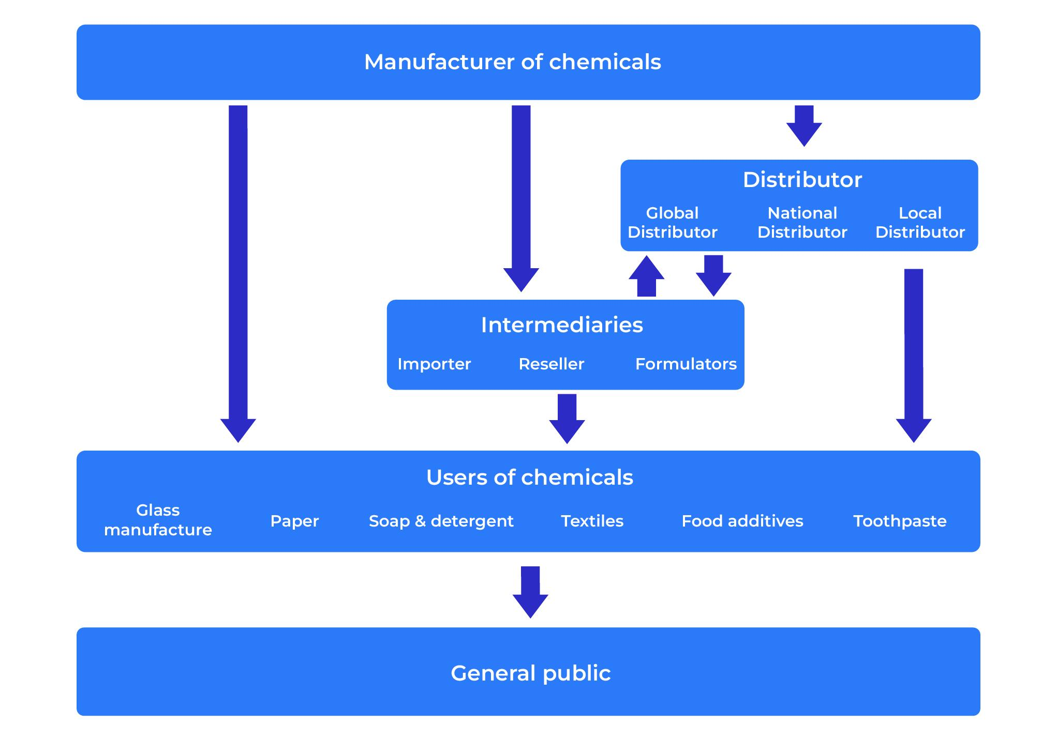
Other considerations.
The term value chain is also used to describe the means by which products move from raw material to the final customer. A useful exercise is to map the value chain. Modifications can be made to this diagram so that the width of the flow diagram represents the proportion of product moving through this particular route. If possible also indicate the price of products and profit margins at each level in the value chain to indicate how value is added at each stage.

Slide 10
Things to think about.
A business is a conveyor belts that takes raw materials and labour and converts it into an offer with added value. Every department plays a role in this process and contributes to the value. Where is the value created in your company? How strong are the links between the different departments? Could they be improved in any way which would add value?
In addition to the value chain within your business, do you know the value chain in your market? What is changing in the way products get from you to the final customer? How are you responding to this change? Who is making the money? How could your business make more money within this value chain?

Slide 11
Thank you.

