Slide 1
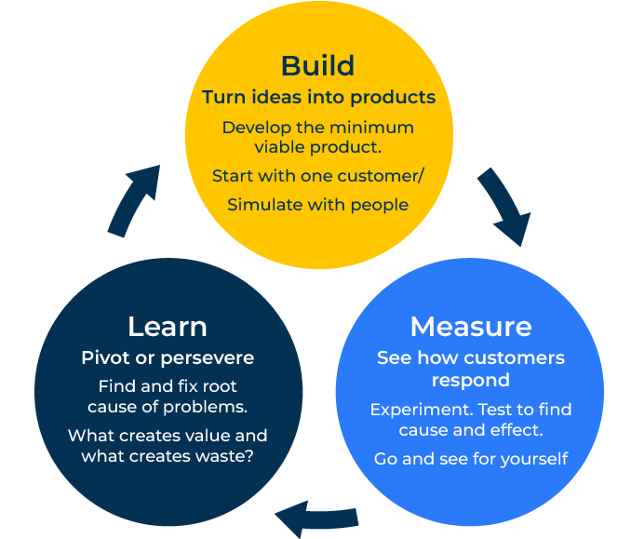
Lean Startups

Slide 2
A business model to build at speed.
Use this framework for a business start-up or to grow your existing company
The Lean Startup model, popularized by Eric Ries, is a methodology that emphasises a systematic and scientific approach to creating and managing successful startups.
The model was initially designed for startups, however its principles are widely applicable and can be effectively used to grow existing companies.
By adopting the Lean Startup model, you can foster a culture of innovation, responsiveness, and customer-centricity within your company, ultimately driving sustainable growth.
The key is to continuously learn, adapt, and iterate based on real-world feedback and data.

Slide 3
Build, measure, learn.
Embrace the Build-Measure-Learn feedback loop. Start with a minimal viable product (MVP) to quickly test your business hypotheses. Collect feedback, measure the results, and learn from the data. This iterative process helps in making informed decisions and adjustments.
 | Complete these boxes
What is your minimal viable product – ie the simplest offer you can make the core of your business?
What feedback is telling you if this product is going to grow (or not)?
From what you have learned, what can you change about this product to improve the chance of business success?

Slide 4
Listen to those that matter.
Place a strong emphasis on customer engagement. Engage with customers to understand their needs, pain points, and preferences. This customer-centric approach helps in feedback and developing products and services that truly address market demands. Be open to pivoting if necessary. If the data suggests that your initial approach is not gaining traction, be willing to make significant changes to your strategy. At the same time, if you find success in certain areas, be ready to double down and scale those efforts.
 | Complete these boxes
What are customers saying about your product? What do they like – but in particular what do they dislike?
How does feedback vary among different groups of customers? What is the feedback from your strategically important segment?

Slide 5
Think lean and act quick.
Apply lean thinking not only to product development but also to your company's operations. Eliminate waste, streamline processes, and continuously optimise workflows to improve efficiency and reduce costs. Adopt agile methodologies to enhance flexibility and responsiveness. Break down projects into smaller, manageable tasks, and regularly reassess priorities based on the evolving needs of the market and the company. Establish feedback loops not only with customers but also with employees. Gather insights from your team members who are often on the front lines, interacting with customers or working on the products/services. Their perspectives can be invaluable for identifying areas of improvement.
 | Complete these boxes
What will be your next product following success with your minimal viable product? How quickly can you develop and launch it?
Where are your trusted feedback loops? Customers (of course) and employees (also of course).
How can you think big and act small?

Slide 6
Editable framework.
Use this to add your own text and edit to suit your own branding
Turn ideas into products
Develop the minimum viable product.
Start with one customer/ Simulate with people
Learn
Pivot or persevere
Find and ﬁx root cause of problems.
What creates value and what creates waste?
Measure
See how customers respond
Experiment. Test to ﬁnd cause and effect.
Go and see for yourself

Slide 7
Thank you.

