Slide 1
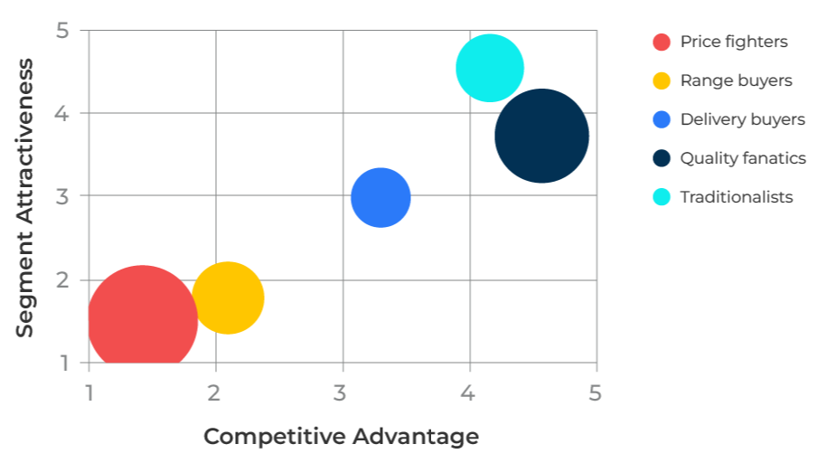
Directional Policy Matrix

Slide 2
A model to prioritise segments or new ideas.
Use this model to focus on the segments or ideas that should be targeted.
This is a tool to help focus on products or segments that are attractive to your company and where you have a strong competitive position.
The tool has two axes as illustrated opposite. In the example, two segments are obvious for focus – traditionalists and quality fanatics. There appears to be opportunities for “delivery buyers” if the company can improve its competitive advantage.
The opportunities for company with price fighters and range buyers do not bode well unless something changes to make the segments more attractive and improve the company's competitive advantage. Unless these changes are possible, the red and yellow segments will be deselected.

Slide 3
Determine the attractiveness of the segments.
The attractiveness of a segment will be determined by some or all of the following:
Segment size
Segment growth rate
Numbers of potential customers and access to them via channels
Segment profitability
Competitive intensity
Customer pressures
Openness of market
Environmental pressures
It is worthwhile rating the attractiveness of these various factors for each segment.
 | Attractiveness (score out of 5)
 | Segment 1 | Segment 2 | Segment 3
Segment size
Segment growth rate
Numbers of potential customers
Channel access
Segment profitability
Competitive intensity
Customer pressures
Openness of market
Environmental pressures
Average score

Slide 4
Determine your competitive strength in each segment.
Your competitive strength in each segment will be determined by some or all of the following:
Penetration of the market
Share of customers’ wallets
Customers’ satisfaction score
Loyalty score
Patent/technology protection
Strength of brand
Rate these various factors for each segment.
 | Competitiveness score out of 5
 | Segment 1 | Segment 2 | Segment 3
Penetration of the market
Share of customers’ wallets
Customers’ satisfaction score
Loyalty score
Patent/technology protection
Strength of brand
Average score

Slide 5
Plot the position of your segments.
Now plot the position of your segments using their average attractiveness and competitive scores.
For each segment, consider your options based on the suggested strategies in the following matrix.
Competitive advantage
Weak
Medium
Strong
5
Selectively focus
Invest
Protect
High
Market attractiveness
Selectively focus or harvest
Build selectively
Medium
Harvest
Low
Withdraw?
Harvest
Defend and refocus
0
5
0

Slide 6
Things to think about.
Use the directional policy matrix to focus your strategy.
The biggest opportunity is usually associated with improving your competitive strength. This requires you to know your strengths and weaknesses.
Use a SWOT in conjunction with the direction porting matrix.

Slide 7
Thank you.

