Slide 1
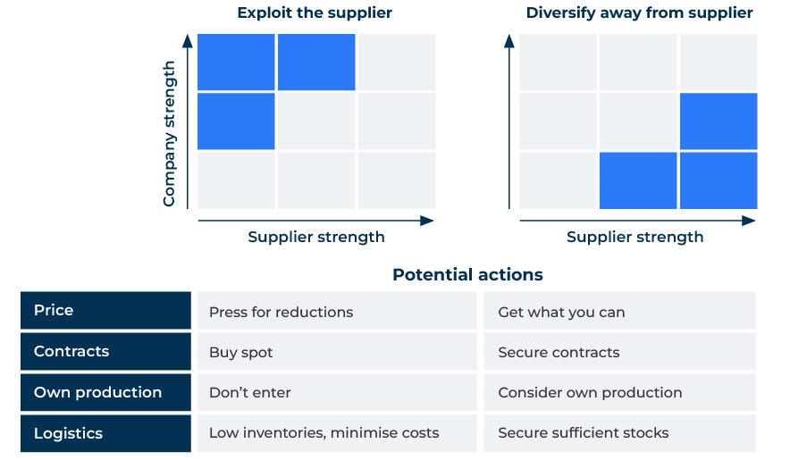
Kraljic Matrix

Slide 2
A business model to manage suppliers.
Use this framework to segment your suppliers and your customers
The Kraljic Matrix, also known as the Purchasing Portfolio Matrix, is a strategic tool used in supply chain management and procurement to analyse and categorise a company's purchasing portfolio based on two key dimensions: your company’s strength and that of the supplier. This matrix, developed by Peter Kraljic, helps companies develop a tailored approach to managing their suppliers.
Implementing the Kraljic Matrix as part of a business strategy allows companies to tailor their approach to each supplier, optimising costs, mitigating risks, and fostering strategic partnerships where needed.

Slide 3
Segment your suppliers.
The Kraljic Matrix categorizes suppliers into four quadrants: Strategic, Leverage, Bottleneck, and Non-Critical. This segmentation helps businesses prioritise their focus and resources based on the strategic importance of each supplier.
 | Complete these boxes
Which of your suppliers would you say is strategic to your future success? Why do you say this?
Which of your suppliers is in a weak position relative to yours which means you can leverage it?
Which of your suppliers creates problems for you because the restrict supplies (bottleneck)?
Which of your suppliers is not critical to your companies future success?

Slide 4
Think about supplier risk and profit impact.
The matrix considers two dimensions - supply risk and profit impact. Strategic suppliers are those with high profit impact and high supply risk, making them crucial to the business but also potentially risky. By identifying these suppliers, companies can develop specific strategies to manage and strengthen these relationships.
 | Complete these boxes
For each of your suppliers in the strategic segment consider which could be a risk to your company? How can you mitigate this risk?
For each of your suppliers in the strategic segment consider how you can leverage them for profit at your company?
What about other suppliers you use or don’t use – could they be elevated into the strategic partnership category?
Which are the other suppliers who have no strategic value to your company? What will you do with these?

Slide 5
Sort out the bottlenecks and leverage opportunities.
For suppliers in the Bottleneck quadrant (high supply risk but low profit impact), focus on risk mitigation. This could involve finding alternative suppliers, developing contingency plans, or negotiating more favourable terms to reduce dependency. Suppliers in the Leverage quadrant have a high profit impact but low supply risk. For these suppliers, the emphasis is on cost optimisation and negotiation. You can explore opportunities to reduce costs, improve terms, or leverage your buying power.
 | Complete these boxes
Which suppliers could be a threat to your company because they may not be able to supply you? Consider alternative sources.
Which suppliers generate good profits for you and product few problems? How can you leverage your buying power with these suppliers?

Slide 6
Checking for changes.
The Kraljic Matrix is not a one-time exercise but a tool for continuous monitoring and adjustment. Business conditions, supplier dynamics, and market factors change over time. Regularly reassessing the supplier portfolio ensures that strategies remain aligned with the current business environment. The matrix assists in allocating resources effectively. By understanding the criticality and risk associated with each supplier, businesses can allocate resources proportionately. High-risk, high-impact suppliers may require more attention and resources.
 | Complete these boxes
What changes are taking place in the market and with your suppliers that could affect their strategic importance?
How can you strengthen your supplier base with more resource such as better partnerships, negotiation, contact etc?
Which high risk suppliers do you need to keep an eye on?

Slide 7
Editable framework.
Use this to add your own text and edit to suit your own branding
Exploit the supplier
Diversify away from supplier
Company strength
Supplier strength
Supplier strength
Potential actions
Price
Contracts
Own production
Logistics
Press for reductions
Buy spot
Don’t enter
Low inventories, minimise costs
Get what you can
Secure contracts
Consider own production
Secure sufﬁcient stocks

Slide 8
Thank you.

