Slide 1
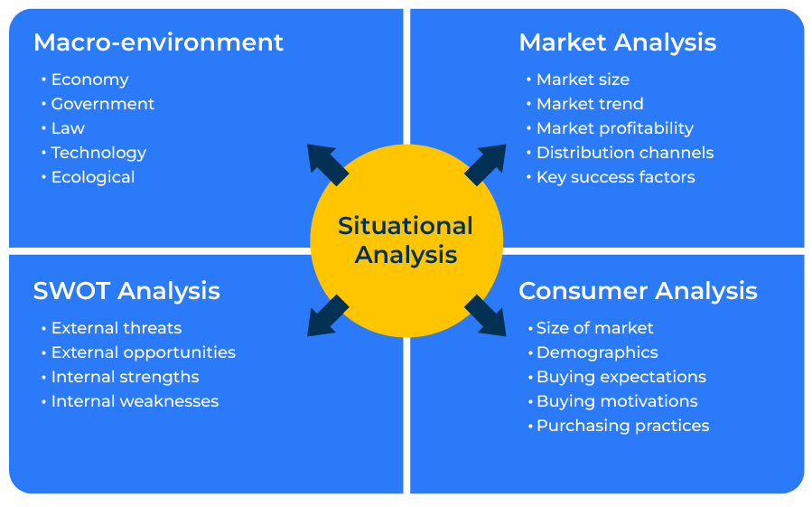
Situation Analysis

Slide 2
A business model from which to plan your strategy.
Use this framework to understand your competitive strength and where to exploit it
A situation analysis is a comprehensive examination of an organisation's internal and external environment to understand its current position, capabilities, challenges, and opportunities.
This analysis serves as a foundation for strategic planning and decision-making. The primary goal is to gather information and insights that will inform the development and implementation of effective strategies.
Situation analysis is a key component of the strategic planning process and may be conducted periodically to ensure ongoing relevance.

Slide 3
Carry out a market analysis.
You can begin this framework examining any of the four corners. However, a good place to begin is looking at the marketplace. Here you want to build a picture of the market in which you play broken down by geography, segments, and products. You need to list the competitors and their market shares. You need to assess the size of the market and show trends. This provides a big picture before you dive into and understanding of customer needs.
 | Complete these boxes
How would you define your market? How does it break down geographically? How does it break down in types of products purchased? How does it segment in terms of who buys the products?
What is the size of the market (and its segments)? How has the market changed in the past? How will it change in the future?
Which companies compete in the market? What are their market shares? What are their strengths and weaknesses?
What are the routes to market? How are these changing?

Slide 4
Carry out a consumer analysis.
You now need to turn your attention to customers and potential customers. Describe these people or companies - what is the decision-making unit, what do they look for from suppliers, what are their needs? How do they buy their products (what are their behaviours in terms of frequency of purchase, loyalty to suppliers, satisfaction with suppliers etc)?
 | Complete these boxes
How many buyers of products are in the marketplace? How many of these do you supply?
What is the profile of these consumers in terms of demography and behaviour?
What are needs and unmet needs among these consumers?

Slide 5
Study the macro environment.
Take a look at the macro environment in which your customers and the competition operate. What are the political, economic, social and technological factors (PEST) that affect this market? Are there any legislative or environmental factors that need to be considered? How are they changing? What effect does the macro environment have on your company and others within it?
 | Complete these boxes
What are the influences of the PEST factors on your company?
How is the macro environment changing? Are changes likely to be positive or negative to your company?

Slide 6
Carry out a SWOT.
Finally bring everything that you have studied into a SWOT analysis (strengths, weaknesses, opportunities, and threats).
 | Complete these boxes
What are your company’s strengths? How are you performing better than competitors? Why is this?
Where is your company weaker than the competition? Why is this – resources, understanding of the market, weakness of product or marketing?
What are the opportunities in the market arising out of changes in the macro environment or the competitive environment? How can you best exploit these opportunities?
What are the threats in the market arising out of changes in the macro environment or the competitive environment? How can you fend off the threats?

Slide 7
Things to think about.
Carrying out a situation analysis is the starting point for almost every strategic plan.
The situation analysis should be based on inputs from customers, colleagues, and independent reports. It is worth considering running internal workshops to discuss aspects of the situation analysis.
The situation analysis is always fluid. It will change and therefore you need to frequently revisit it.

Slide 8
Editable framework.
Macro-environment
Use this to add your own text and edit to suit your own branding
Market Analysis
Situational Analysis
SWOT Analysis
Consumer Analysis

Slide 9
Thank you.

