Slide 1
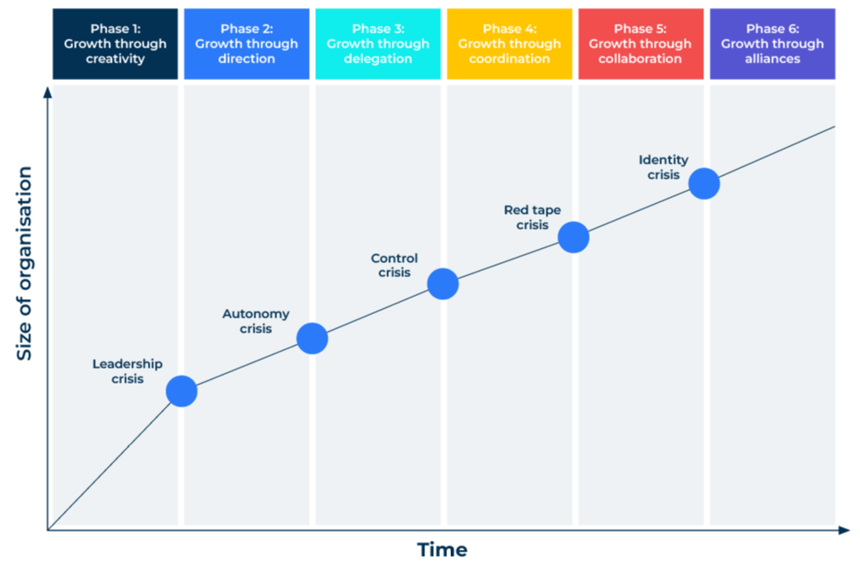
Greiner’s Growth Model

Slide 2
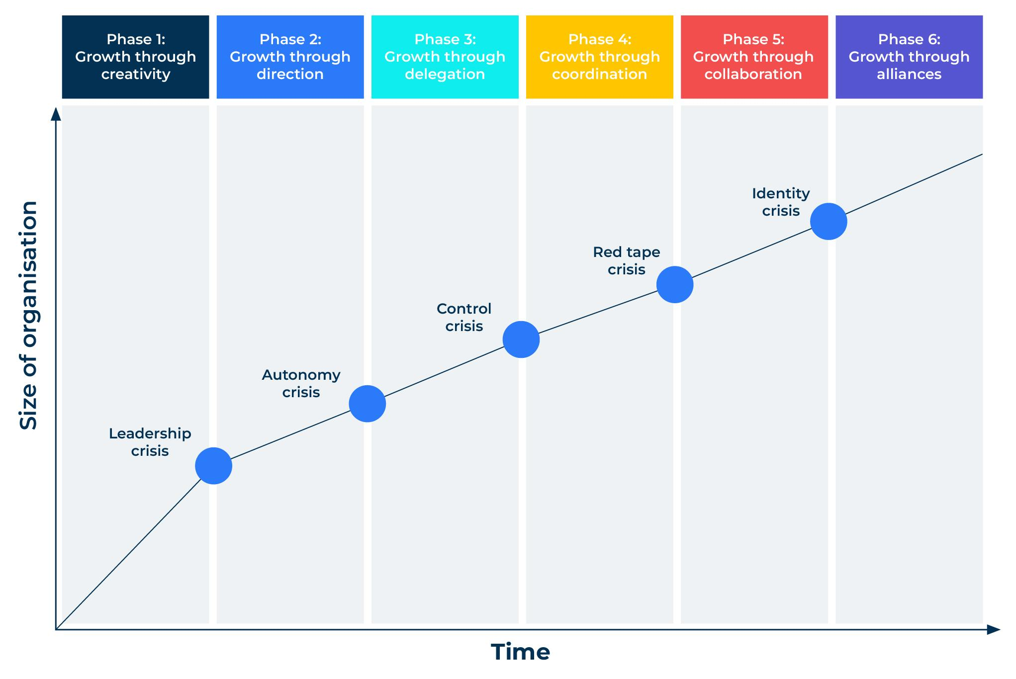
A model to recognize phases of company growth.
Use this model to identify the stage of your company in its lifecycle
This model will help you identify the phase of growth of your company. Knowing the phase of your company you will be better able to adjust to the phase and plan for future growth.
It is a model that is likely to be of most value to leaders within a company as they are able to recognise the phases and make the necessary changes.
Greiner argues that small companies begin to grow and move through a series of crises. He identified 5 phases as shown in the chart opposite. He later added a sixth phase which, in a mature company, reflected growth through mergers and acquisitions.

Slide 3
Growth through creativity.
Work through this check list of questions to determine whether your company is in this phase
The company is small and led by its founders. They can be cavalier in their management style.
The company exhibits rapid growth as is growing from a small base.
Cash availability is often a problem and there are pressures on salaries and items of expenditure.
Because the company is small everyone has access to each other, especially the boss.
Everything is informal although as growth takes place, more processes are imposed.
As the company grows, more people are drawn into it, including professional managers. This leads to a crisis of leadership.

Slide 4
Growth through direction.
Work through this check list of questions to determine whether your company is in this phase
The company begins to formalise various aspects of the business. There are new processes for recruitment, credit control is more stringent, rules are set for various processes – and many are ignored.
The founders of the company are still active and can be the worst culprits for not attending to the new processes.
They also find it hard to delegate. They act as puppet masters.
There is still a relatively lean workforce and people are overloaded. However, they are used to working long hours in order to simply get the job done.
The controls that have been imposed during this phase are not really working and there is a crisis of autonomy (a need for the founders to release their control on decision-making) and a need for more formal structure. This leads to a crisis of autonomy.

Slide 5
Growth through delegation.
Work through this check list of questions to determine whether your company is in this phase
The company has a number of middle managers, some of them recruited from outside.
The lack of the delegation in the earlier phases now changes and there can be too much delegation to these middle managers.
The leaders of the company know where it is going but they are not always good at communicating this down the line.
Managers of separate business units have a significant amount of control through the delegation process and could head off in their own direction.his leads to a crisis of control.

Slide 6
Growth through coordination.
Work through this check list of questions to determine whether your company is in this phase
The larger company has a number of subsidiaries and business units. These are profit centres with tight financial controls.
The original founders are likely to have sold out and the company is run by professional managers.
There is a strong human resources department and firmly stated corporate goals.
Controls such as expenses are tight.
The workforce begin to feel that there is little flexibility and the company is rule driven. This leads to a crisis of bureaucracy and red tape.

Slide 7
Growth through collaboration and cooperation.
Work through this check list of questions to determine whether your company is in this phase
The organisation is now quite some size. In order to make this more manageable the hierarchy operates as a matrix of responsibilities.
Managers have mixed responsibilities and as a result are always in meetings.
The company installs SAP or other enterprise software and people grumble that it is restrictive.
Because the company is large, its growth has slowed.
People within the company begin to lose an understanding of its purpose.his leads to a crisis of identity.

Slide 8
Growth through alliances.
Work through this check list of questions to determine whether your company is in this phase
In this sixth phase the company has grown into a huge corporation with subsidiary offices scattered over many geographical regions.
Many activities (sometimes core activities) are outsourced.
Consultants are brought in regularly and there are frequent changes to the core business.
The original business may not be recognisable.
Any future growth is likely to come from mergers and acquisitions.

Slide 9
Things to think about.
Recognising growth problems and dealing with them is essential if growth is to be continuous.
Growth poses problems which must be recognised and dealt with.
Leadership and management practices have to change at each phase of growth.
Things to think about throughout all the phases are:
Delegation – is it happening, are you good at it, could you be better?
Recruitment – are you bringing in the right people and are you training people to be aligned to your goals?
Controls – are they the right ones, are they working, could they be better, are they stifling people?
Initiatives – as the company grows are you losing the entrepreneurial drive, are you good at driving growth both organically and through acquisition?
Purpose – do people in the company understand why you do things and not just how you do things? Do people understand the raison d'être of the company?

Slide 10
Thank you.

