Slide 1
Price Quality Strategy

Slide 2
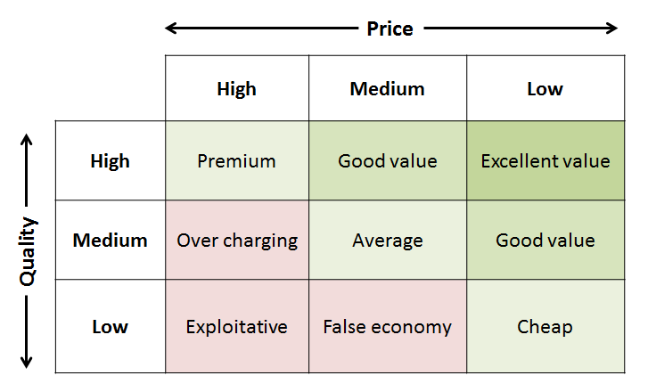
A business model for guiding a pricing strategy
Use this model to find out the value perceptions of your product
This is a model proposed by Philip Kotler. He sees three levels of price – high, medium and low. He also recognises three levels of quality – high medium and low. The combination of these levels of price and quality result in nine pricing strategies.
There are only six possible combinations that produce viable pricing strategies as three would not work – high price/low quality, medium price/low quality, and high price/medium quality. These inappropriate strategies are shaded pink in the figure opposite.

Slide 3
Six steps to develop the strategy
First decide where your product sits in terms of its quality – high, medium or low. On what basis can you say this?
Now select your price objective – is it to maximise profit, maximise market share, achieve a fast penetration of the market, achieve product quality leadership? Will your price strategy be high, medium or low?
Estimate the demand you will achieve at the price/quality strategy you are considering.
Check your costs to determine whether you will make an acceptable profit.
Consider how you will position your product against the competition and in particular what will differentiate it and generate demand.
Set your final price.
Where does your price sit in the Kotler matrix?
Does it make sense?

Slide 4
Other things to think about
How does your pricing strategy for the product you have been addressing fit with other pricing strategies within your company?
How will your pricing strategy address the different segments of the market?
What discount strategy will you adopt for volume sales?
How will the pricing strategy fit within channel pricing?
How will warranties and services fit in with your product pricing strategy?
Are your customers obtaining enough value from your pricing strategy?
Are you achieving sufficient profits from your pricing strategy?

