Slide 1
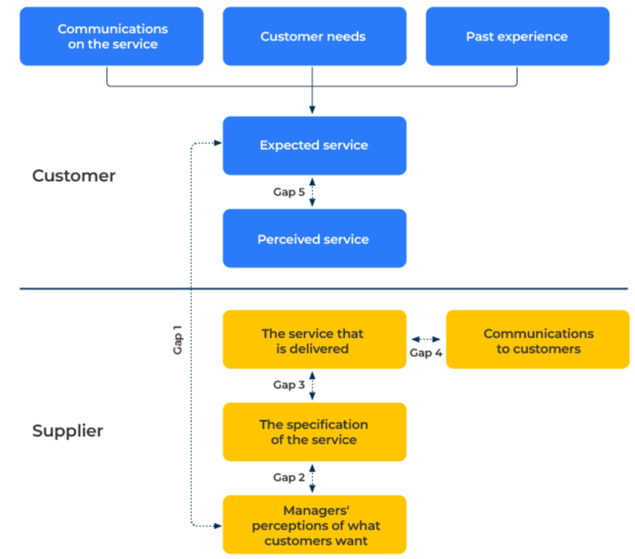
SERVQUAL

Slide 2
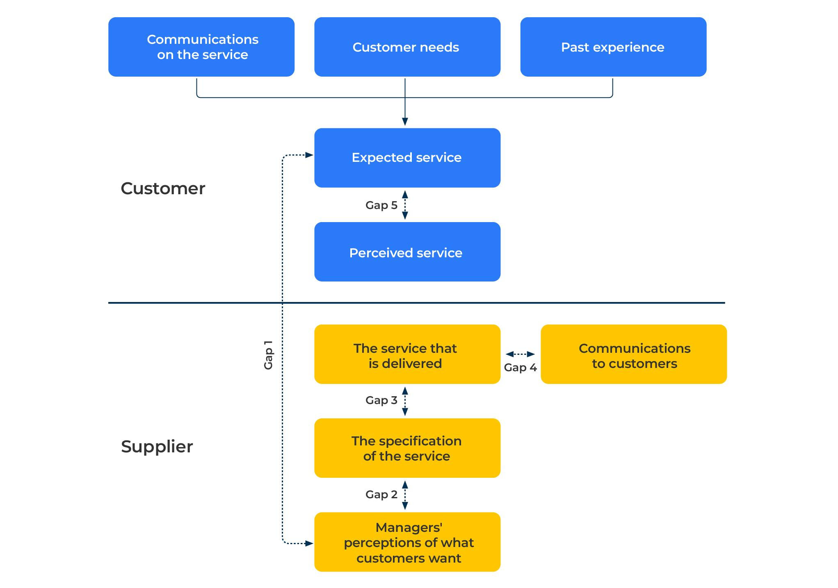
Align customer expectations and company performance.
Use this model to make sure that you deliver services to customers they expect
Expectations are built up from what customer knows about a supplier, past experiences with that supplier, and customers’ needs. In a SERVQUAL study people are asked to rate the expectations they have of various aspects of service from a company and the degree to which these expectations are satisfied.
The results show where there are gaps between expectations of the service and the performance of the company in meeting these expectations. There are 5 possible gaps to be measures as shown in the figure opposite.

Slide 3
Measure the knowledge gap
Managers of a company can sometimes fail to understand the service levels that are expected by their customers. Two surveys are required – one with managers and the other with customers – to obtain answers to the following questions (in the case of the managers they would be asked to state what they expect customers to say in answer to the following questions).
Responsiveness questions
The deliveries from the company are always on time
I can always reach someone at the company any time I want to
When I have a problem, the company shows interest in solving it
Assurance questions
Employees of the company are knowledgeable about their products
Employees of the company are able to solve my problem satisfactorily
Employees of the company are helpful
Employees of the company are friendly
I have confidence in the employees of the company
Tangible questions
The company has modern equipment
the company’s products are of a high quality
The company’s employees always look smart
The company’s promotional material is visually appealing
Empathy questions
Employees of the company listen carefully to my needs
Employees of the company give me individual attention
The company has operating hours that are convenient to my needs
The company has my best interest at heart
Reliability questions
Overall the company provides good quality service to its customers.
I am satisfied with the company's services
I will continue using the company's services
I will recommend the company to other people
At the time you are asking customers their perception of your service, you should also ask their expectations of your service. This is to gain an understanding of Gap 5 – the gap between what customers perceive they are receiving and what they expect to receive.
What is the gap between the answers received from managers and from customers? Where is the biggest gap? How can you fill the gap?

Slide 4
Measure gap between managers’ perceptions and the specification of the services
Check any disconnect between managers’ perceptions of what people need and your company’s specifications of the services. You need the right set of standards for service and ensure that they are met (these are gaps 2 and 3 as shown on slide 2). Ask yourself the following questions:
Responsiveness standardsds
What standards does the company have for delivering on time in full?
How fast does the company respond to requests for quotations?
How fast does the company respond to queries or technical problems?
Assurance standards
How knowledgeable are employees of the company about products?
What training is given to employees on products?
What training is given to employees on delivering customer experience?
Tangible standards
What is the failure rate of products that are delivered to customers?
How clean and fresh is company signage, vehicle livery and the company premises?
Empathy standards
How customer orientated our members of staff?
Net promoter score and customer satisfaction
What are the target NPS and customer satisfaction scores of the company?
Make sure that you have a plan in place to achieved congruence between the service standards that are set by your company and those that are expected by your customers

Slide 5
Step 3: Communication with customers
Managers in a business can devise communications to customers that are out of kilter with the service that is actually delivered. This is Gap 4. Ask yourself the following questions:
What expectations do you create in the minds of customers? How do you create these expectations?
What do you promise customers?
Who makes these promises? (Previous commitments, sales representatives, technical teams, customer service representatives, other members of staff, word-of-mouth between customers)
What training do you provide members of staff on creating the right level of expectations?
What internal measures do you have to ensure that these promises to customers are being delivered?
What efforts do you make to be realistic about the service delivery to your customers?
How do you know that your communications with customers have been received and understood by them?
How could communications with customers better manage their expectations?
Consider the communications you have with customers - how are they delivered, how could they be changed to improve customers’ perceptions of your service?

Slide 6
Perceived service and expected service.
Communication (or the absence of it) can sometimes be the cause of customer discontent. This is Gap 5. Ask yourself the following questions:
What expectations do customers have of your service?
How are these expectations created?
What do you promise customers?
Who makes these promises? (Sales representatives, other members of staff, word-of-mouth between customers)
What efforts do you make to be realistic about the service delivery to your customers?
How do you know that your communications with customers have been received and understood by them?
How could communications with customers better manage their expectations?
Consider your communications with customers, how they are delivered, and how they could be changed to improve their perceptions of your customer service

Slide 7
Considerations.
Measure everything: the SERVQUAL model requires measurements between customers’ perceptions, customers’ expectations, management’s perceptions, standards set by managers, and communications with customers. You will need to have a system for regularly collecting these measurements inside and outside your company.
Understand causation: once you have measurements, look for causation. You need to understand what is causing problems and develop responses. For example, work out if a problem is late deliveries or that customers are promised unrealistically fast deliveries?
Benchmark with best in class: consider using benchmarks used by customers that set their expectations. Increasingly customers expectations are determined by suppliers that do not compete within your class of business (e.g. Amazon).

Slide 8
Things to think about.
Service is a crucial factor in delivering satisfaction. Customers have become increasingly demanding in their expectations of service. Comparisons of your company will be made by customers who enjoy high service delivery in unrelated areas but this nevertheless influences their expectations.
Delivering good service needs a service “mind-set”. Ask yourself “Do we employ the right people to delivery service?” “Do we train our people to deliver the very best service?” “Do we give our people the right resources to allow them to delivery superb services?”.

Slide 9
Thank you.

