Slide 1
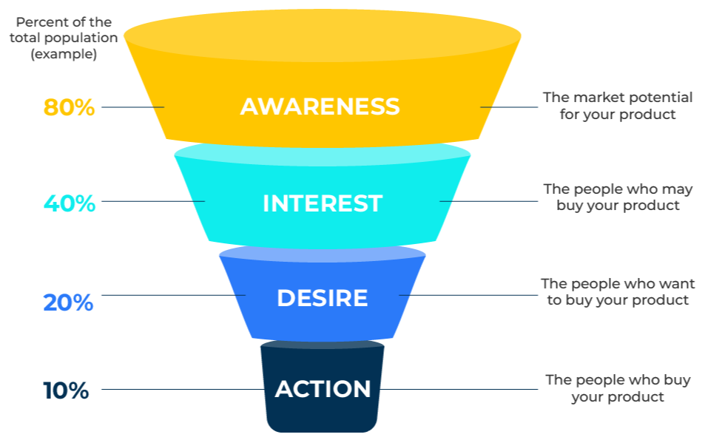
AIDA

Slide 2
A business model for improved communications.
Use this model to improve your communication with your target audience
Communications programs have different objectives. Some are aimed at building awareness or a strong brand position. Others are geared to selling products. Think through the objectives of your communications programme and use the model to determine its effectiveness.
The percentages shown on the left-hand side of the inverted triangle indicate how the effect of the communication declines as it gets closer to driving action. The model presupposes that a decision to buy a product follows a number of steps – first people need to be aware of what you are selling, then they need to be interested, then they need to have desire until finally they take action.

Slide 3
Your promotional objectives.
Rank the importance of various promotional objectives in the table below. Then write a “tight” overall objective for the promotional campaign for the product.
Product name: | Rank importance
Build awareness of the brand
Influence people’s attitudes to the brand
Communicate a specific marketing message
Drive people to ask for more information on the product
Drive people towards your website
Sell more products
Other promotional objectives…
Other promotional objectives…
Now write an overall objective for your promotional campaign in no more than 25 words
_______________________________________________________________________________________________________________________________________________________________________________________________________________________________________

Slide 4
Determine who the promotion will be aimed at.
Once you have decided upon the objectives of your communications programme, define your target audience. Some suggestions are provided in this worksheet. You may also want to consider building a persona that represents your target market (see an alternative toolkit).
Describe the customers who are the most likely targets for your product? | Complete these boxes
Who are the key decision-makers in the DMU?
What are their demographics, their behaviours, their attitudes and their psychographic profiles?
What drives their choice of supplier/product?
How would they be described as a segment?

Slide 5
Finally, consider your promotional mix.
Complete the following grid and consider the roles and impact of the different promotional tools. In the far right-hand column indicate a budget for each of the components of the mix.
Promotional tools | Rank the importance of the promotional tools at each stage of the promotional journey
 | Awareness | Interest | Desire | Action | Budget
Ads in newspapers, magazines
Ads in TV, radio
Billboards and street furniture
Point of sale displays
Direct mail
Exhibitions and seminars
Sales calls (telephone)
Sales calls (visits)
Press releases
Website
Social media
Other

Slide 6
Thank you.

