Slide 1
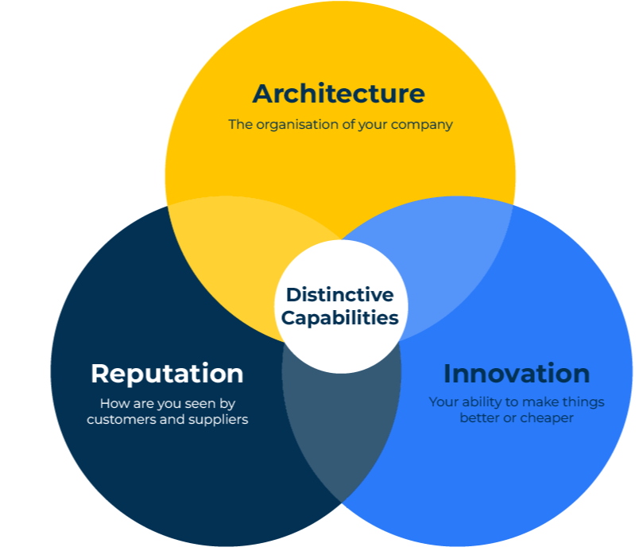
Kay’s distinctive capabilities

Slide 2
How to stand out
Use this model to add value to your company by identifying your distinctive capabilities
John Kay in his book The Foundations Of Corporate Success says that there are three distinctive capabilities that a company can use to achieve a competitive advantage:
Architecture – by this Kay means the way that the company is organised. The company should have clear corporate objectives and people within the company should be focused on achieving these. Its distribution channels and networks are also part of the architecture.
Reputation – this is how customers and potential customers see the company. It is clearly important to companies that sell quality products and very often is determined by experience. Advertising messages will help, as will warranties.
Innovation – innovation as a source of competitive advantage is quite rare. It is hard to constantly innovate and so improve products or reduce costs.

Slide 3
Capabilities must be sustainable
These three capabilities are difficult to build and maintain. This means that they are also hard for competitors to copy. For them to be effective they need to endure (Kay calls this "sustainability") and be "appropriable" in benefiting the company (Kay calls appropriability the capacity to retain the added value it creates for its own benefit).
Kay makes the point that companies can achieve market dominance because they have ownership of a particular resource – such as a utility network, or a licence, or a very expensive asset. These are monopolistic companies that are big because they have ownership of a structural resource rather than because of their distinctive capabilities.
Of course, a company can beat the competition and prove successful even though it doesn’t fulfil the three capabilities suggested by John Kay. If it works harder, sells more efficiently, produces more efficiently, and advertises more profusely, it may well gain a competitive advantage.
John Kay's model has some similarities and some differences with those of Michael Porter. Porter argues that success comes from cost leadership, differentiation, and focus. Porter's generic strategies model is more based on strategic intent rather than building distinctive capabilities.

Slide 4
List potential capabilities
Step 1
Consider every aspect of your company's capabilities in terms of its architecture, its reputation, and innovation. At this stage don't be concerned which of these capabilities are your strengths or weaknesses - just make a comprehensive list:
Three distinctive capabilities | Answers
Architecture: list the key aspects of your company’s organisation – its objectives, its people, its distribution channels, its suppliers
Reputation: list how customers and potential customers view your organisation. What are the strong points of its brand, product, price and promotion.
Innovation: list all aspects of your company’s innovation – in products and services
4
Copyright © B2B Frameworks Ltd 2018

Slide 5
Compare your capabilities
Step 2
Thinking about all the capabilities listed in Step 1, give your company a score out of 10 on each where 10 means you are brilliant and 1 means you are rubbish. Now score your three most important competitors on each capability.
Three distinct capabilities | Our company (Score out of 10) | Competitor 1 (Score out of 10) | Competitor 2 (Score out of 10) | Competitor 3 (Score out of 10)
Architecture ____________ ____________ ____________ ____________ ____________
Reputation ____________ ____________ ____________ ____________
Innovation ____________ ____________ ____________ ____________
5
Copyright © B2B Frameworks Ltd 2018

Slide 6
Things to think about
What is your company known for that is better than the competition? What if anything is your company’s distinctive capability?
If you had to choose just one thing that made your company distinctive, would it be the structure of the company (its architecture), its reputation, or its innovation?
What can you do to build upon your distinctive capability to make it more difficult for the competition to copy?
To what extent does this distinctive position result in a high market share, high profits, or good growth?

Slide 7
Thank you.

