Slide 1
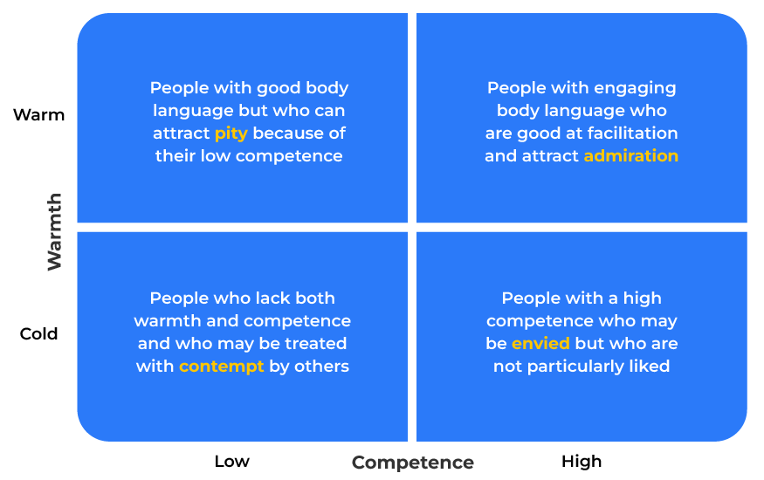
Stereotype Model (warmth/competence)

Slide 2
A business tool to understand people.
Use this tool to manage personnel and the position of your brands
The Stereotype Content Model (SCM), which includes the Warmth/Competence framework, is a psychological theory developed by social psychologists Susan Fiske, Amy Cuddy, and Peter Glick. The model explores how individuals perceive and categorise social groups based on two primary dimensions: warmth and competence.
Warmth: This dimension refers to whether a group or individual is perceived as friendly, well-intentioned, and trustworthy. Warmth is associated with traits like friendliness, helpfulness, and good intentions.
Competence: This dimension relates to whether a group or individual is perceived as capable, skilled, and effective. Competence is associated with traits like intelligence, skill, and efficacy.

Slide 3
Identify characteristics - warmth.
In the main you can tell quickly whether someone is warm or not. They are likely to have a body language that is open and “invite you in”. Of course, you have to be careful of the con men who may be capable of deluding you.
 | Complete these boxes
Does this person show or lack empathy?
Do they have high or low levels of social skills?
Are they friendly or unfriendly?
Could you go on holiday with them?

Slide 4
Identify capabilities.
People's skills, capabilities and competences can usually be observed, or at least determined by examination. Don't take these for granted and don't be embarrassed to test them.
 | Complete these boxes
What level of capability does this person have? How do you know? How can you be sure?
How can you measure their competence?

Slide 5
Cross analyse warmth and competence.
High Warmth/High Competence: These groups are generally well-regarded and positively stereotyped. Examples might include in-groups or admired social categories.
High Warmth/Low Competence: These groups are seen as friendly and well-intentioned but may be perceived as less capable. This category often includes groups that are pitied or perceived as needing assistance.
Low Warmth/High Competence: These groups are seen as capable but may be perceived as less friendly or even threatening. This category often includes out-groups that are viewed with suspicion or as competitors.
Low Warmth/Low Competence: These groups are often stigmatized and negatively stereotyped. They may be perceived as both unfriendly and ineffective.

Slide 6
Finally…
The SCM suggests that stereotypes often arise from a combination of these warmth and competence dimensions, and these perceptions influence social interactions, attitudes, and behaviours.
Moreover, individuals and groups may be evaluated differently depending on the context and the goals of the perceiver.
The model is useful in business for:
Ensuring diversity and inclusion
Team building and collaboration
Training and development
Improving customer relations
Helping leaders and managers motivate staff
Building brands that exude warmth

Slide 7
Editable framework.
Use this to add your own text and edit to suit your own branding
Warm
Warmth
Cold
Low
Competence
High

Slide 8
Thank you.

