Slide 1
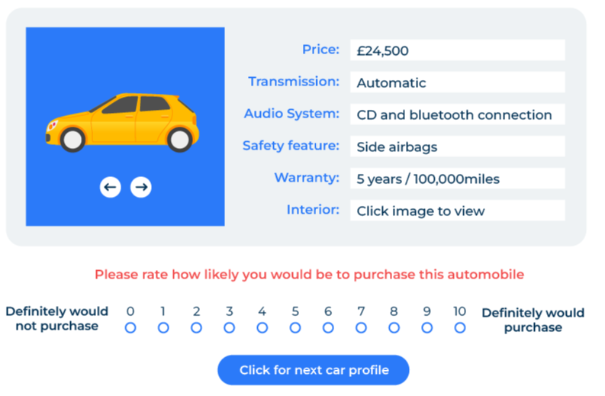
Conjoint Analysis

Slide 2
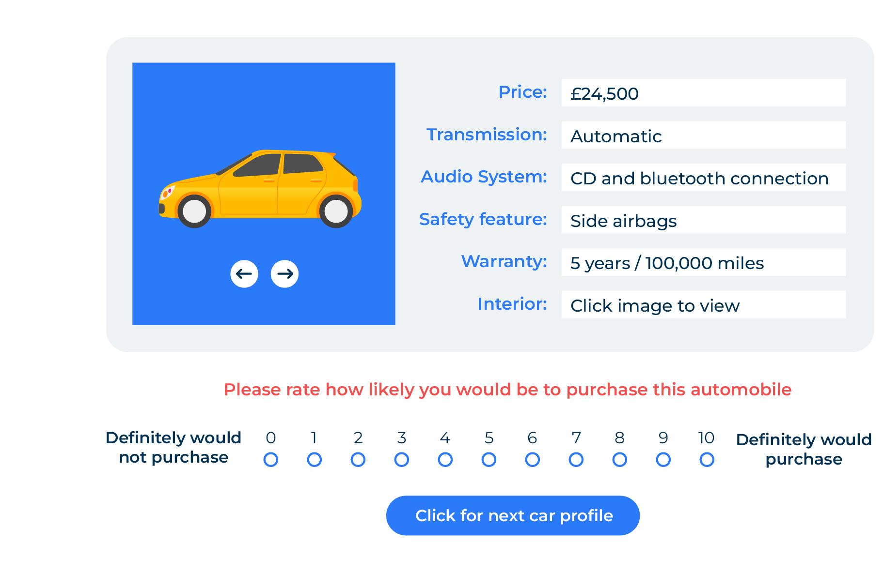
For assessing the price and value of an offer.
Use this model to find which attributes make the best product, what price should be charged, and what share of the market will be achieved.
Conjoint analysis is a specialist tool requiring specialist software. Using conjoint analysis is best carried out by someone with a good statistical background and preferably somebody who has been trained in the use of the specialist software.
This template is a high-level guideline on conjoint analysis.
Conjoint analysis is a tool to predict what people like and dislike about products and what will prompt them in their purchase choice. It is a "trade-off" tool that determines the most and least important factors in this decision-making process.

Slide 3
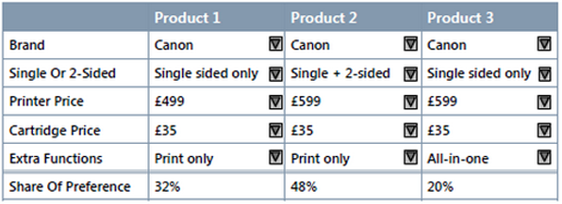
Trade-off results will show share of preference.
The tool presents people with combinations of attributes that relate to the product together with a price. Respondents consider the combinations of attributes and prices selecting those that they like best and least.
The software will help you develop an appropriate number of product combinations that can be shown to respondents and that represent a good cross-section of the many alternatives that are possible.
The software will also carry out the analysis of the results though here it will be necessary to have some further guidance on how to interpret them. It is also possible to develop a simulator to answer "what if" questions – for example, what market share would be achieved with a certain product at a given price.
An example of these results (made up) is:

Slide 4
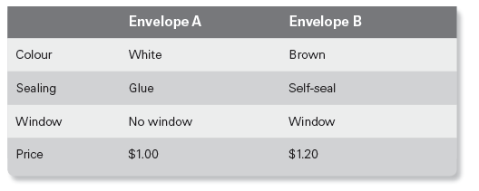
The starting point – what attributes to test at what levels?
A key requirements of conjoint analysis is to have the right attributes built into the questions. You may be given a list of attributes to work with or you may choose to find them out using qualitative research. As a rule of thumb, it is best to have a maximum of 6 attributes of which price is one. For each attribute there will be a range of around 4 or 5 possibilities, referred to as levels. There should be sufficient differences between the levels to matter.
Imagine that you have the job of finding out what type of paper envelopes people prefer. The envelopes can vary in colour, the way they are sealed, whether or not they have a window, and their price. An attribute is the colour and in this case there are two levels – white or brown. Another attribute is the way the envelope is sealed and again we have two levels – glue or self-seal. In this very simple example where we have just two choices, the combinations, together with a price difference could be presented as per the example:

Slide 5
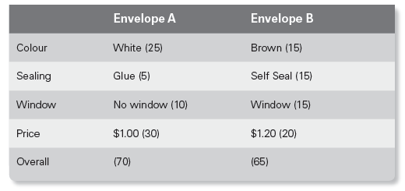
The results.
The results you may obtain from the simple choice of two envelopes could be as follows:
A utility value can be calculated for each of the envelopes and their attributes. This tells is which is preferred and by how much. In the above example the utility values are in brackets and are simply an index that does not add to 100. We can see that although a white envelope is much preferred to a brown envelope, the self-seal function is highly appealing. However, overall, the combinations that were presented to mean that envelope A is marginally preferred although this may well be due to its lower price.
It would be relatively easy to add more concepts such as envelope C and envelope D, each with different attributes and prices. The more choices we give to people the more we will be able to determine the best combination and price.

Slide 6
List your attributes and their levels.
List the different attributes of your product in the left-hand column.
List the different levels of each attribute bearing in mind you don’t have to have four levels (you can have less) and the different prices that you anticipate could be charged.
Attributes | Level 1 | Level 2 | Level 3 | Level 4
1.
2.
3.
4.
5.
6. Price

Slide 7
Use software to establish the concepts that will be shown.
Now choose a software package to run your conjoint and get started. Popular packages are:
https://conjoint.online/
https://www.xlstat.com/en/
https://www.1000minds.com/
https://www.surveyanalytics.com/
http://www.sawtoothsoftware.com/
The software package will present different concepts to respondents showing different attributes at different prices. At the end of the whole survey it will calculate the utility values of each attribute and the optimum price depending on respondents’ likelihood of purchasing the different options.

Slide 8
Things to think about
Conjoint is appropriate if you are trying to work out the importance of the different mix of attributes in a product. However, if all the attributes are fixed and locked in, and you just want to test prices, it might be better to use van Westendorp or Gabor-Granger.
When designing your conjoint survey, limit yourself to five or six different attributes plus price. If you have too many attributes, you will need a large sample size and it can be confusing to respondents if they are shown too many variations of the offers.
If you can only find a maximum of 100 respondents to take part in the survey, consider using a different tool such as SIMALTO.

Slide 9
Thank you.

