Slide 1
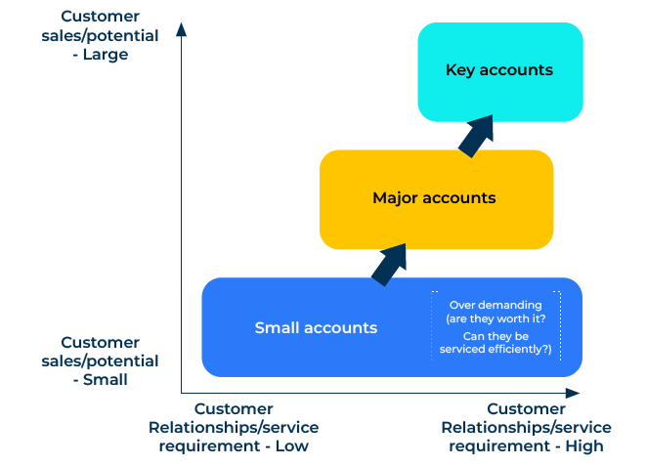
Key Account Management

Slide 2
A business model to serve the “biggies”.
Use this framework to manage strategically important customers
Key Account Management (KAM) is a strategic approach to managing and nurturing relationships with a select group of high-value customers, often referred to as key accounts or strategic accounts.
It is important for companies looking to maximise revenue, build strong and lasting relationships, and strategically navigate the competitive landscape.
By focusing efforts on key accounts, businesses can create a win-win scenario where both parties benefit from a collaborative and tailored approach to business interactions.

Slide 3
Segment to identify key accounts.
Identify and segment customers based on criteria such as revenue potential, strategic importance, and mutual value. Not all customers will qualify as key accounts. Define clear criteria for selecting key accounts, considering factors like the customer's market influence, long-term potential, and alignment with the company’s strategic goals.
 | Complete these boxes
What are the criteria for identifying key accounts? (Current revenue is obvious but what about anticipated growth of the account?).
How many key accounts have you got? How many can you manage?
Who is going to manage your key accounts?

Slide 4
Needs of the key accounts.
Conduct a thorough analysis of the key accounts' business objectives, challenges, and priorities. Understand their industry trends, market position, and competitive landscape. Identify key decision-makers and influencers within the key accounts. Understand their roles, responsibilities, and expectations.
 | Complete these boxes
Thinking first about the key account itself, – what does it need?
What is the composition of the decision making unit at the key account? How are the needs changing?
What are the roles and needs of these people in the DMU? How are these needs changing?

Slide 5
Make a Key Account Plan.
Develop a Key Account Management plan that outlines the overall strategy, objectives, and tactics for each key account. Align the plan with your company's broader business strategy. Set specific and measurable goals for each key account. These goals should align with both the customer's objectives and your company's revenue and relationship-building targets
 | Complete these boxes
How many key account companies are in the plan? What are the objectives for each account?
Who within your organisation is best able to handle these key accounts? How many people at your end will be required?
What goals do you have for each account in terms of revenue, share of wallet, loyalty etc?

Slide 6
Deliver and learn.
Develop customised solutions that address the specific needs of each key account. Tailor your value proposition to demonstrate how your products or services uniquely meet their requirements. Be responsive to feedback and consistently seek ways to enhance the value you provide. Establish Key Performance Indicators (KPIs) to measure the performance and success of Key Account Management efforts. Metrics may include revenue growth, customer satisfaction, and adherence to agreed milestones.
 | Complete these boxes
What does each key account need? How are you able to deliver this and make a profit?
What measurements will help you stay on track with each key account?
What are you learning that will help you improve your offer to these key accounts?

Slide 7
Editable framework.
Use this to add your own text and edit to suit your own branding
Customer sales/potential
- Large
Key accounts
Major accounts
Over demanding (are they worth it?
Can they be serviced efﬁciently?)
Small accounts
Customer sales/potential
- Small
Customer Relationships/service requirement - Low
Customer Relationships/service requirement - High

Slide 8
Thank you.

