Slide 1
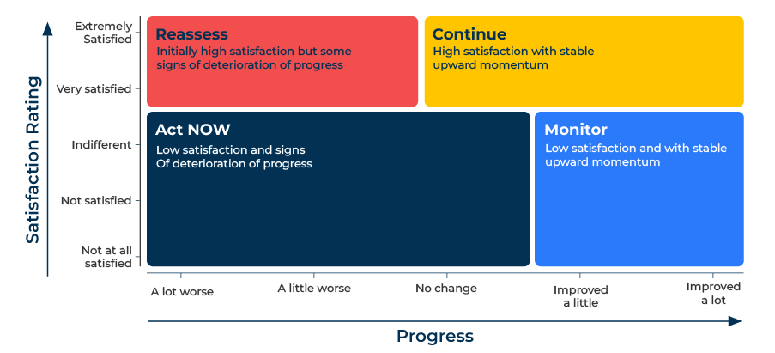
Momentum Matrix

Slide 2
A business model improve customer satisfaction.
Use this framework to make improvements in customer experience
The Momentum Matrix is designed to measure current levels of satisfaction and how satisfaction levels are changing. It does this with two simple questions:
Overall how satisfied are you with Company X on a scale of 1 to 10 where 1 is not at all satisfied and 10 is extremely satisfied?
2. In the past 12 months, would you say that customer experience from Company X has improved a lot, improved a little, not changed, has got a little worse, has got a lot worse?

Slide 3
Prepare your customer database.
This framework is survey driven. The starting point is to build a list of customers who will be surveyed. You should also consider how the survey will be carried out. Now-a-days online surveys are the norm. This means you will need up to date email addresses for individuals at your customers who are key decision makers. It would also be good to know the amount of business you do with each customer.
 | Complete these boxes
Do you have an up-to-date customer list with email addresses? If not do you have a list with telephone numbers?
Can you interrogate the customer list to show the value of business carried out with the customer in the last year?

Slide 4
Run the survey.
Design a questionnaire for the survey. The two critical questions are “Overall how satisfied are you with our company on a scale of 1 to 10 where 1 is not at all satisfied and 10 is extremely satisfied?” And “In the past 12 months, would you say that customer experience from our company has improved a lot, improved a little, not changed, has got a little worse, has got a lot worse?”. Crucially you will also need to ask “Why did you say that?” so you can understand the reasons for improvement or deterioration. You will need questions to classify each company in terms of its size, location, segment etc.
 | Complete these boxes
Who is going to master mind the survey? Can it be carried out and run internally or will you need outside help?
Will your survey have an appropriate cover note by way of introduction and a thank you note on completion?
How will you keep track of the response and will you have a mechanism for sending out reminders?

Slide 5
Analyse the results.
When you have completed the survey, cross analyse the findings to see the proportions of people who are satisfied against the proportion who think the customer experience with your company is getting better or worse. And you will need to analyse the open ended responses that explain why things are getting better or worse.
 | Complete these boxes
What proportion of your customers are highly satisfied but concerned that improvements aren't continuing? (Assess what is going wrong)
What proportion of your customers are highly satisfied and believe that the customer experience is improving? (Keep up the good work)
What proportion of your customers are not so satisfied and believe that the experience isn't improving? (Lots to do here)
What proportion of your customers aren't satisfied but do acknowledge an improvement in customer experience? (Keep it up)

Slide 6
Action.
Actions should flow from the analysis. Customers who aren't satisfied need attention. It is also important to see if there is momentum resulting in improvements or deterioration. The survey should show what is driving this momentum.
In surveys of this kind it is valuable to analyse results according to the size of customer and other segmentation characteristics. This will show if there are problems with certain groups of customers.
Following the momentum survey, you may need to carry out qualitative research to obtain a deeper understanding of what Is driving customer experience.

Slide 7
Editable framework.
Reassess
Initially high satisfaction but some signs of deterioration of progress
Use this to add your own text and edit to suit your own branding
Extremely Satisﬁed
Continue
High satisfaction with stable upward momentum
Very satisﬁed
Act NOW
Low satisfaction and signs Of deterioration of progress
Monitor
Low satisfaction and with stable upward momentum
Indifferent
Satisfaction Rating
Not satisﬁed
Not at all satisﬁed
A lot worse
A little worse
No change
Improved a little
Improved a lot
Progress

Slide 8
Thank you.

