Slide 1
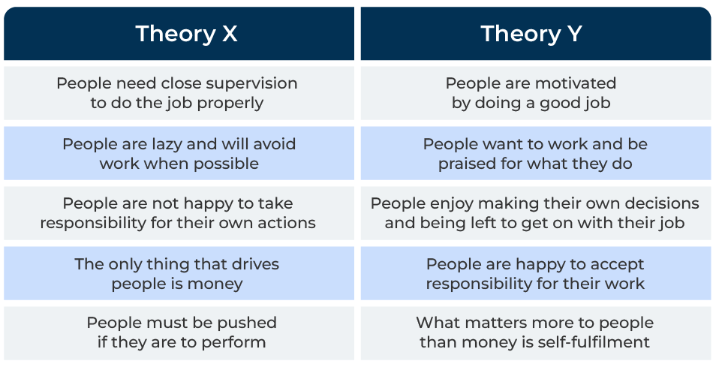
Theory X & Theory Y

Slide 2
A business tool to better understand people.
Use this framework to motivate employees and improve marketing coms
Theory X and Theory Y are management theories proposed by Douglas McGregor in the 1960s. They characterise two contrasting approaches to employee motivation and management.
A thoughtful integration of Theory X and Theory Y principles, based on the specific needs and context of the company, can contribute to its growth by optimising employee performance, fostering innovation, and creating a positive work culture.
While these theories were initially developed to understand human behaviour in the workplace, they can also be applied strategically to foster growth in a company by improving marketing communications.

Slide 3
Sort out the Theory X people.
Theory X assumes that employees and customers are inherently lazy. In certain situations, a focus on efficiency and control can be beneficial for specific tasks or projects. For example, in manufacturing or production processes where precision and consistency are crucial. Theory X people like clear guidelines and a structured work environment. Theory X principles may be applied when there's a need for strict adherence to procedures, ensuring compliance with industry standards, or following instruction on a product they have purchased. In situations where tasks are routine and require minimal creativity or innovation, a Theory X approach can be effective. Management can adopt a task-oriented style to ensure that employees and customers follow established processes and meet predetermined targets.
 | Complete these boxes
What processes in your company demand Theory X protocols?
How do your company’s products require a Theory X communication?
To what extent are leaders of your company Theory X people?

Slide 4
Sort out the Theory Y people.
Theory Y people enjoy taking responsibility. Applying Theory Y principles involves empowering employees and customers, providing them with autonomy, and fostering a sense of ownership. This approach can lead to higher engagement and creativity. Theory Y is well-suited where there is innovation and adaptability. Theory Y emphasises the importance of developing someone’s potential. Investing in training and continuous learning can help here. Employees and customers may have diverse needs and preferences. This means Theory Y employees favour flexible work and Theory Y customers should be segmented on their needs.
 | Complete these boxes
How much responsibility are you prepared to give to your employees? How much responsibility are they happy to take?
How many and which of your customers are flexible and adaptable in buying and using your products?
How do your communications with employees and customers treat them as “responsible people” who can make their own minds up about things?

Slide 5
Recognise that both types of people are relevant.
Neither Theory X nor Theory Y is universally applicable. This involves adapting management styles based on the specific context, tasks at hand, and segmentation of your customers. Combining elements of both theories can create a balanced approach. For example, using Theory X principles for routine tasks that require precision and control, while applying Theory Y principles for fostering innovation and creativity in strategic projects.
 | Complete these boxes
Where within your company would Theory X and Theory Y help motivate and manage staff?
How can Theory X and Theory Y be used to better communicate with segments of customers?
How can you get feedback from employees and customers to find out if you have positioned them correctly and that your communications are effective?

Slide 6
Editable framework.
Theory X
Use this to add your own text and edit to suit your own branding
Theory Y
People need close supervision to do the job properly
People are motivated by doing a good job
People are lazy and will avoid work when possible
People want to work and be praised for what they do
People are not happy to take responsibility for their own actions
People enjoy making their own decisions and being left to get on with their job
The only thing that drives people is money
People are happy to accept responsibility for their work
People must be pushed if they are to perform
What matters more to people than money is self-fulﬁlment

Slide 7
Thank you.

