Slide 1
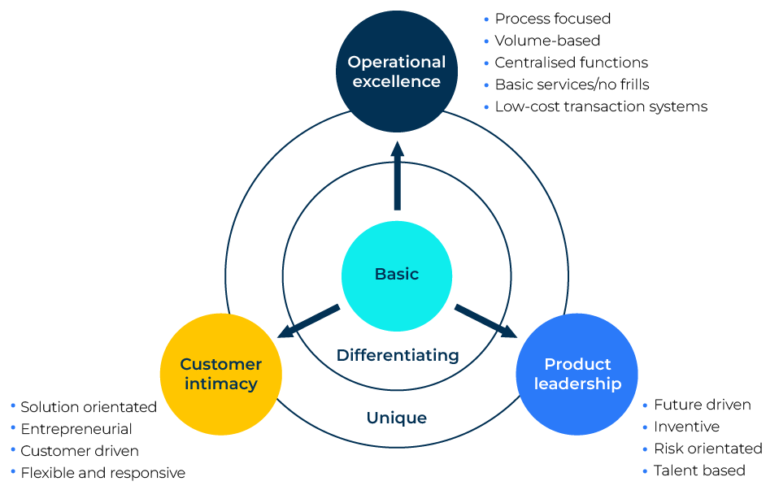
Value Disciplines

Slide 2
A business model to achieve market leadership.
Use this framework to focus on key disciplines
Michael Treacy and Fred Wiersema introduced the concept of value disciplines in their book "The Discipline of Market Leaders." The authors argue that successful companies excel in one of three value disciplines, which are operational excellence, customer intimacy, and product leadership. Businesses that focus on a particular value discipline can use it as a strategic framework to guide their growth.
Treacy and Wiersema's value disciplines provide a strategic framework that helps businesses define their unique value proposition. By aligning their focus with operational excellence, customer intimacy, or product leadership, businesses can make targeted efforts to grow, differentiate themselves in the market, and achieve sustainable competitive advantage.

Slide 3
Operational excellence.
Companies following the operational excellence discipline strive to deliver products or services at the lowest cost with high efficiency. This allows them to offer competitive pricing to customers. The emphasis on streamlined processes and cost control can lead to improved profitability and market share. Businesses can achieve growth by scaling their operations efficiently. Operational excellence involves optimising processes to handle increased demand without a proportional increase in costs. This scalability is crucial for accommodating growth without sacrificing cost-effectiveness.
 | Complete these boxes
What processes or operations in your company are better than those of competitors?
How easy is it to scale your business without increasing costs per unit?
What frills, if any, exist in your company that can be eradicated?

Slide 4
Customer intimacy.
Companies focusing on customer intimacy aim to build strong, personalised relationships with their customers. By understanding and meeting individual customer needs, businesses can enhance loyalty and repeat business. This approach can lead to customer retention and long-term growth. Customer intimacy requires a deep understanding of customer preferences. By actively seeking and incorporating customer feedback, businesses can continuously innovate their products or services to align with evolving customer needs, fostering growth and market differentiation.
 | Complete these boxes
How well do you understand your customers? How often does the CEO visit random customers to discuss their needs?
How good are you at incorporating customer recommendations into your products?
How good are you at recognising different customers have different needs? And how good are you at delivering those different needs?

Slide 5
Product leadership.
Businesses pursuing product leadership concentrate on delivering innovative and superior products or services. This requires a commitment to continuous research and development, staying ahead of competitors through cutting-edge offerings. This can result in market dominance and premium pricing. A focus on product leadership can open up opportunities for businesses to enter new markets or expand their market share. Superior products can attract a broader customer base, providing avenues for growth beyond the current customer segment.
 | Complete these boxes
How special are your products – how different and better than those of competitors?
How readily can you take your products into new markets?
What matters most to you – leadership in market share or profits?

Slide 6
Finally…
Strategic Alignment: Treacy and Wiersema's framework encourages businesses to choose one primary value discipline and align their strategies accordingly. This clarity in focus helps in making strategic decisions that are consistent with the chosen discipline, avoiding conflicting priorities.
Resource Efficiency: By understanding their chosen value discipline, businesses can allocate resources effectively. Whether it's investing in operational efficiency, customer relationship management, or research and development, resource allocation aligns with the chosen discipline and promotes sustainable growth.
Adaptability and Continuous Improvement: Businesses can adapt their strategies to changing market conditions while staying true to their chosen value discipline. This flexibility allows them to navigate evolving landscapes and capitalize on emerging opportunities.
Continuous Learning and Improvement: Regardless of the chosen discipline, the value disciplines framework encourages businesses to engage in continuous learning and improvement. This commitment to excellence fosters an environment where organisations can adapt, innovate, and grow over time.

Slide 7
Editable framework.
Use this to add your own text and edit to suit your own branding
Operational
Excellence
Basic
Differentiating
Customer intimacy
Product Leadership
Unique

Slide 8
Thank you.

